Slide 1
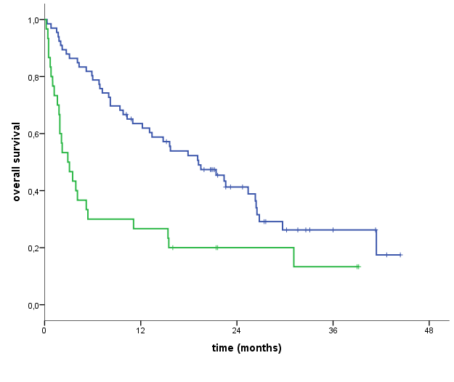
P<0.0001
dNLR < 3
dNLR > 3
Fig. S2. Kaplan-Meier OS curves of melanoma patient treated with nivolumab, according to the baseline derived neutrophils-to lymphocyte ratio (dNLR). Green line: dNLR≥3; Blue line: dNLR<3. Patients with dNLR<3 had a median OS of 19.2 ( 95% CI: 12.4-26.0) months respect to patients with dNLR>3 with a median OS of 2.9 (P<0.0001).

