Slide 1
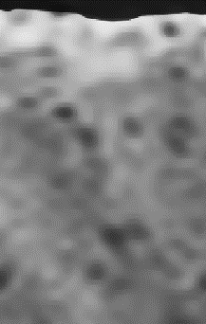
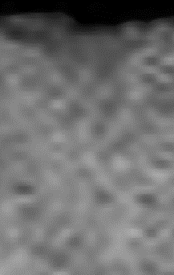
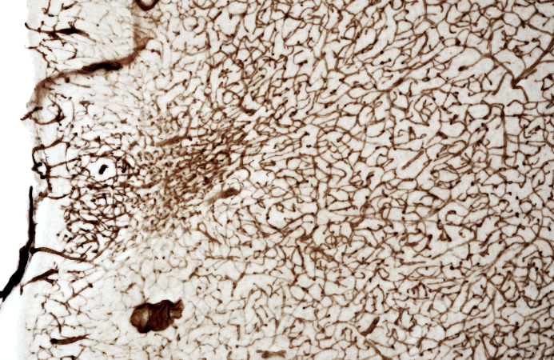
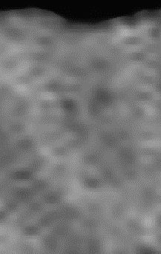
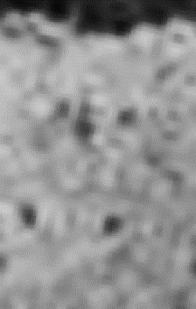
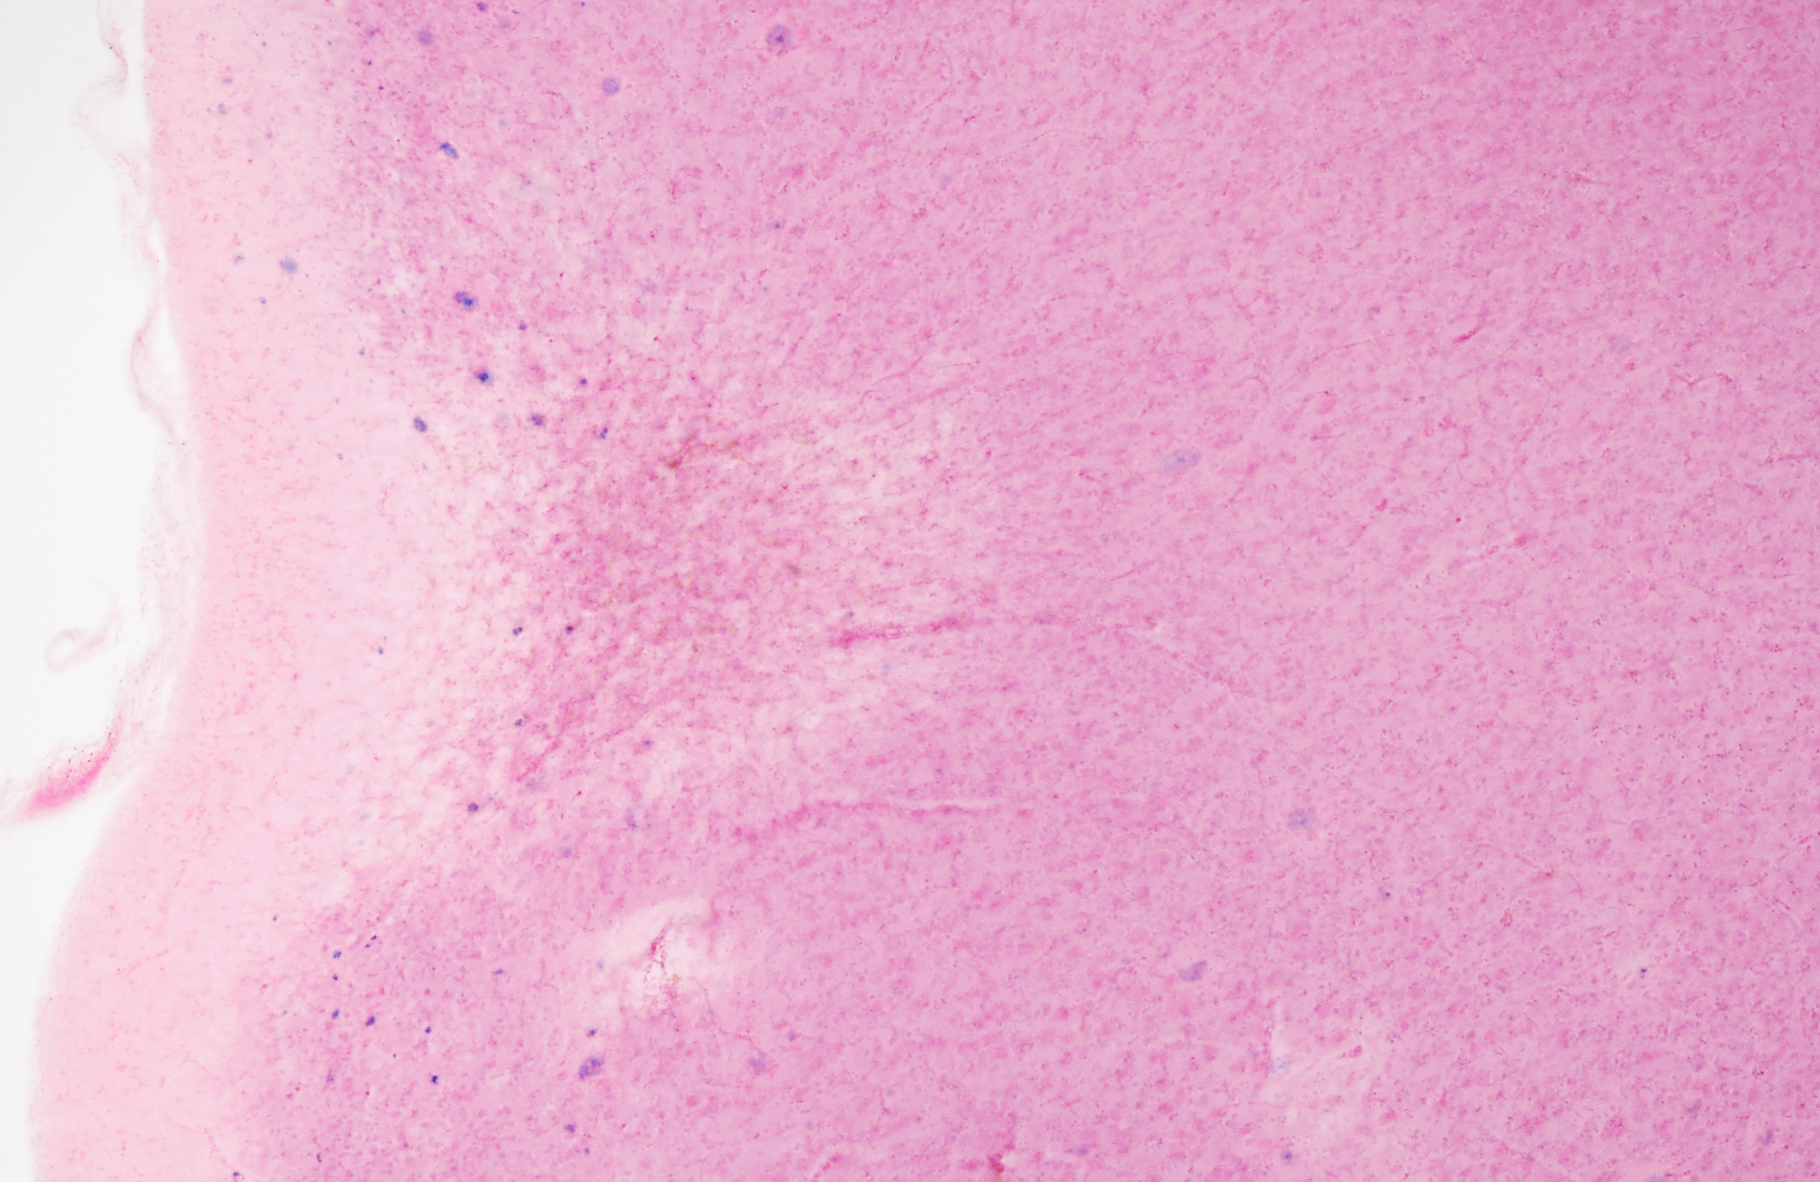
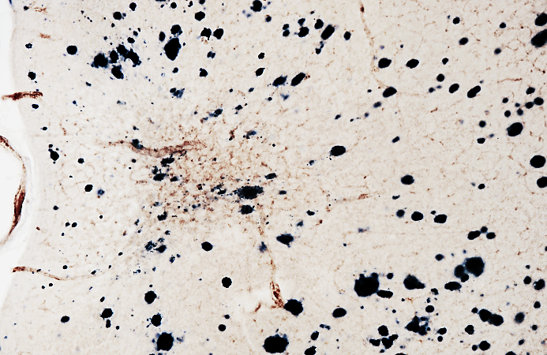
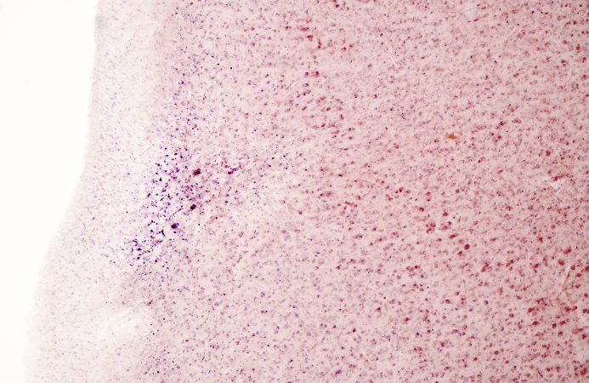
Supplementary Figure S3
a
b
e
Coll4
Coll4
T2
T1
c
d
e₁
e₁
PD
T2*
400 µm
f
Prussian Blue
f₁
g
Coll4
Aβ
f₁
Coll4
Aβ
f₂
f₂
400 µm
400 µm
h
PN
i
AF
i'
400 µm
200 µm
Supplementary Material S2: The insets of MR images from Fig.8 are presented here again (a-d) together with an autofluorescence image (AF) taken from the same 100µm-thick section after the MRI scan (i). The microinfarct was also visualized in neighboring sections using single-labeling for Coll4 (e), Prussian blue staining (f), double-labeling for Coll4 and beta amyloid (Aβ) (g) and the pigment Nissl (PN) stain (h).
Like the other chronic cortical cerebral microinfarcts, this microinfarct exhibited a Coll4-labeled dense microvascular meshwork (e) with string vessels (e₁). The microinfarct area covered by the dense microvascular meshwork produced a hyperintense signal in the T2-weighted MR image (a) and a hypointense signal with a hyperintense rim in the proton density (PD)-weighted image (c), whereas the hypointense MRI signal in the T1-weighted image was comparatively weak. In addition, the microinfarction zone as well as the areas surrounding the microinfarct displayed a low iron load in Prussian blue staining (f), which correlated well with the low signal contrast produced in the T2*-weighted image (see in d). The microinfarct and its marginal zone also displayed a low density of Aβ deposits (g). In the PN stain, the superficial part of the microinfarct contained a high density of aldehyde fuchsin-stained lipofuscin pigment (h), which showed strong autofluorescence (i). The inset (i') in the PN-stained neighboring section (h) corresponds approximately to the same area of the MRI-scanned section shown in (i). Scale bars: 400 µm (e-h) and 200 µm (i).

