Slide 1
Supplementary Figure 1

Slide 2
Supplementary Figure 2
A
B

Slide 3
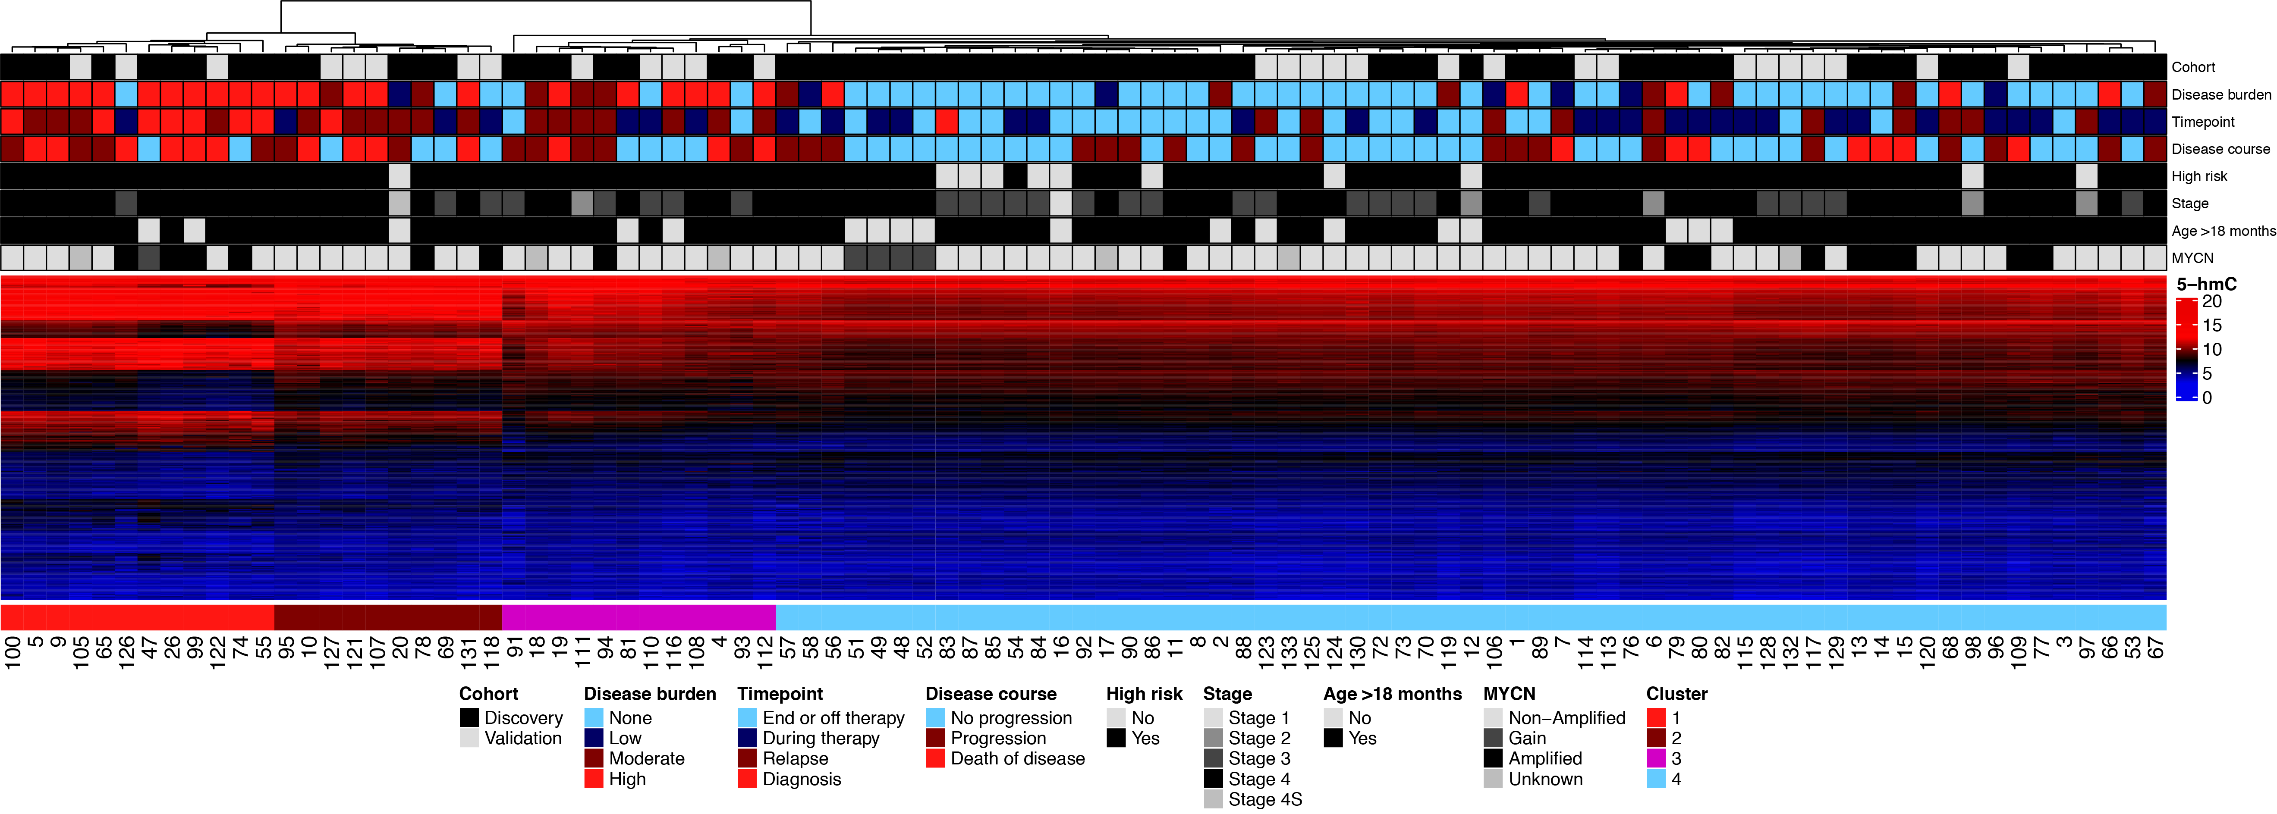
Supplementary Figure 3

