Slide 1
Table S1 Genome-edited rice lines (T₁ generation)
 | Line No. | Weight of six grains (mg) | Grain weight (mg/grain) | GABA (nmol/g FW) | Class of DNA and amino acid sequence¹⁾
 | 8_1 | 125.9 | 21.0 | 19.6 | ①x1, ⑤x1, WTx1
 | 8_1_2 | 119.1 | 19.9 | 17.9 | ①x3, WTx1
 | 8_2 | 124.9 | 20.8 | 35.6 | ND
 | 8_2_2 | 150.1 | 25.0 | 63.3 | ND
 | 8_3 | 142.7 | 23.8 | 20.5 | ③x1, ④x1, ⑦x3
 | 8_3_2 | 133.2 | 22.2 | 18.9 | WTx1
 | 8_4 | 121.7 | 20.3 | 16.9 | ND
 | 8_6 | 129.5 | 21.6 | 14.5 | ⑧x1, WTx1
 | 8_7 | 106.1 | 17.7 | 14.2 | WTx1
 | 8_8 | 117.0 | 19.5 | 71.8 | ⑤x3,⑧x2
 | 8_9 | 127.5 | 21.3 | 11.5 | ③x1, WTx9
 | 8_11 | 127.5 | 21.3 | 16.0 | ND
 | 8_15 | 138.3 | 23.1 | 21.7 | ②x1, ⑧x2, WTx5
 | 8_17 | 118.8 | 19.8 | 29.3 | ⑤x1, ⑧x2, WTx6
 | 8_18 | 104.0 | 17.3 | 25.9 | ND
 | 8_18_2 | 101.1 | 16.9 | 23.5 | ⑧x1, WTx9
 | 8_19 | 129.1 | 21.5 | 30.6 | ND
 | 8_19_2 | 134.0 | 22.3 | 22.8 | ⑥x1, ⑧x3
 | 8_19_3 | 122.6 | 20.4 | 9.2 | ND
 | 8_20 | 103.9 | 17.3 | 33.2 | ND
 | 8_20_2 | 128.9 | 21.5 | 66.8 | ⑧x2
 | 8_22 | 104.9 | 17.5 | 15.9 | ⑧x1
 | Ni | 109.1 | 20.3 | 26.4 | _
¹⁾ Class (①~⑧) listed in Table 1 and Fig. 3. Plain numbers indicate frequency of sequences determined. ND: not determined
Notes:
Table S1 Summary of grain weight, GABA content and DNA and amino acid sequence analysis of target region in transformed rice plant lines. ND indicates not detemined. 1) Results of DNA and amino acid analysis are classed in 1 to 8. Detailed is shown in Table 1 and Table 2. WT means identical sequence of wild-type rice. The presence of multiple clones determined sequence indicates number.

Slide 3
Grain
*
Protein
**
Fig. S1 Comparison of rice grain weight and protein concentration from wild-type Nipponbare and genome-edited lines (#8_1 and #8_8). Values represent means ± standard deviation from four independent rice samples. * and ** indicate P < 0.05 versus Ni and P < 0.01 versus Ni and #8_1, respectively.

Slide 4
a
b
(bp)
SM
Ni
#8_1
#8_8
300
200
100
GAD3
20
300
200
100
TBP2
20
Ni
#8_1
#8_8
Fig. S2 Semi-quantitative RT-PCR analysis of RNA extracted from seeds. PCR conditions were as follows: cycles of 95℃ 30 s, 60℃ 30 s, 72℃ 30 s were repeated by 27 times for GAD3 and by 25 times for TBP2. a GAD3 as a target RNA; TBP2: TATA-binding Protein 2 as an internal control. b Relative expression of each GAD3 determined by normalization of that of TBP2.

Slide 5
Fig. 4
a
Leaf
Stem
Root
Seed
Leaf
Stem
Root
Seed
(bp)
SM
Ni
#8_1
#8_8
Ni
#8_1
#8_8
Ni
#8_1
#8_8
Ni
#8_1
#8_8
Ni
#8_1
#8_8
Ni
#8_1
#8_8
Ni
#8_1
#8_8
Ni
#8_1
#8_8
SM
(bp)
GAD1
GAD5
GAD2
TBP2
GAD4
b
GAD1
GAD4
GAD2
GAD5
Ni
#8_1
#8_8
Ni
#8_1
#8_8
Ni
#8_1
#8_8
Ni
#8_1
#8_8
Ni
#8_1
#8_8
Ni
#8_1
#8_8
Ni
#8_1
#8_8
Ni
#8_1
#8_8
Leaf
Stem
Root
Seed
Leaf
Stem
Root
Seed
Fig. S3 Semi-quantitative RT-PCR analysis of RNA extracted from various tissues. PCR conditions were as follows: cycles of 95℃ 30 s, 60℃ 30 s, 72℃ 20 s were repeated by 24. a GAD1 (AB056060), GAD2 (AB056061), GAD4 (AK101171), GAD5 (AK070858) as a target RNA; TBP2: TATA-binding Protein 2 as an internal control. b Relative expression of each GAD determined by normalization of that of TBP2.
Notes:
Fig. 4 Semin-quantitative RT-PCR analysis of RNAs transcribed from OsGAD3 genes in wild-type (Ni) and genome edited rice (#8_1 and #8_8).
Total RNA was isolated from the tissues indicated above lanes. Single-stranded cDNA synthesized from each RNA (2 ug) with oligo-dT primer by reverse transcripatase was accordingly amplified with an appropriate primer set (Table 1S). PCR conditions was follows: cycle of 95 30s, 60 30s, 72 30s was repeated by 27 times. Samples were analyzed with DNA 500 of MuLTINA (Shimadzu, Kyoto, Japan). +RT and –RT indicate reaction with and without reverse transcriptase, respectively. SM shows DNA size maker.

Slide 6
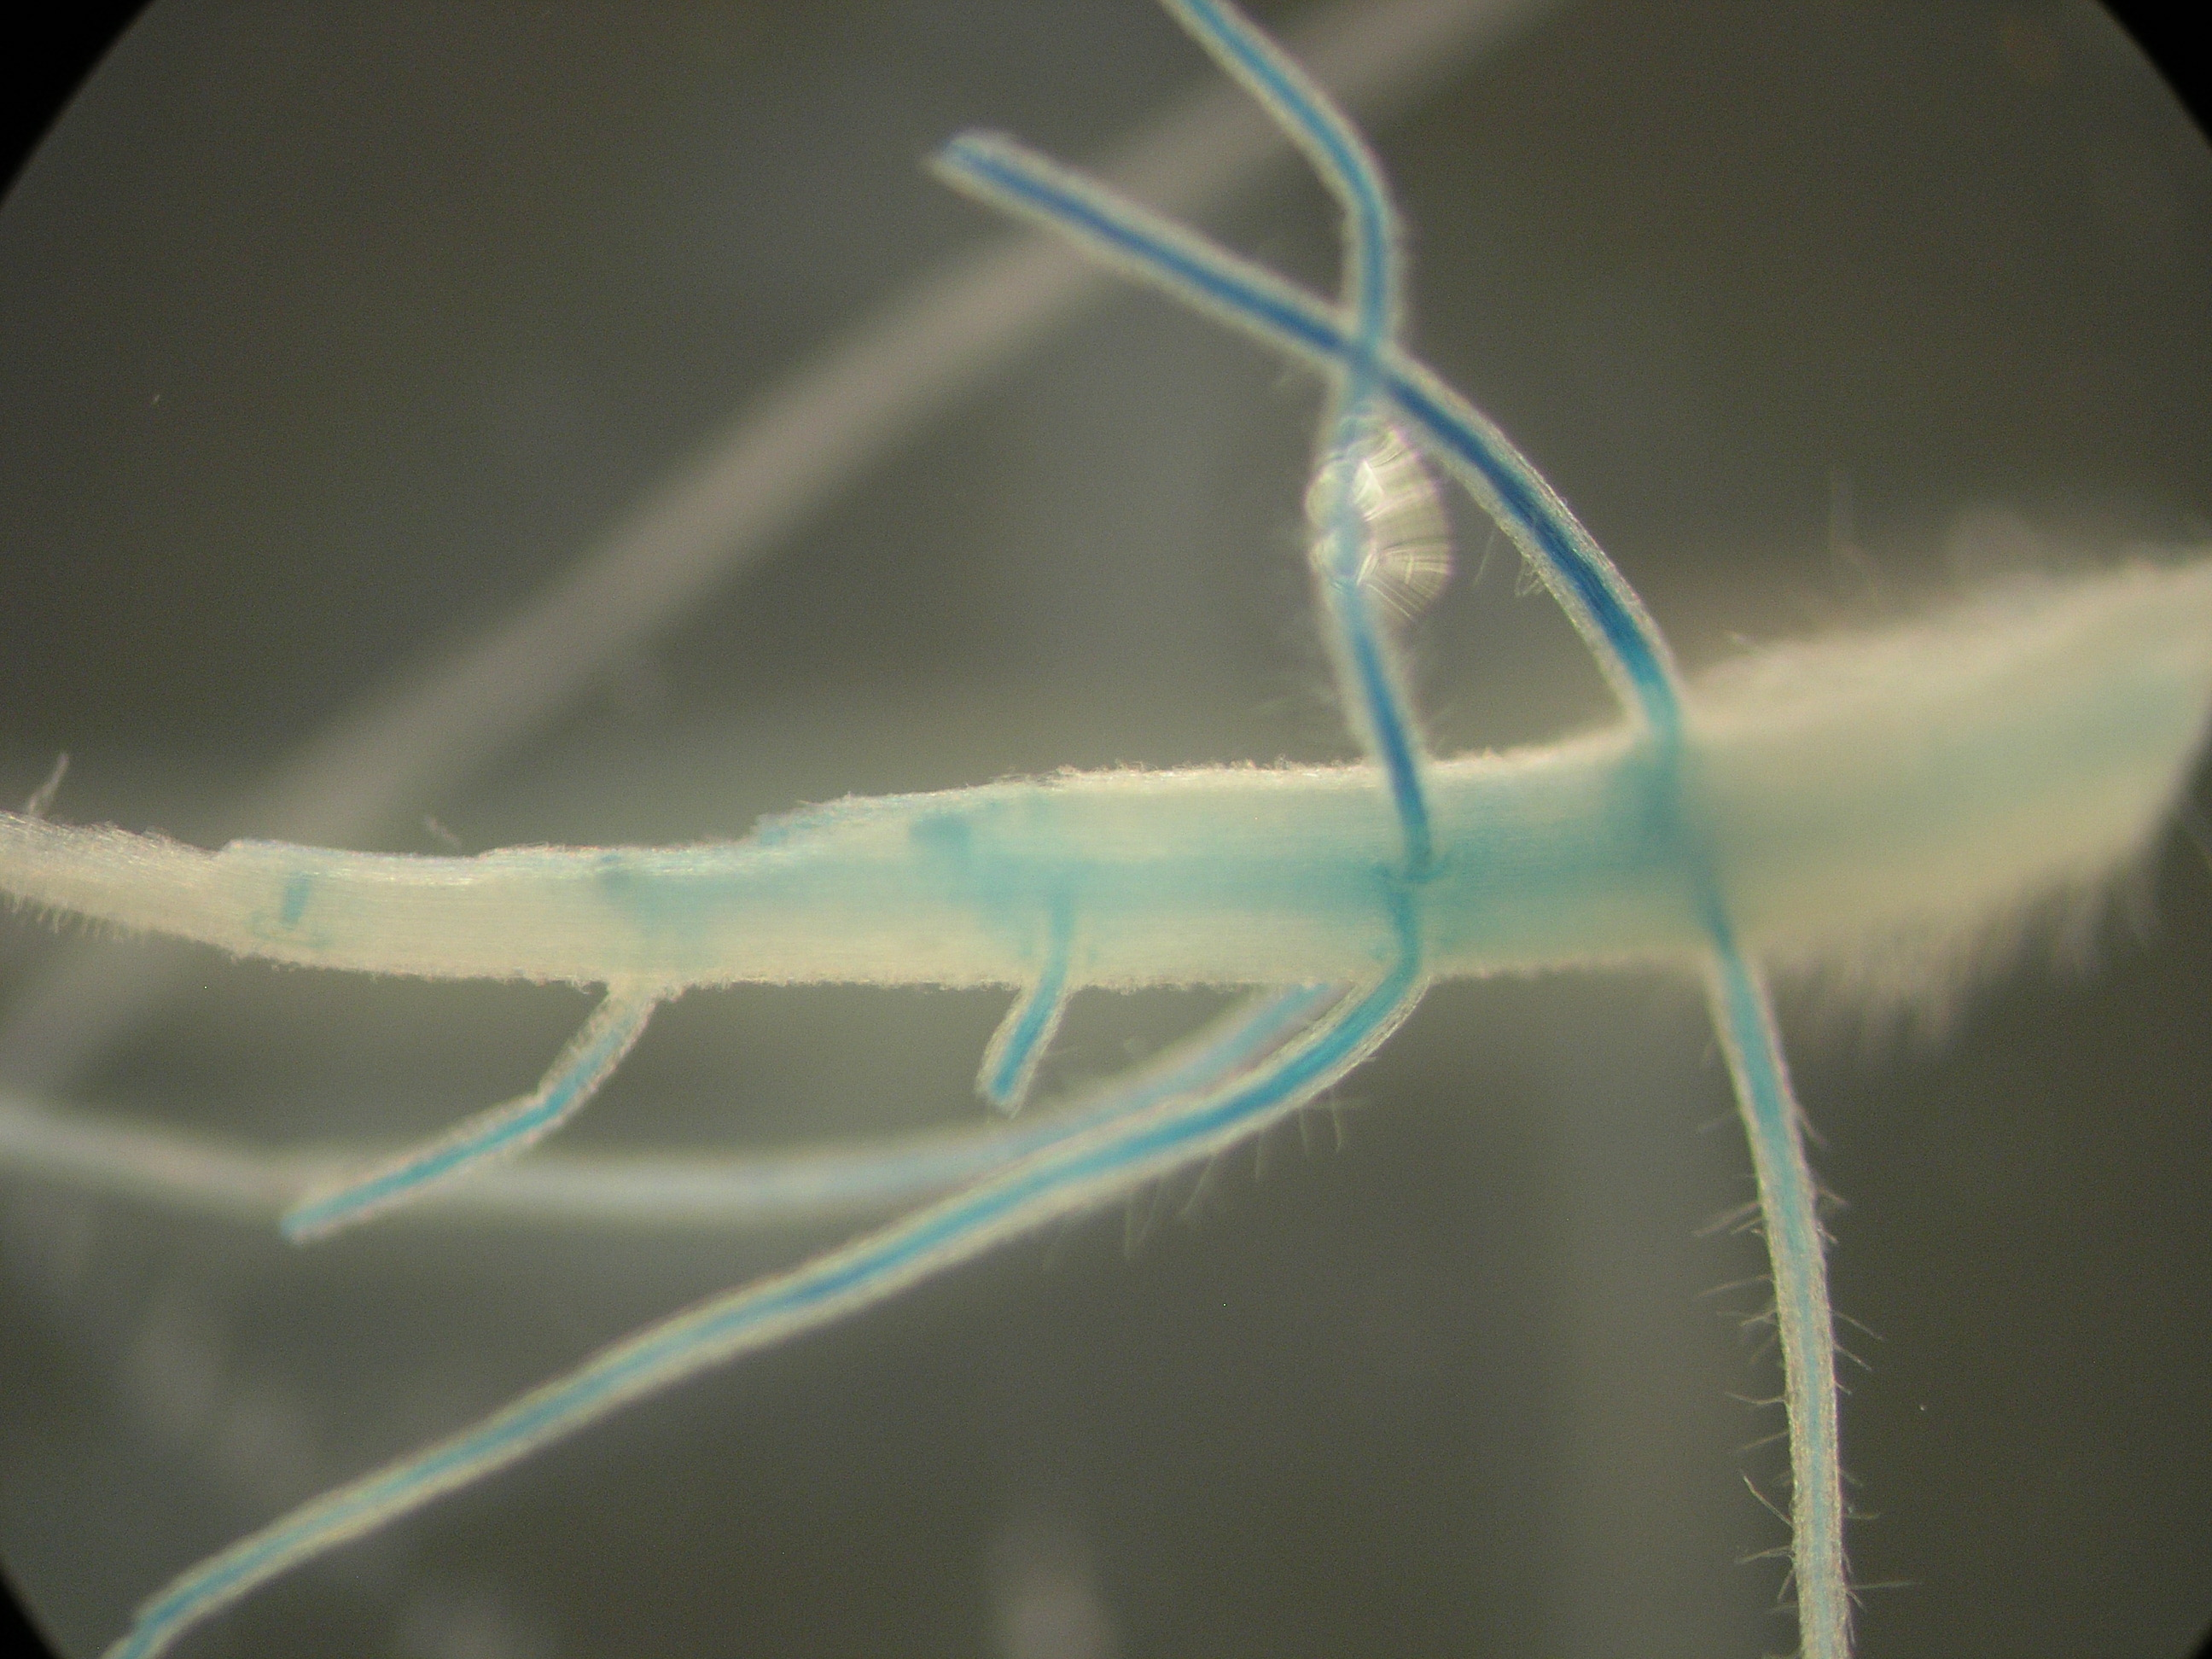
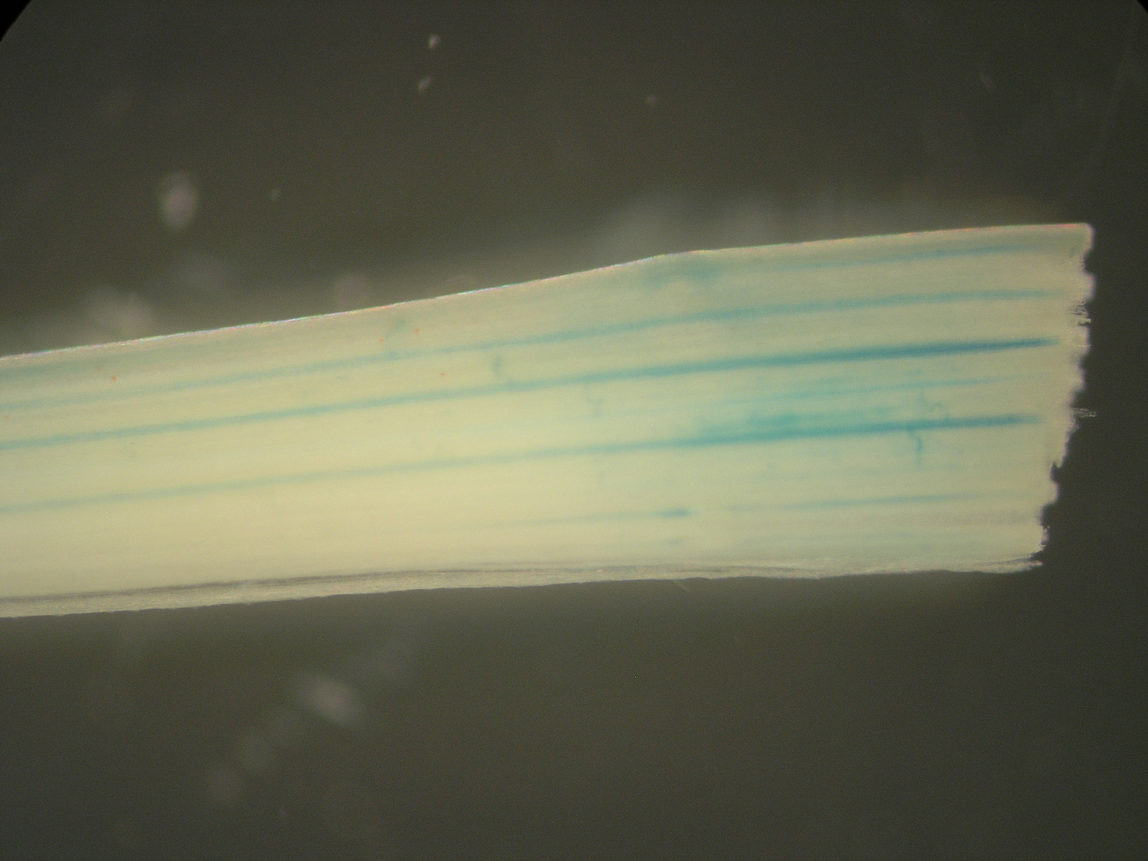
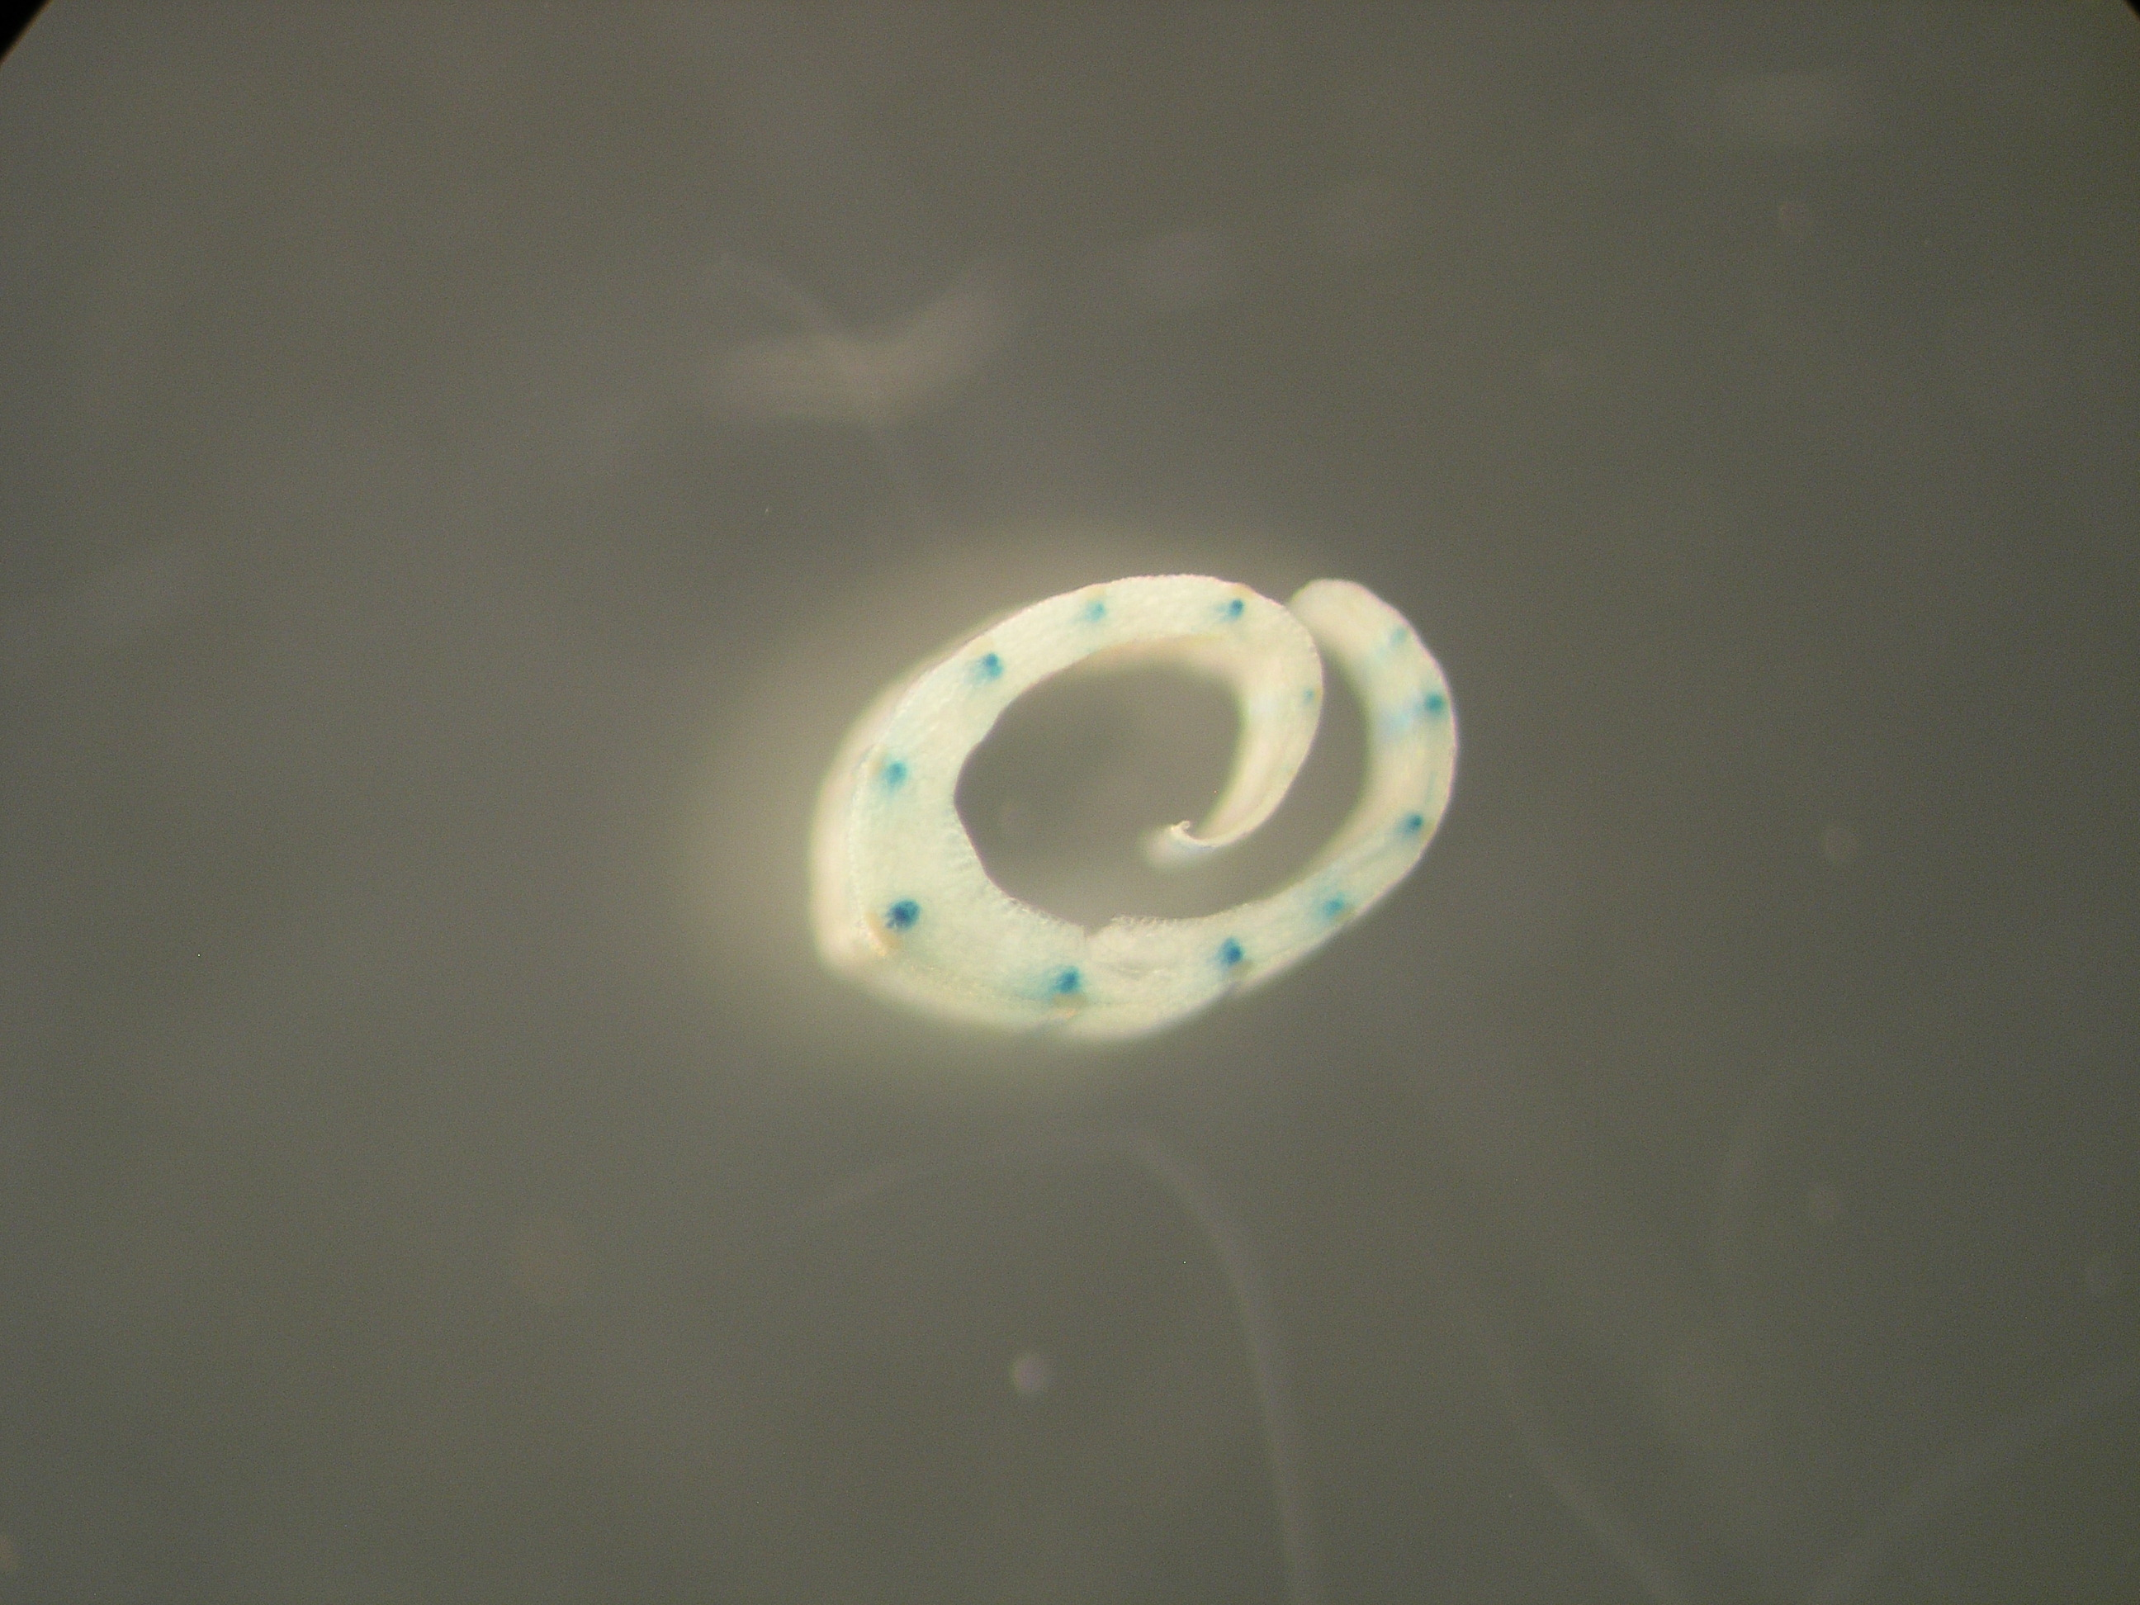
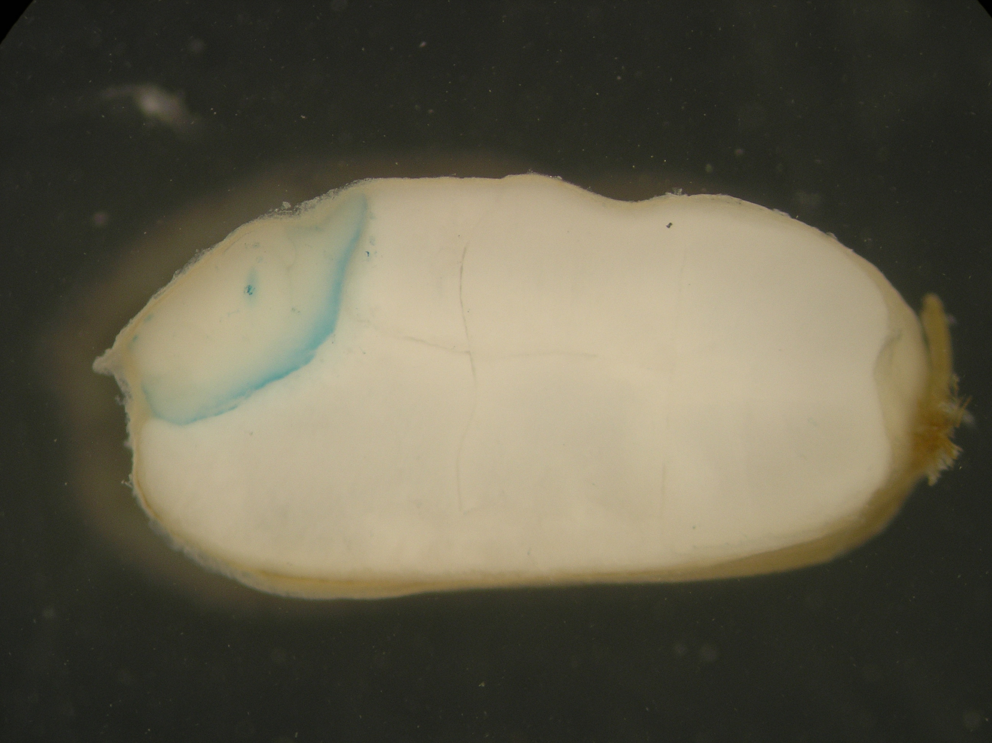
a
b
c
d
Fig. S4 Promoter activity of OsGAD3 in rice. Beta-glucuronidase (GUS) reporter assays were performed in transgenic rice plants by introducing a promoter region of the OsGAD3 gene (2868 bp from the initiation codon) :: GUS gene, showing GUS expression at 1 week after germination of seedlings a to c and in seed d. a: lateral root, b: surface of leaf sheath, c: cross section of leaf sheath, d: transverse section of brown rice grain. Scale bars = 1 mm.

