Slide 1
Determinants of cancer cell response to PDE3A modulators
Xiaoyun Wu¹, Gavin R. Schnitzler¹, Galen F. Gao¹, Brett Diamond¹, Andrew R. Baker¹, Bethany Kaplan¹, Colin W. Garvie², Steven Horner², Kaylyn Williamson¹, Lindsay Westlake¹, Selena Lorrey¹, Timothy A. Lewis², Martin Lange⁴, Sikander Hayat⁴, Henrik Seidel⁴, John Doench³, Andrew D. Cherniack^{1,5}, Charlotte Kopitz⁴, Matthew Meyerson^{1,5}, and Heidi Greulich^{1,5}*
Supporting Information
Figures S1-S3
Table S1 and S2
Supplementary Dataset 1 and 2

Slide 2
Figure S1. Biomarker optimization improves positive predictive value. (A) Optimized biomarker thresholds for PDE3A and SLFN12 mRNA expression maximize the geometric mean of the sensitivity and positive predictive value (PPV) over all possible biomarker thresholds (“Combined Score”). (B) Optimized biomarker thresholds (purple lines) result in a PPV of 62.5% for sensitive cell lines as previously defined, using a robust z score of < -4 (de Waal et al., 2016). (C) Linear regression shows good concordance between manual validation (AUC 2) and original high-throughput dose response results (AUC 1) for DNMDP sensitivity. AUC 1 values were normalized on a scale of 0-4 to facilitate comparison, as for Table S1. The 95% confidence interval of the best-fit line is indicated. AUC, area under the dose response curve. (D) Full-length immunoblot for anti-PDE3A (Bethyl A302-740A), left panel; and anti-PDE3B (Bethyl A302-473A), right panel. Arrows mark the three isoforms of PDE3A and PDE3B. Parts of these immunoblots were used in Figure 5B.
PDE3A and PDE3B immunoblot lanes:
1. HeLa 8. A2058
2. HeLa - PDE3B CRISPR sg2 9. HuT78
3. HeLa - PDE3B CRISPR sg2 10. RVH421
4. HeLa - PDE3B CRISPR sg5 11. SKMEL3
5. HeLa - PDE3B CRISPR sg5 12. SKMEL3 - PDE3A CRISPR sg2
6. HeLa 13. SKMEL3 - PDE3A CRISPR sg3
7. HeLa - PDE3A CRISPR sg2
Figure S2. Representative sections of cell fate trees for partially sensitive cell lines treated continuously with DMSO or 2 μM DNMDP. (A) Strong responder cell line GB1, (B) moderate responder cell line TE4, (C) weak responder cell line H2172. Cells were stained with an activated caspase substrate-conjugated green fluorescent dye, marking apoptotic cells. Phase contrast and green fluorescence live cell images were taken every 1 to 2 hours with the Incucyte imaging system. Red ovals, apoptotic events. Ellipsis (“…”), cells lost to tracking due to movement that precluded identification. Vertical blue dotted lines mark the 72 h timepoint at which viability was typically measured by CellTiter-Glo in these studies. Asterisks mark two H2172 cells that appear to be completely resistant to DNMDP.
Figure S3. (A) Ectopic expression of V5-tagged PDE3B in PDE3A-knockout HeLa cells restores sensitivity to DNMDP. Left panel, 72-hour CellTiter-Glo assay. GFP, green fluorescent protein. Right panel, anti-V5 immunoblot showing expression of exogenous PDE3B and GFP. (B) Optimized biomarker thresholds for [the higher value of PDE3A or PDE3B] and SLFN12 maximizing the geometric mean of the sensitivity and the PPV over all possible biomarker thresholds (“Combined Score”). PDE3A and PDE3B expression values in log₂(RPKM+1). (C) Double expression plots of RNA-Seq values. Left, plot from Figure S1B with two sensitive cell lines lacking PDE3A expression, HUT78 and RVH421, indicated. Right, similar plot with the x axis now displaying the highest expression value of either PDE3A or PDE3B, with thresholds of sensitivity independently optimized. PDE3B-expressing HUT78 and RVH421 cell lines are now correctly predicted to be DNMDP-sensitive, but this higher sensitivity of biomarker prediction comes at a cost, with a lower PPV than with expression of PDE3A alone in combination with SLFN12.
Table S1. DNA oligos used in this study.
Table S2. IC50s and standard deviations of biological replicates from dose response curves in this study. n, number of repetitions. N/A, inhibitor response curve cannot be fitted.
Supplementary Dataset 1. Tab 1, RNA-Seq expression values in log2(RPKM+1) for all PDE family members in the cell lines used in Table 1. Tab 2, cAMP abundance in the cell lines used in Table 1, measured by mass spectrometry.
Supplementary Dataset 2. Results from genome-wide CRISPR screen for DNMDP resistance in HeLa cells. First tab, results graphed in volcano plot in Figure 5A. Here, only genes with 3-8 sgRNA were included to eliminate gene families with cross-targeting sgRNA. Second tab, all screening results from which p values were generated. Third tab, raw and log₂-normalized reads per guide with which log fold change was calculated. Fourth tab, list of sgRNAs used in the screen.

Slide 3
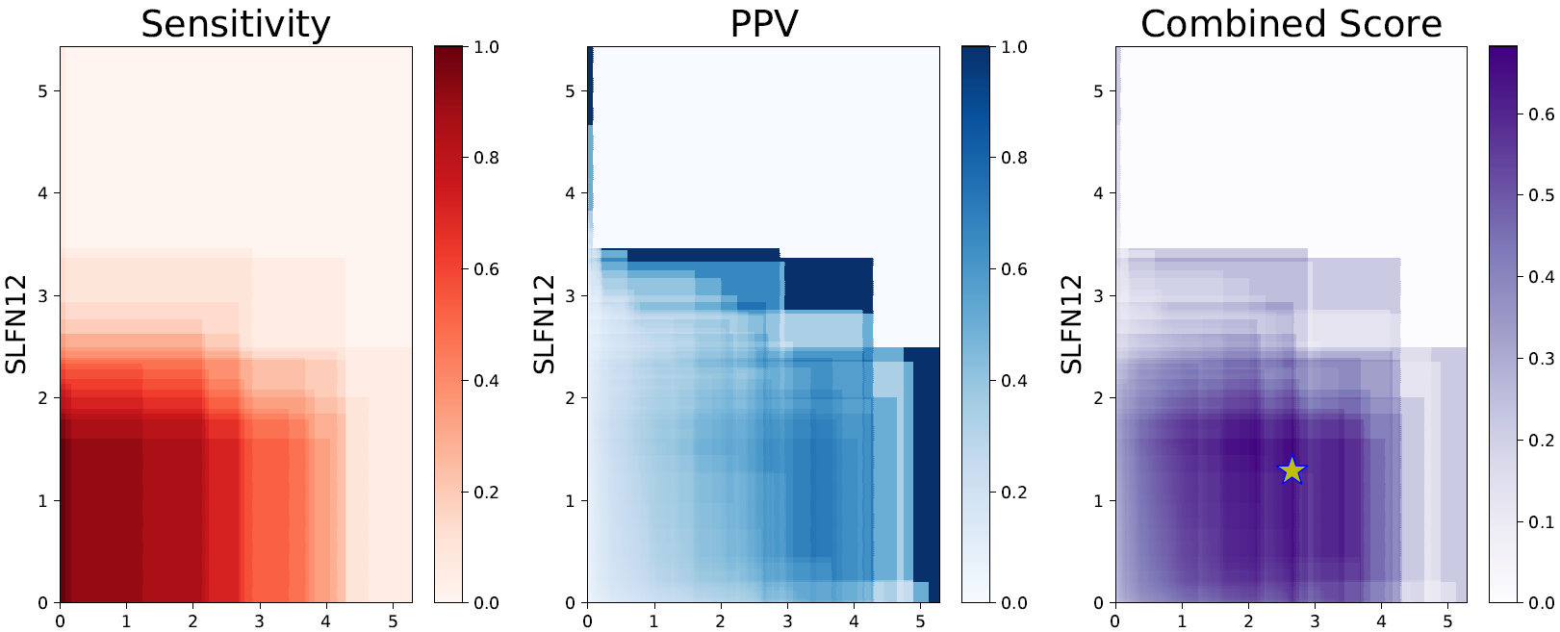
A.
SLFN12 log₂(RPKM+1)
PDE3A log2(RPKM+1)
PDE3A log2(RPKM+1)
PDE3A log2(RPKM+1)
PDE3A log₂(RPKM+1)
PDE3A log₂(RPKM+1)
PDE3A log₂(RPKM+1)
B.
C.
insensitive
sensitive
PPV = 62.5%
DNMDP AUC 2
SLFN12 log₂(RPKM+1)
R² = 0.73
DNMDP AUC 1
PDE3A log₂(RPKM+1)
D.
Anti-PDE3A
Anti-PDE3B
1
5
6
7
8
9
10
11
12
13
1
5
6
7
8
9
2
3
4
250 kDa
2
3
4
10
11
12
13
75 kDa
150 kDa
100 kDa
50 kDa
75 kDa
37 kDa
50 kDa
25 kDa
37 kDa
25 kDa
Figure S1

Slide 4
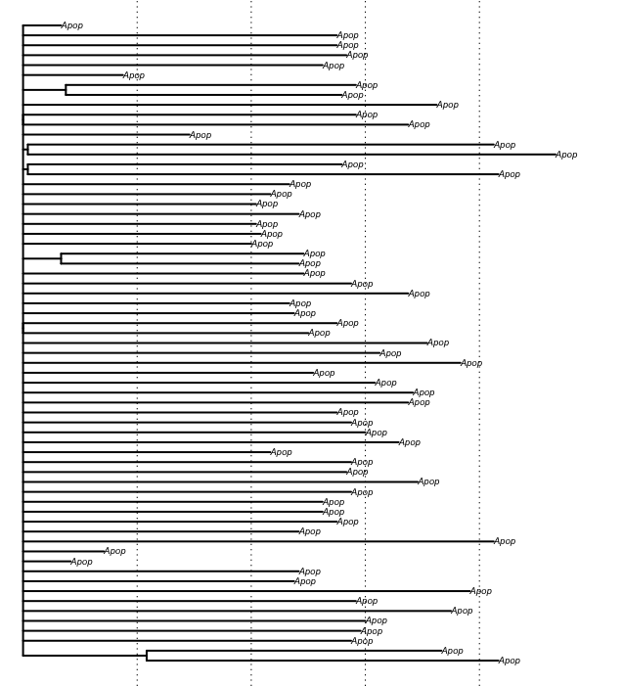
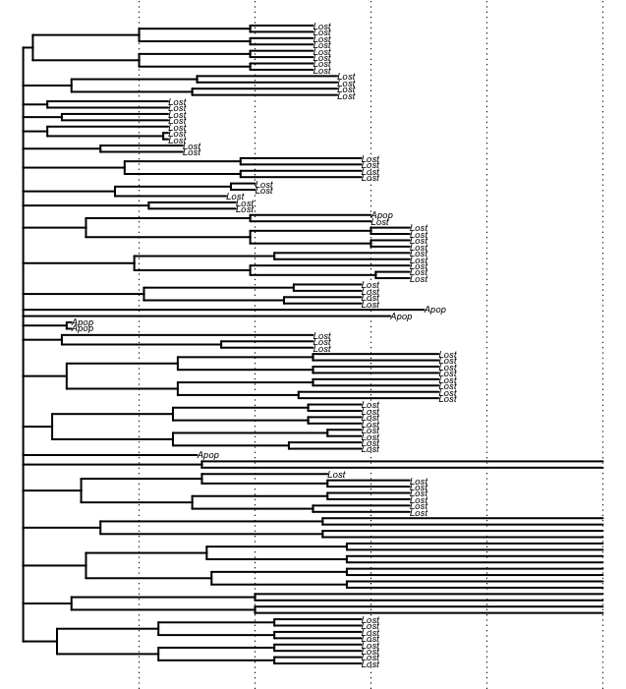
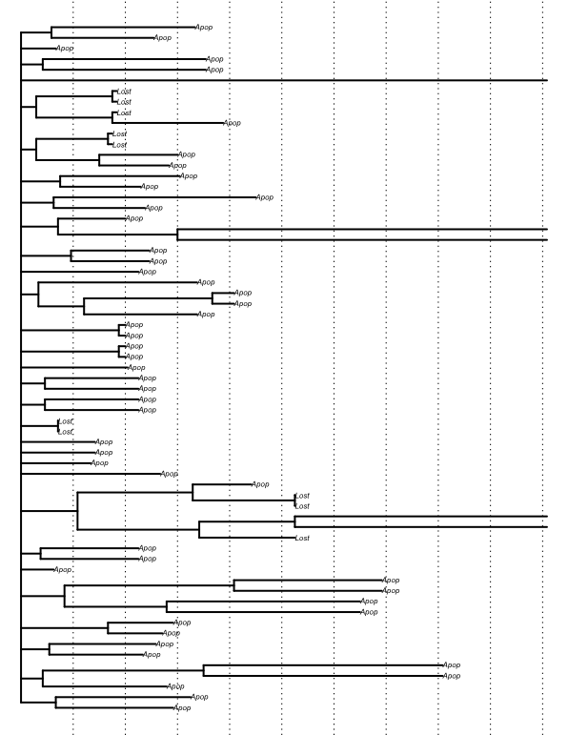
GB1 + DMSO
GB1 + 2µM DNMDP
…
…
…
…
…
…
…
…
…
…
…
…
…
…
…
…
…
…
…
…
…
…
…
…
…
…
…
…
…
…
…
…
…
…
…
24
48
72 hrs
24
48
72
96 hrs
TE4 + DMSO
TE4 + 2µM DNMDP
…
…
…
…
…
…
…
…
…
…
…
…
…
…
…
…
…
…
…
…
…
…
…
…
…
…
…
…
…
…
…
…
…
…
…
…
…
…
…
…
24
48
72 hrs
24
48
72
96
120 hrs
H2172 + DMSO
H2172 + 2µM DNMDP
…
…
…
…
*
…
…
…
…
…
…
…
…
…
…
…
*
…
…
24
48
72 96 hrs
24
48
72
96
120
144
168 hrs
Figure S2

Slide 5
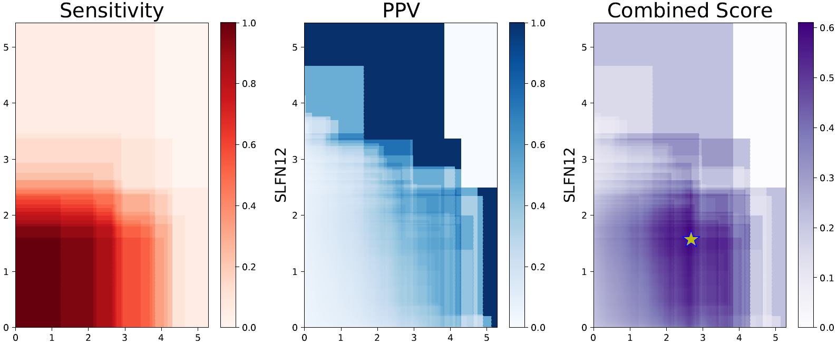
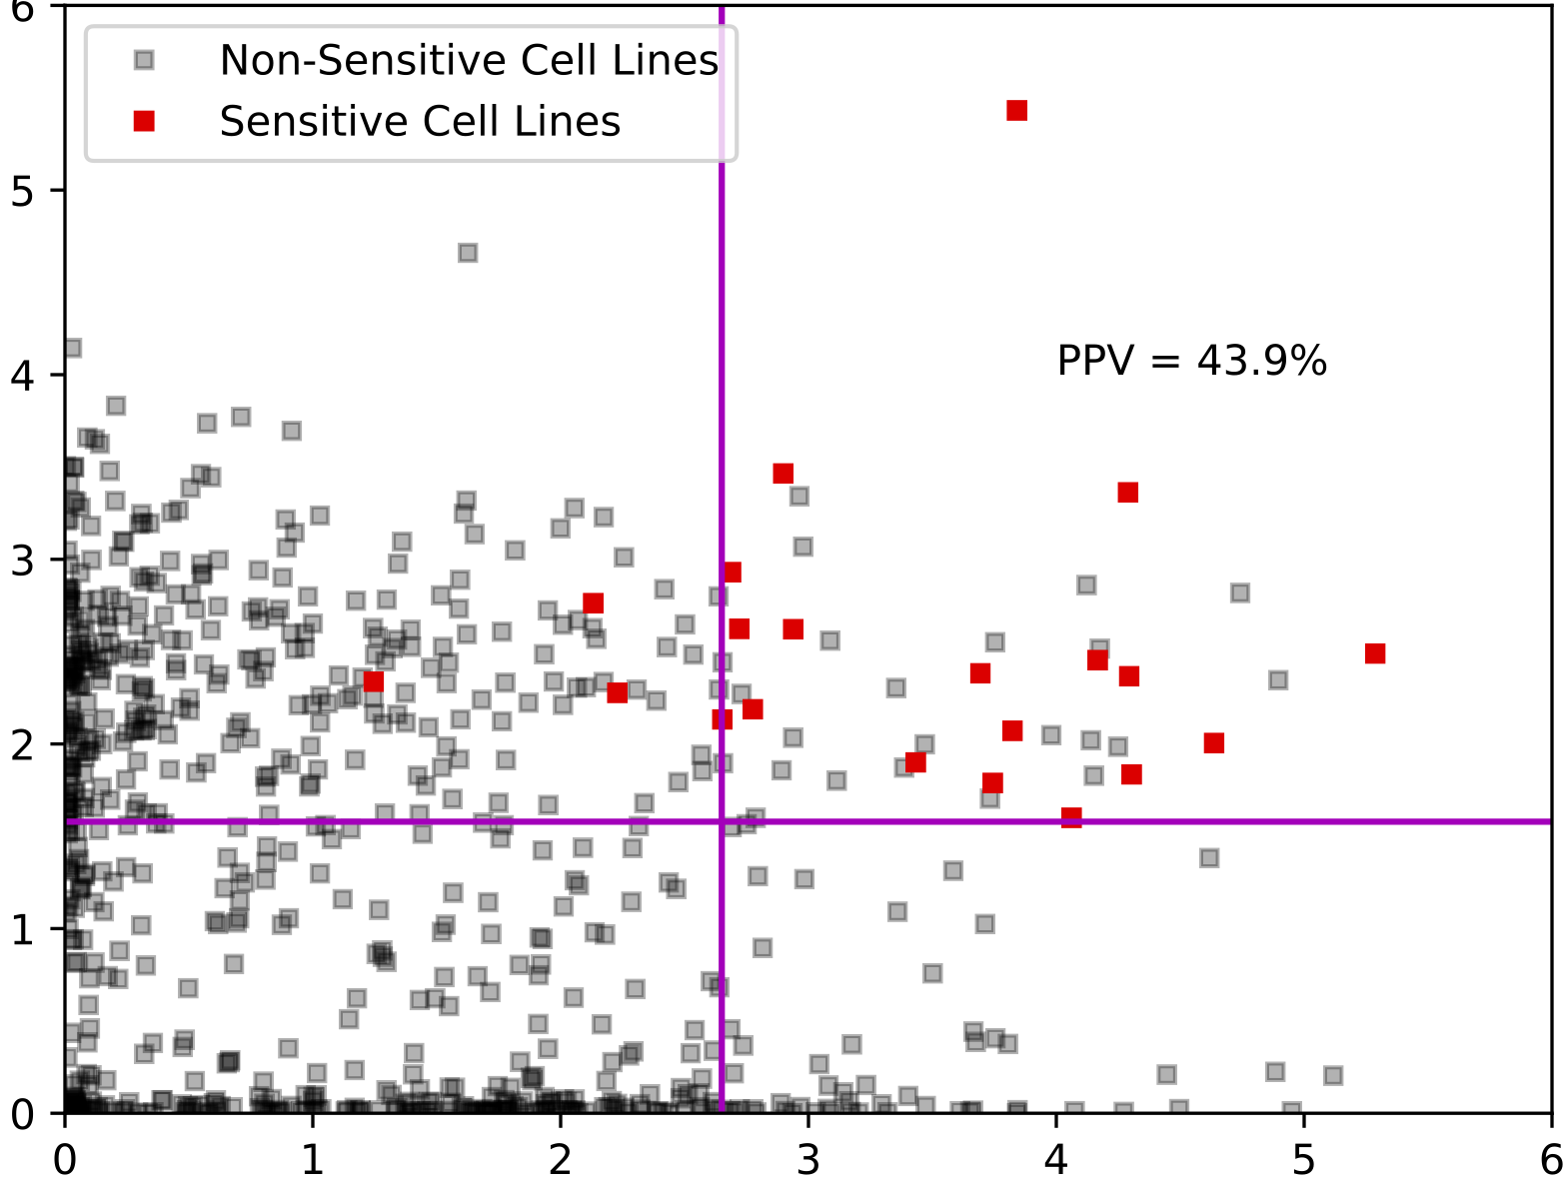
A.
PDE3A KO HeLa
PDE3A CRISPR KO HeLa
PDE3B
Parental HeLa
GFP
WB
GFP
250 kDa
PDE3B
150 kDa
Percent survival
100 kDa
75 kDa
V5
50 kDa
Log M DNMDP
150 kDa
vinculin
100 kDa
B.
SLFN12 log₂(RPKM+1)
Highest PDE3 [A or B]
Highest PDE3 [A or B]
Highest PDE3 [A or B]
C.
HuT78
insensitive
insensitive
HuT78
sensitive
sensitive
PPV = 62.5%
PPV = 43.9%
RVH421
RVH421
SLFN12 log₂(RPKM+1)
SLFN12 log₂(RPKM+1)
PDE3A log₂(RPKM+1)
Best PDE3 log₂(RPKM+1)
Fig S3

Slide 6
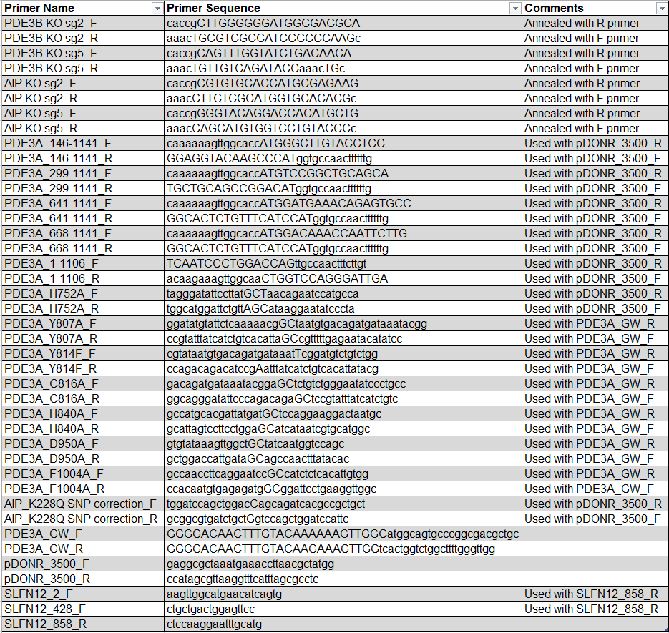
Table S1. DNA oligonucleotide sequences used in this study
Table S1

Slide 7
Table S2. IC₅₀s and standard deviations for dose response curves
Biological replicates for dose response curves in Figure 1A
Cell Line | n= | Average IC50 ± STDEV (nM) | Average Bottom ± STDEV (% Viability) | Average AUC ± STDEV
HeLa | 5 | 6.9 ± 3.2 | 1.4 ± 0.3 | 145.8 ± 18
IGR37 | 3 | 23.7 ± 21.3 | 9.5 ± 12.3 | 204.2 ± 60.5
COLO741 | 3 | 9.5 ± 3 | 4 ± 0.7 | 167.8 ± 8.4
NCIH1563 | 4 | 21.4 ± 3.7 | 9.7 ± 7.3 | 218.9 ± 22
NCIH2122 | 4 | 13.8 ± 5.4 | 5.7 ± 4.7 | 187.4 ± 31.4
SKMEL3 | 5 | 18.2 ± 7 | 7.7 ± 4.8 | 199.5 ± 26.3
JHUEM1 | 3 | 21.8 ± 5.6 | 5.6 ± 0.6 | 213.6 ± 10.5
HEL9217 | 3 | 25.1 ± 3 | 5.7 ± 0.5 | 215.2 ± 11.4
GB1 | 3 | 14.3 ± 5.6 | 18.2 ± 1 | 222.7 ± 16.2
HMCB | 3 | 45.8 ± 32.2 | 18.2 ± 5.1 | 258.6 ± 25.8
JHOM1 | 5 | 89 ± 74.3 | 29.7 ± 19.3 | 280.2 ± 61.3
HEL | 4 | 42.4 ± 7.9 | 16.9 ± 1.5 | 285.4 ± 43.6
A2058 | 6 | 41.9 ± 8.5 | 17.3 ± 2.3 | 266.3 ± 8.5
L3.3 | 4 | 357.7 ± 504.4 | 31.8 ± 11.6 | 327.6 ± 34.5
NCIH1734 | 3 | 44.9 ± 9.8 | 33.5 ± 9.7 | 287.8 ± 20.2
TE4 | 4 | 59.1 ± 32.7 | 35 ± 10.1 | 308.8 ± 38.3
DKMG | 4 | 100.7 ± 123.8 | 38.6 ± 8.8 | 308.5 ± 34.3
HS578T | 3 | 93 ± 31.3 | 45.6 ± 3.7 | 334.1 ± 6
C32 | 4 | 36.9 ± 16.7 | 51.4 ± 11.6 | 319 ± 35.3
H2172 | 5 | 105 ± 52.5 | 71.2 ± 9.5 | 386.4 ± 23.5
CAL51 | 3 | 420.1 ± 505.6 | 65.7 ± 13.7 | 385.7 ± 14.7
UACC257 | 3 | N/A | N/A | N/A
HCC15 | 3 | N/A | N/A | N/A
HUT78 | 3 | 88.7 ± 68 | 38.1 ± 39.4 | 313.3 ± 84.1
RVH421 | 4 | 132 ± 24.3 | 42.6 ± 4.2 | 339.6 ± 6.1
N/A: inhibitor response curve cannot be fitted
Biological replicates for dose response curves in Figure 8B
HeLa | n= | Average IC50 ± STDEV (nM) | Average Bottom ± STDEV (% Viability)
sgEmpty | 4 | 4.9±0.3 | 2.6±1.9
AIP sg2 | 4 | 1274±241.8 | 67.9±7.3
AIP sg5 | 4 | 2709.7±1220.6 | 49.2±13
A2058 | n= | Average IC50 ± STDEV (nM) | Average Bottom ± STDEV (% Viability)
sgEmpty | 2 | 30.8±3 | 16.3±9.1
AIP sg2 | 2 | N/A | N/A
AIP sg5 | 2 | N/A | N/A
N/A: inhibitor response curve cannot be fitted
Table S2

Slide 8
Biological replicates for dose response curves in Figures 5D, 6B, 7A, 7B, S3A
A2058-PDE3ACRISPRsg2 | n= | Average IC50 ± STDEV (nM) | Average Bottom ± STDEV (% Viability)
PDE3A_wild type | 4 | 12±4.3 | 32.2±12.7
PDE3A_146-1141 | 4 | 24±13.7 | 29±9.3
PDE3A_299-1141 | 3 | 12.6±8.2 | 15.3±7.4
PDE3A_641-1141 | 3 | 10.8±6.3 | 12.3±1.4
PDE3A_668-1141 | 6 | 35.9±19.2 | 25.8±10.6
PDE3A_1-1106 | 5 | 8.1±3.3 | 20.8±5.5
PDE3A_668-1106 | 1 | 29.5 | 26.5
PDE3A_H752A | 3 | 423.7±607 | 55.2±17.3
PDE3A_Y807A | 1 | 8.3 | 17.5
PDE3A_Y814F | 1 | 9.9 | 20.1
PDE3A_Y816A | 1 | 10 | 20.9
PDE3A_H840A | 1 | 514.8 | 3.4
PDE3A_D950A | 1 | 68 | 23.6
PDE3A_F1004A | 1 | 699 | 16.8
PDE3B | 4 | 23.7±9.2 | 23.1±7.5
GFP | 6 | 62±24.4 | 62.6±8.3
A2058 | 4 | 46.8±5.2 | 14.9±0.5
HeLa-PDE3ACRISPRsg2 | n= | Average IC50 ± STDEV (nM) | Average Bottom ± STDEV (% Viability)
PDE3A_wild type | 3 | 21.7±7.6 | 29.7±8.4
PDE3A_H752A | 1 | 868.4 | 34
PDE3A_Y807A | 1 | 46.2 | 33.3
PDE3A_Y814F | 1 | 9 | 23.1
PDE3A_Y816A | 1 | 18.5 | 35
PDE3A_H840A | 1 | 240 | 19.8
PDE3A_D950A | 1 | 79.2 | 29.9
PDE3A_F1004A | 1 | 898.2 | 46.8
PDE3B | 3 | 51.1±15.9 | 24.7±5.6
GFP | 4 | 275.2±139.9 | 61.8±14.1
HeLa | 3 | 6.7±1.3 | 1±0.2
Biological replicates for dose response curves in Figure 9B
UACC257 | n= | Average IC50 ± STDEV (nM) | Average Bottom ± STDEV (% Viability)
NT | 2 | N/A | N/A
GFP | 2 | N/A | N/A
PDE3A | 2 | 152.9±104.1 | 29.8±4.4
AIP | 2 | 204.8±72.1 | 48.7±6.3
N/A: inhibitor response curve cannot be fitted
Table S2, continued

Slide 9
Technical replicates for dose response curves in Figure 2B
HCC15 | n= | Average IC50 ± STDEV (nM) | Average Bottom ± STDEV (% Viability)
NT | 3 | N/A | N/A
GFP | 3 | N/A | N/A
PDE3A | 3 | 8.8±4 | 41.2±0.4
N/A: inhibitor response curve cannot be fitted
Technical replicates for dose response curves in Figure 5C
RVH421 | n= | Average IC50 ± STDEV (nM) | Average Bottom ± STDEV (% Viability)
sg Empty | 2 | 133.5±21.1 | 36.7±1.6
PDE3B sg2 | 2 | N/A | N/A
PDE3B sg5 | 2 | N/A | N/A
N/A: inhibitor response curve cannot be fitted
Table S2, continued

