Slide 1


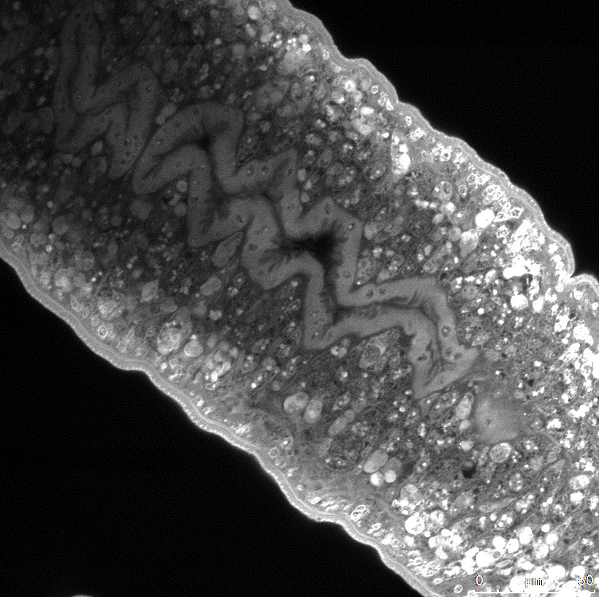
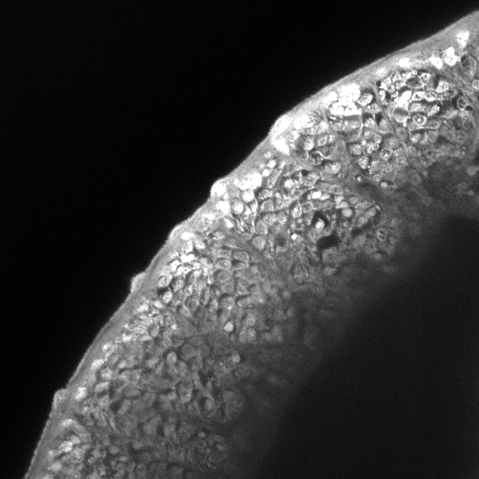
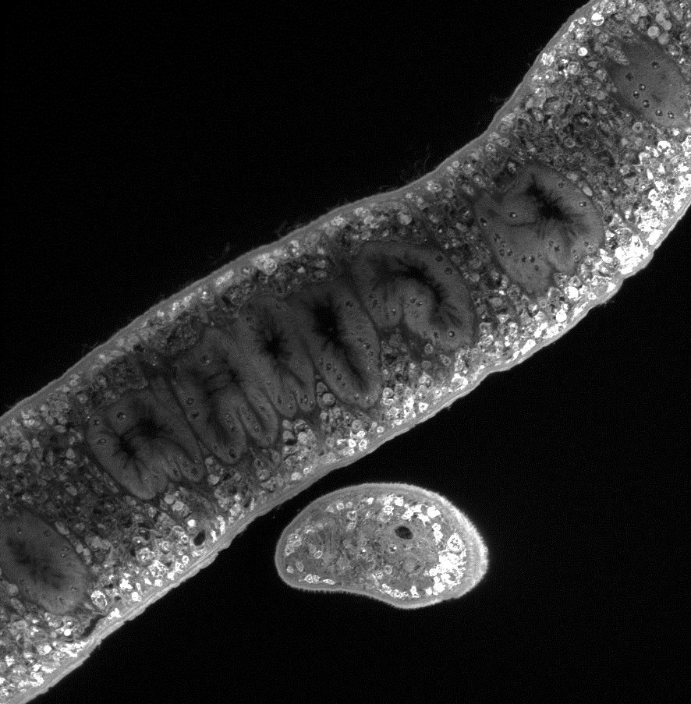
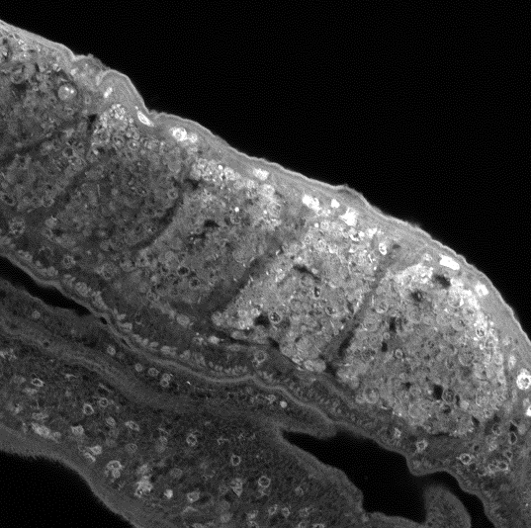
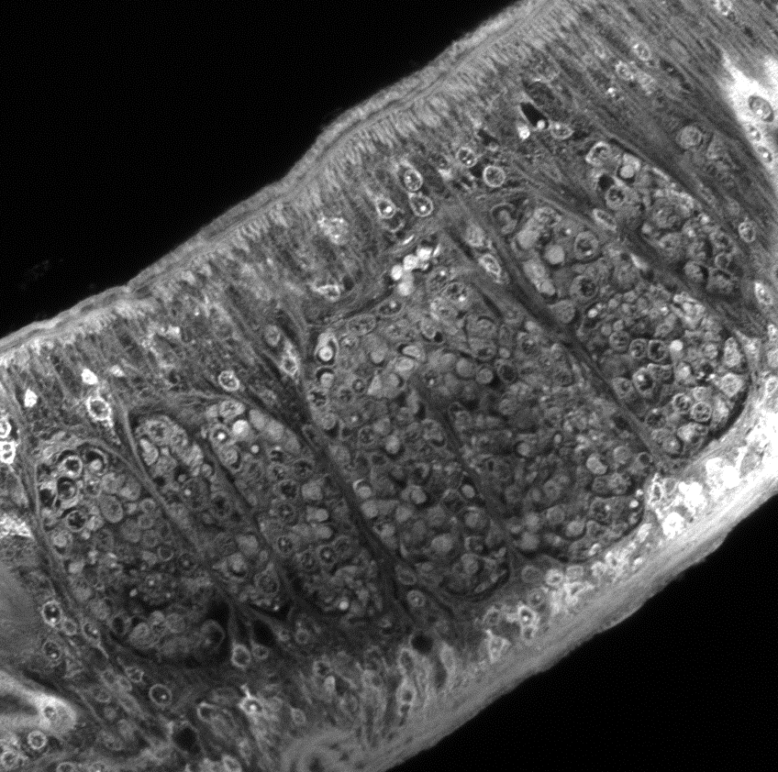
a-f Females worms highlighting the cellular disorganization (cd) of the parenchyma and the cells lining the gut after GSK-J4 treatment. g Schematic drawing illustrating the position of male testes with testicular lobes in blue (te). h-m Male worms depicting the testicular lobes containing germinal cells revealing some cellular disorganization after GSK-J4 treatment. n-s Muscle fibers (mf) of male worms revealing alterations after GSK-J4 exposure. AFA-fixed whole mount adult worm stained with Langeron's carmine. Scale-bars: 50 µm.
g
te
a
h
n
Control
te
mf
b
i
o
mf
te
GSK-J5 5 μM
c
j
p
mf
GSK-J5 20 μM
te
d
k
q
GSK-J4 800 nM
te
mf
e
l
r
te
GSK-J4 7.5 μM
cd
mf
f
m
s
GSK-J4 20 μM
mf
cd
te

