Slide 1
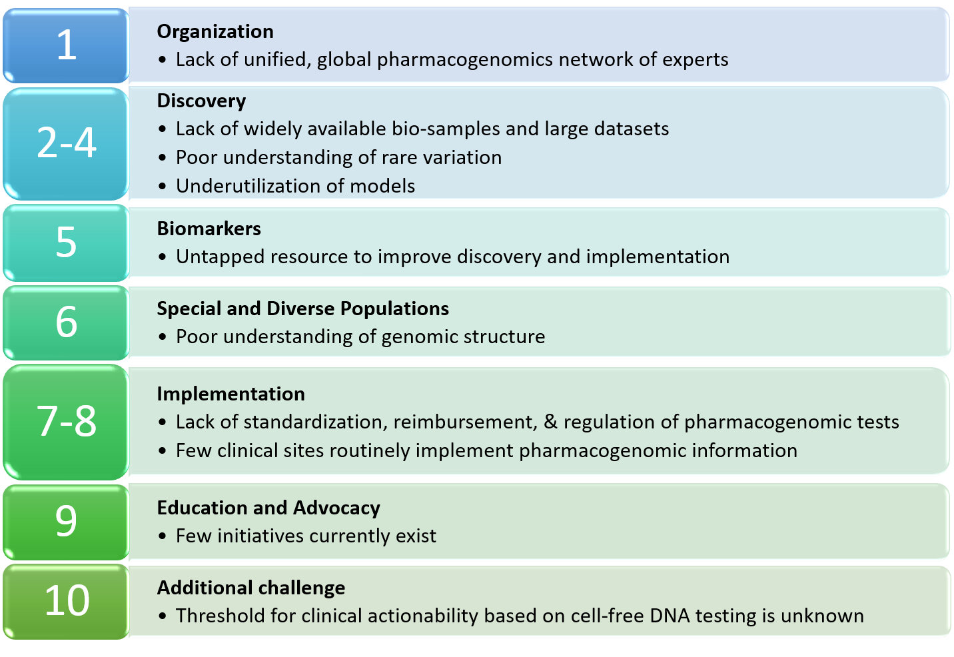
Figure S1. 10 identified challenges that currently limit the widespread clinical implementation of pharmacogenomics.
Chenoweth MJ, Giacomini KM, Pirmohamed M, Hill SL, van Schaik RHN, Schwab M, Shuldiner AR, Relling MV, Tyndale RF.
Global pharmacogenomics within precision medicine: challenges and opportunities. Clin Pharmacol Ther, 2019.

