Slide 1
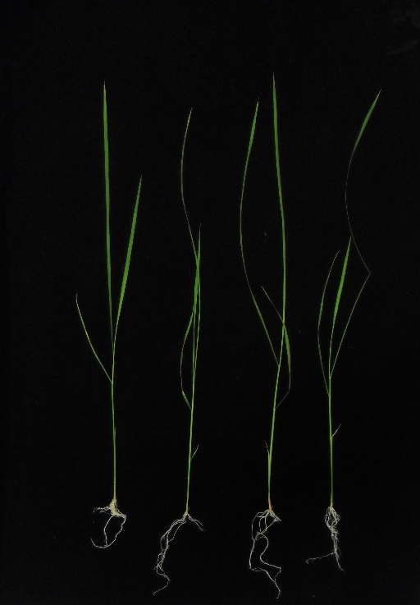
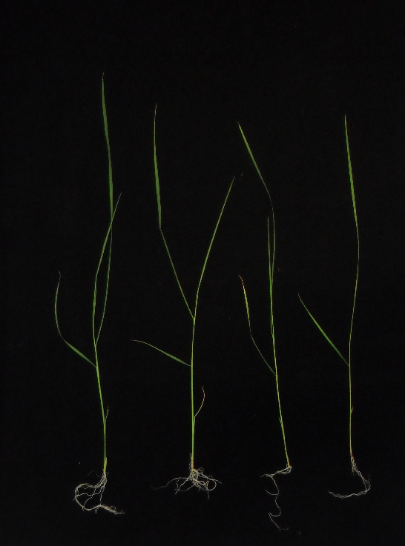
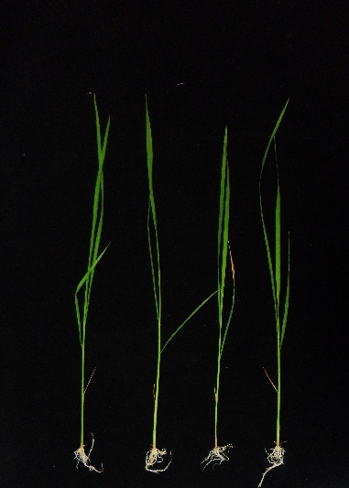
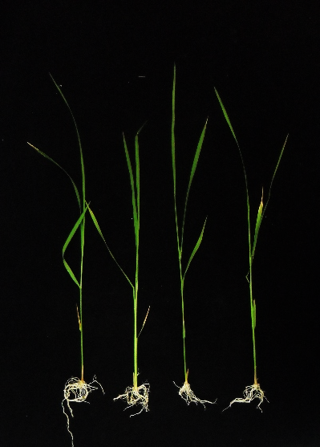
Pokkali
IR29
0 mM NaCl
200 mM NaCl
0 mM NaCl
200 mM NaCl
Fig. S1 Characteristic of in vitro rice seedlings of Pokkali and IR29 after subjected with 0 or 200 mM NaCl treatment for 360 min.

Slide 2
0 mM NaCl
200 mM NaCl
Time (min)
0
15
30
45
60
180
360
0
15
30
45
60
180
360
Pokkali
Root
IR29
Pokkali
Leaf
IR29
Fig. S2 Semi-quantitative RT-PCR of OsEF1α in root and leaf tissues of rice cvs. Pokkali and IR29 seedlings when exposed to control (0 mM NaCl) and salt stress (200 mM NaCl) for 0, 15, 30, 45, 60, 180, and 360 min.

Slide 3
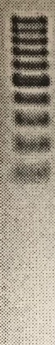
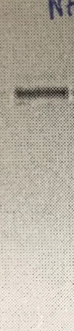

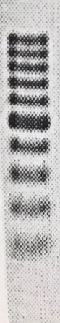

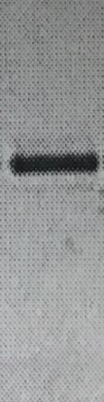
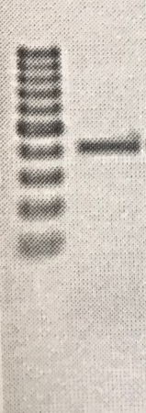
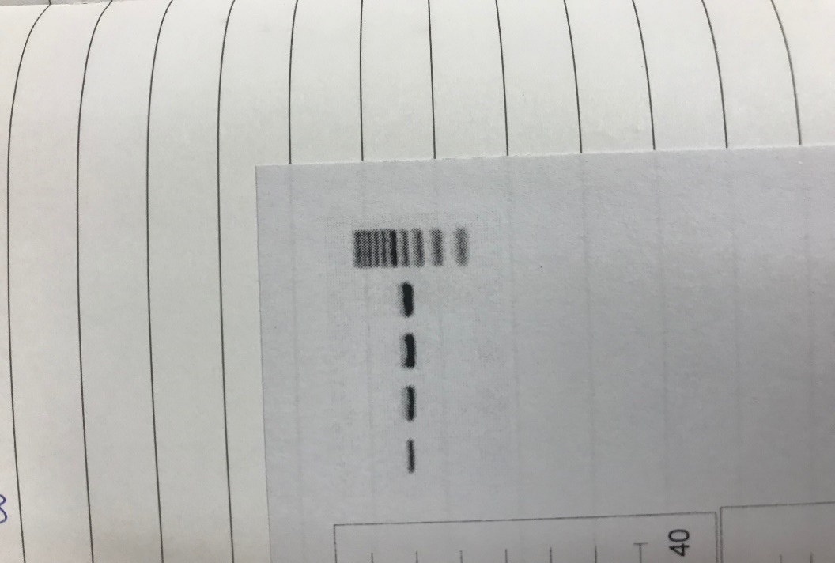
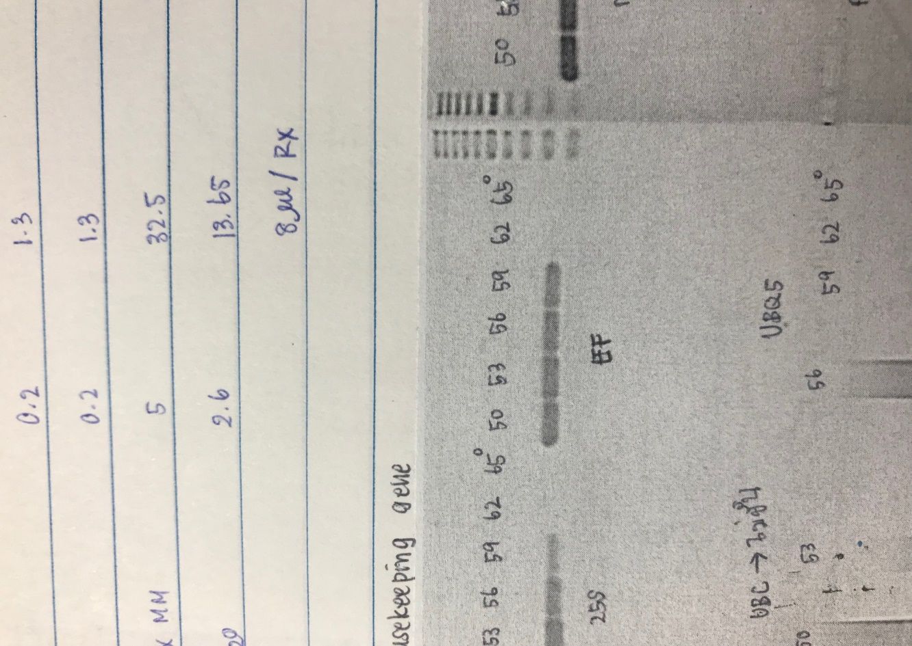
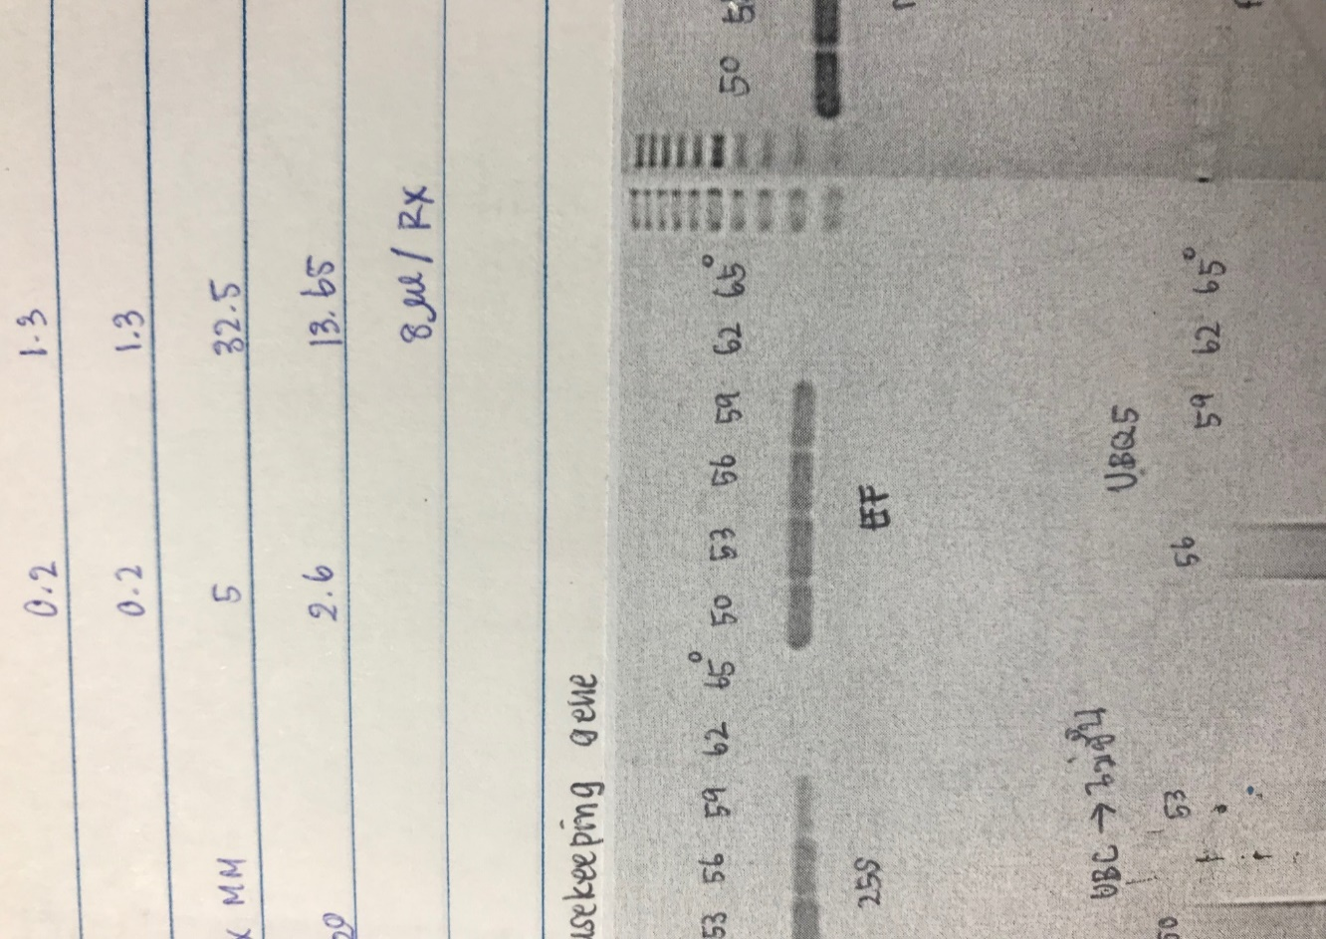
OsNHX1
OsNHX3
OsNHX5
500 bp
500 bp
500 bp
100 bp
100 bp
100 bp
OsHKT2;1
OsAVP1
Os18S rRNA
OsEF1α
500 bp
500 bp
500 bp
500 bp
100 bp
100 bp
100 bp
100 bp
Fig. S3 Predicted size of amplification products, OsNHX1, OsNHX3, OsNHX5, OsHKT2;1, OsAVP1, Os18s rRNA and OsEF1α on 1.5% Agarose gel electrophoresis

