Slide 1
Supplementary Table S1
Signal peptides and sequences used in this work:
Signal peptides | Sequences
AIVsp | MSMIAIIVIAILATAGKS
hAZsp | MTRLTVLALLAGLLASSRAGSSPLLDDIMS
GP67sp | MLLVNQSHQGFNKEHTSKMVSAIVLYVLLAAAAHSAFAVDTS
AIVsp = Avian influenza (A/chicken/Taiwan/2838V/00) signal peptide (Hsu and Wang, 2006)
hAZsp = Human azurocidin gene signal peptide (Olczak and Olczak, 2006; Chen et al., 2012)
GP67sp = Glycoprotein 67 signal peptide (Whitford et al., 1989)
References:
Chen, W.S., Villaflores, O.B., Lu, C.F., Wu, H.I., Chen, Y.J., Teng, C.Y., Chang, Y.C., Chang, S.L. and Wu, T.Y., Functional expression of rat neuroligin-1 extracellular fragment by a bi-cistronic baculovirus expression vector. Protein Expr. Purif. 81, 2012, 18-24.
Hsu, C.N. and Wang, C.H., Sequence comparison between two quasi strains of H6N1 with different pathogenicity from a single parental isolate. J. Microbiol. Immunol. Infect. 39, 2006, 292-396.
Olczak, M. and Olczak, T., Comparison of different signal peptides for protein secretion in nonlytic insect cell system. Anal. Biochem. 359, 2006, 45-53.
Whitford, M., Stewart, S., Kuzio, J. and Faulkner, P., Identification and sequence analysis of a gene encoding gp67, an abundant envelope glycoprotein of the baculovirus Autographa californica nuclear polyhedrosis virus. J. Virol. 63, 1989, 1393-1399.

Slide 2
Supplementary Fig. S1
T7 promotor
GP67sp
pET-32b-His
H6HA1-His
TA
cloning
H6HA1-His
pTA-GP67-
H6HA1-His
PPH promotor
pFAST-GP67-
H6HA1-His
pBac-MCS-
RhPV-IRES-
EGFP
PPH promotor
GP67sp
H6HA1-His
pFAST-GP67-
H6HA1-His-
RhPV-IRES-
EGFP
RhPV-IRES
(Rhir)
EGFP
Supplementary Fig. S1
A map for the construction of the pFast-GP67-H6HA1-His-RhPV-IRES-EGFP vector.

Slide 3
Supplementary Fig. S2
(A)
Glycosylation in insect cells (1.1 kDa)
Asn
(B)
Glycosylation in human cells (2.5 kDa)
Asn
N-Acectylgalactcosamine
Fucose
Galactose
Mannose
Sialic acid
Supplementary Fig. S2
The schematic structure of glycans in the insect cell (A) and the human cell (B).

Slide 4
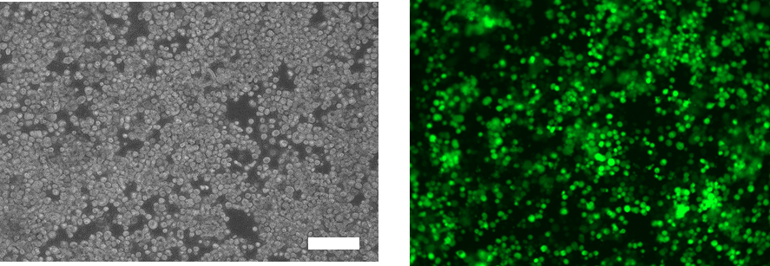
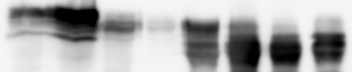
Supplementary Fig. S3
(A) Expressed in High Five cell
(B) Cell lysate
Imidazole elution
kDa
XT
CP
Ub
20
60
100
200
500
Anti-HA
-42-
Anti-His
-42-
Anti-EGFP
-30-
(C) Supernatant
Imidazole elution
kDa
AS
Ub
20
60
100
200
500
Anti-HA
-42-
Anti-His
-42-
Anti-EGFP
-30-
Supplementary Fig. S3
The bi-cistronic recombinant baculovirus was used to infect the insect cell High Five.

Slide 5
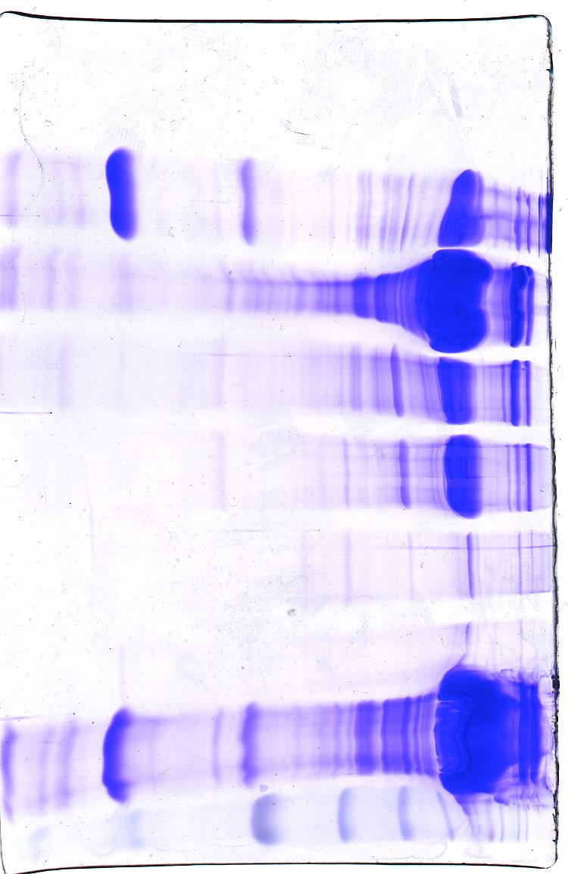
Supplementary Fig. S4
Ammonium sulfate
fractionation (%)
kDa
M XT 20 40 50 60 80 N
Anti-His
-72-
-53-
-42-
-72-
Anti-HA
-53-
-42-
-72-
CBR
-53-
-42-
-30-
-22-
-14-
15% SDS-PAGE
Supplementary Fig. S4
The H6HA1-His protein from the hemolymph of larvae was isolated using ammonium sulfate fractionation and then analyzed by SDS-PAGE and Western blotting. The fractions between 60%-80% saturations were collected and then applied to the gel filtration column (Fig. 6). N, negative control using blank hemolymph.

Slide 6
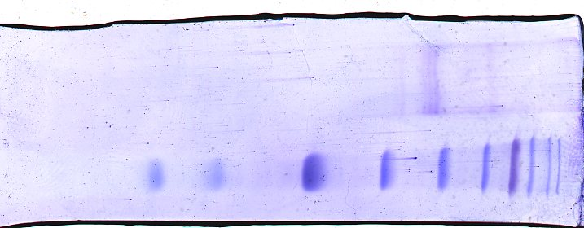
Supplementary Fig. S5
Purification by nickel column
M
H6HA1-His
M
H6HA1-His
M
H6HA1-His
kDa
-72-
-53-
-42-
-30-
-22-
-14-
CBR
Anti-His
Anti-HA
Supplementary Fig. S5
The H6HA1-His protein obtained from the gel filtration (Fig. 6) was further purified by the nickel affinity chromatography. A near homogeneous H6HA1-His protein was revealed on the CBR-stained gel and Western blots.

