Slide 1
Figure 1
% change in serum CA125 from baseline
Days of pazopanib treatment

Slide 2
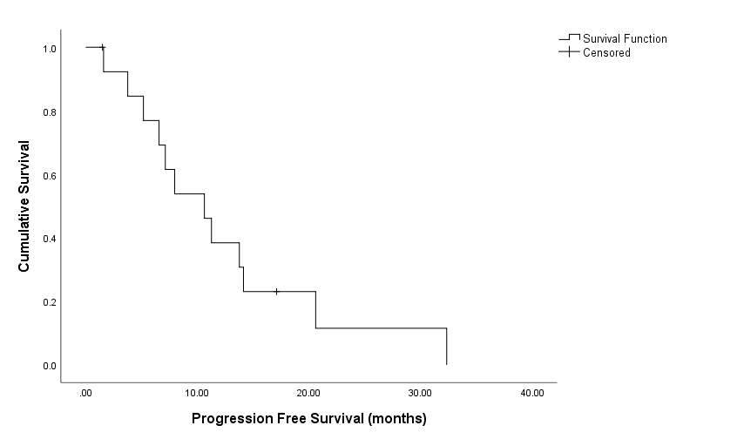
Figure 2A

Slide 3
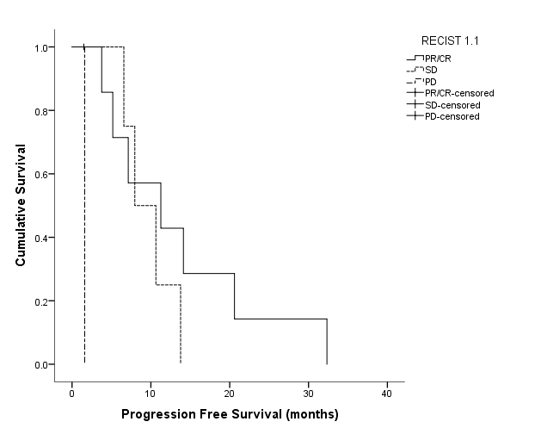
Figure 2B

Slide 4
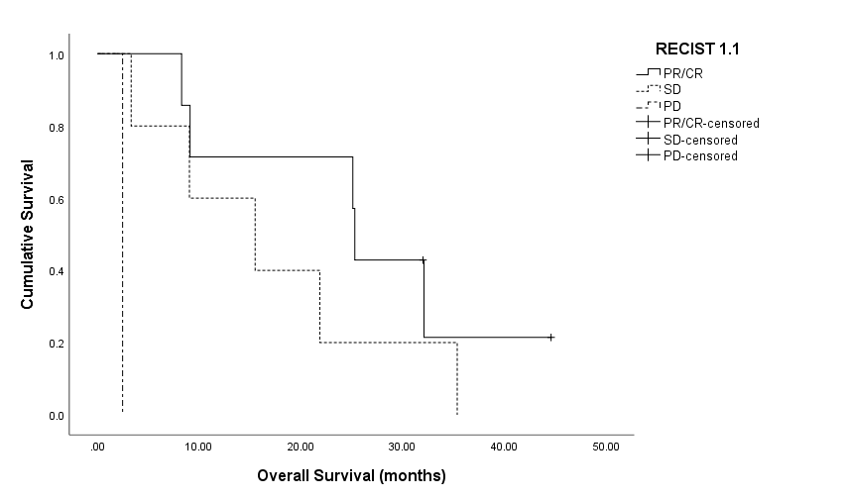
Figure 2C

Slide 5
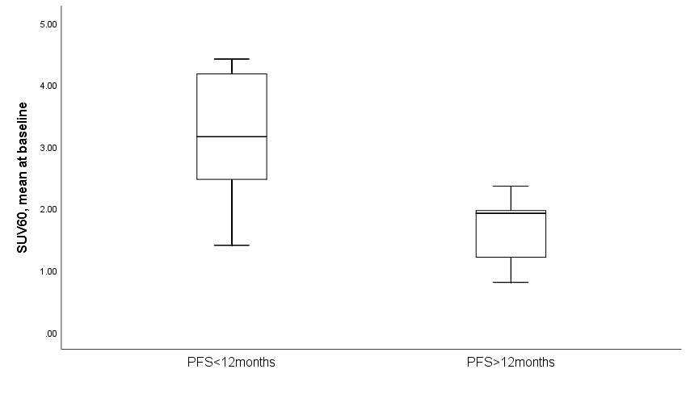
Figure 3
*
Baseline SUV_{60,mean}

