Slide 1
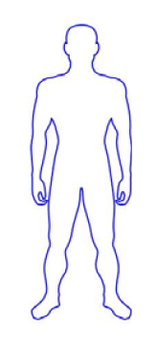
A
Baseline characteristics
Male, 37 years old
ESRD: IgA nephropathy
RRT: peritoneal dialysis
AB0 compatible (Rec: AB, Rh+; Don: A, Rh+)
2 HLA mismatches (HLA A32, DRB1 14)
Negative cross match
Negative anti-donor HLA antibodies
B
5 months prior to transplant
BM aspiration
MSC expansion
Quality control and release
C
Living-donor kidney transplant
(DAY0)
MAINTENANCE THERAPY
CsA: target trough blood levels of 300-400 ng/ml for the first week and of 100-150 ng/ml at month 5 post-transplant. Thereafter 80-100 ng/ml.
MMF: 750 mg twice daily.
Steroids: 500, 250 and 125 mg of MP at post-transplant day 0, 1 and 2, respectively. Thereafter, 75 mg oral prednisone progressively tapered and discontinued at day 7 post-surgery.
MSC IV infusion
(DAY-1)
INDUCTION THERAPY
Low-dose RATG: 0.5 mg/kg daily from day 0 to day 6
-1
0
1
2
3
4
5
6
7
Days post-transplant
Figure S1

