Slide 1
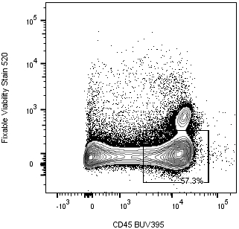
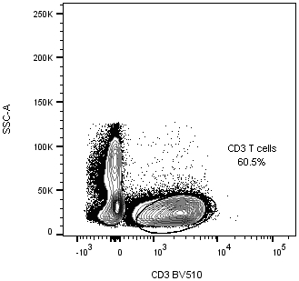
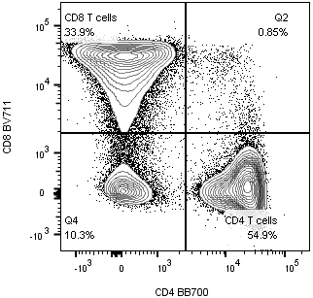
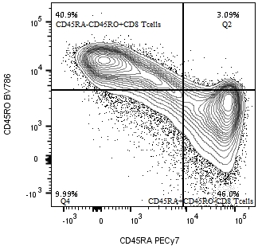
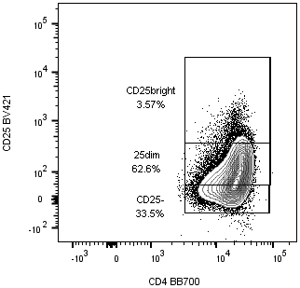
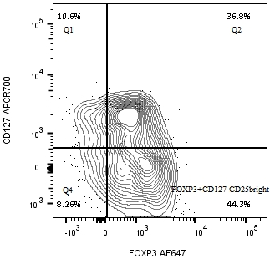
A
Foxp3⁺CD127⁻ Regulatory CD4⁺ T cells
B
CD45RO⁺RA⁻ Memory CD8⁺ T cells
80
60
70
50
MMF tap
60
40
CsA tapering
MMF mono
IS free
50
% on CD3⁺CD8⁺ T cells
% on CD4⁺CD25^{high} T cells
30
40
30
CsA tapering
20
20
IS free
MMF tap
10
MMF mono
10
0
0
1
2
3
4
5
6
7
8
9
0
0
1
2
3
4
5
6
7
8
9
years post-Tx
years post-Tx
C
D
E
F
G
H
Figure S3. (A) Profile of regulatory T cells (Tregs) expressed as percentages of Foxp3⁺CD127⁻ cells on gated CD4⁺CD25^{high} and (B) of memory CD8⁺ T cells, expressed as percentages of CD45RO⁺RA⁻ on CD8⁺ T cells in the patient before, during and after immunosuppressive drug withdrawal. Colored boxes highlight the sequential phases of CsA and MMF tapering and discontinuation, indicated by arrows. (C-H) Representative gating strategy for CD45RA⁻RO⁺ memory CD8⁺ T cells and CD4⁺CD25^{high}Foxp3⁺CD127⁻ Tregs is shown as contour plots with outliers. After gating singlets, live CD45⁺ cells (C) are analysed for CD3 expression (D) and plotted for CD8 (red box in panel E) and CD4 (blu box in panel E) expression, (F) gated CD8⁺ T cells were then plotted for CD45RA and CD45RO expression. CD4+ T cells are plotted for CD4 and CD25 expression (G) and CD25^{bright}CD4⁺ T cells (green box) are gated and analysed for CD127 and Foxp3 expression (H).
CsA: Cyclosporine A, MMF: mycophenolate mofetil.

