Slide 1
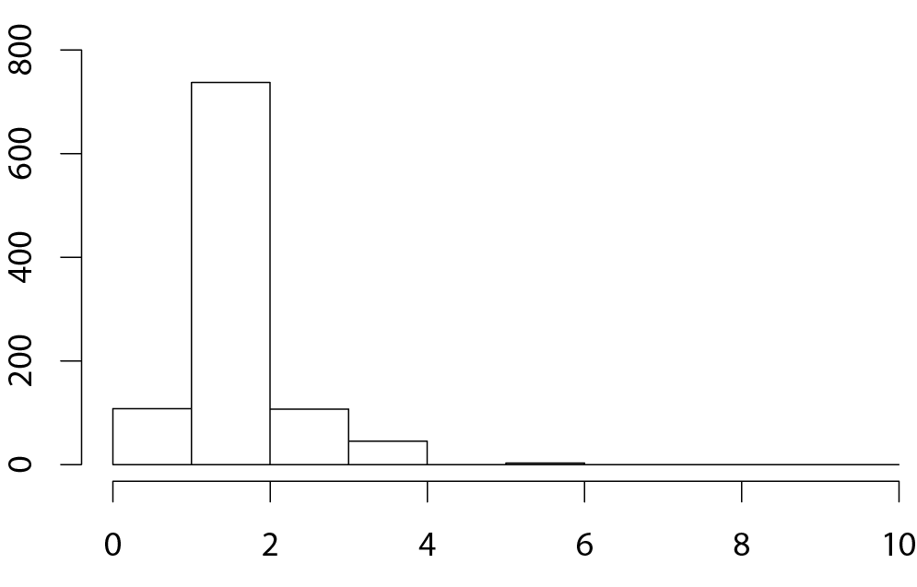
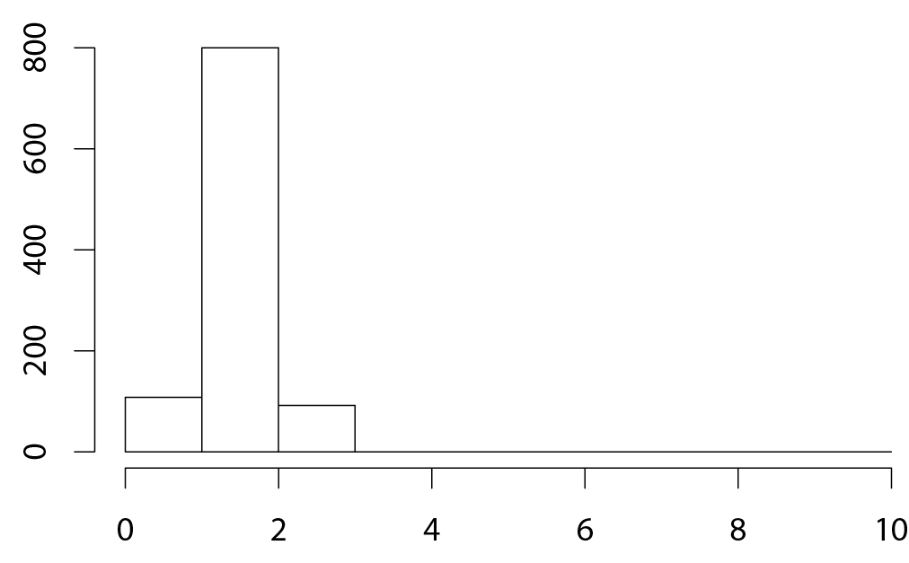
Supplement data 2. Histograms of topological divergences to the reference tree (TCS tree with 45 sequences) for (A) the TCS transmission tree (merging nodes to the closest premises); and (B) for the MSTs. Divergence is quantified by the asymmetric difference of the reference tree edge set and the edge of the topology considered.
A.
B.
Frequency
Frequency
Distance
Mean = 1.101
Distance
Mean = 0.984

