Slide 1
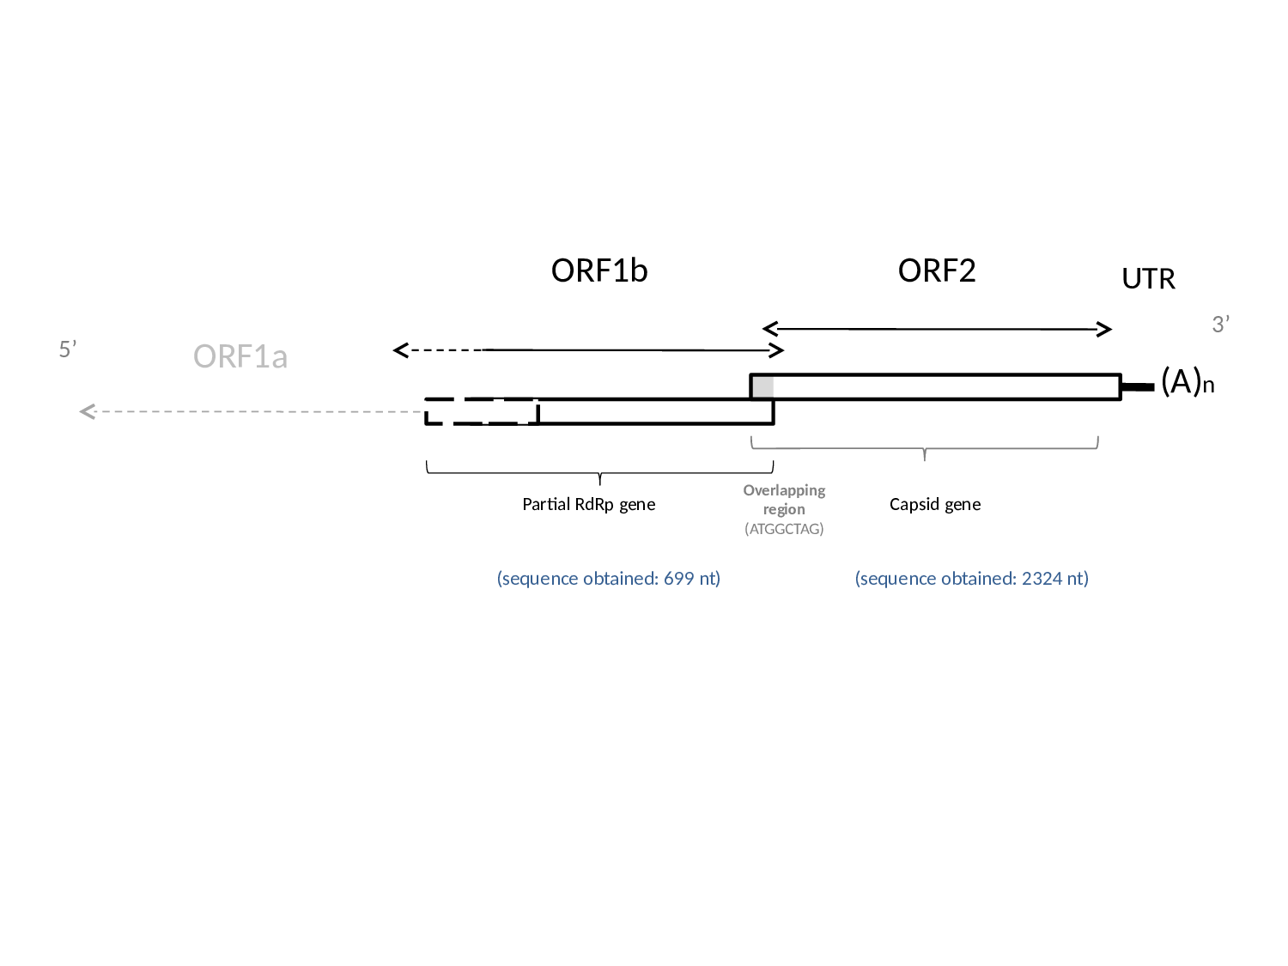
Supplementary Figure 3

