Slide 1
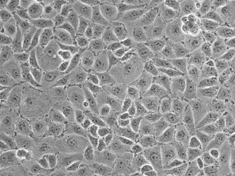
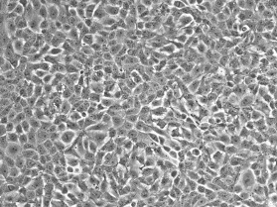
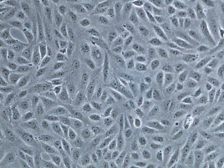
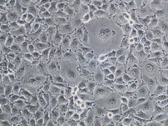
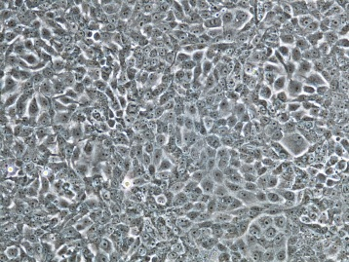
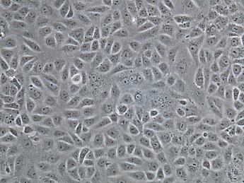
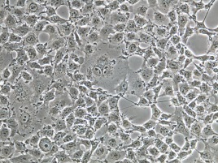
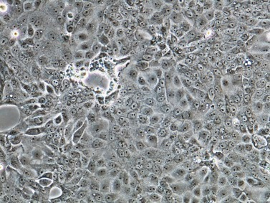
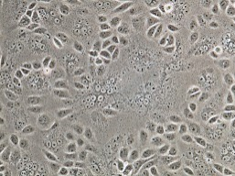
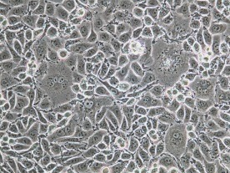
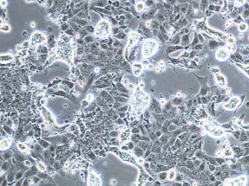
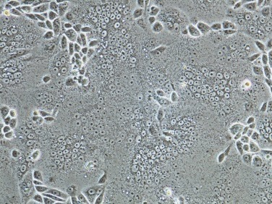
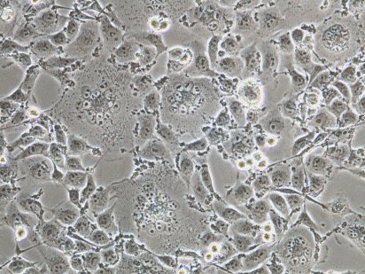
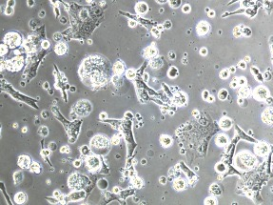
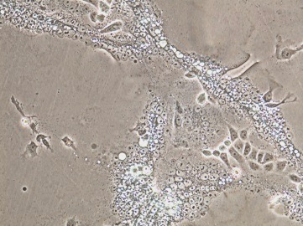
(A)
(B)
MARC-145 LLC-PK1 Vero
0 h
(C)
6 h
9 h
12 h
18 h
Supplementary Fig. 1. Identification of LLC-PK1 as PEDV susceptible cells. (A), multistep growth kinetics of PEDV in different lines of cells. MARC-145, Vero, and LLC-PK1 cells were infected with PEDV at an MOI of 0.01 and cell culture supernatants were collected at different times. Viral titers were determined in respective cells by the 50% tissue culture infectious dose (TCID₅₀) protocol. (B), Cytopathic effects (CPE) of PEDV on different types of cells. Cells were infected with PEDV at an MOI of 5 and CPE was observed at different times. Arrows show multinucleated cells. (C), One step growth curve of PEDV. Cells were infected with PEDV at an MOI of 5, and culture supernatants were collected at indicated times to determine TCID₅₀.
Sup Fig. 1. Zhang et al.

