Slide 1
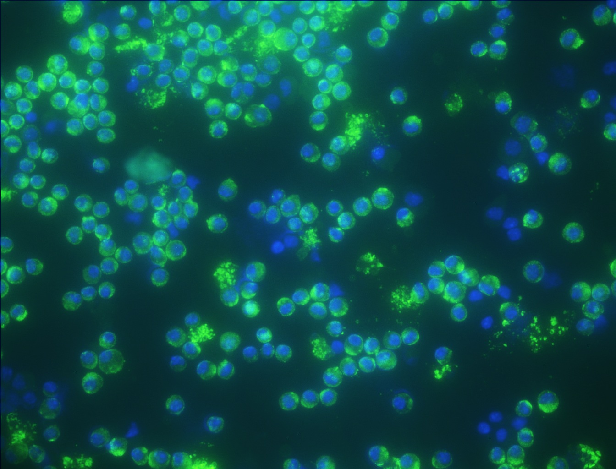
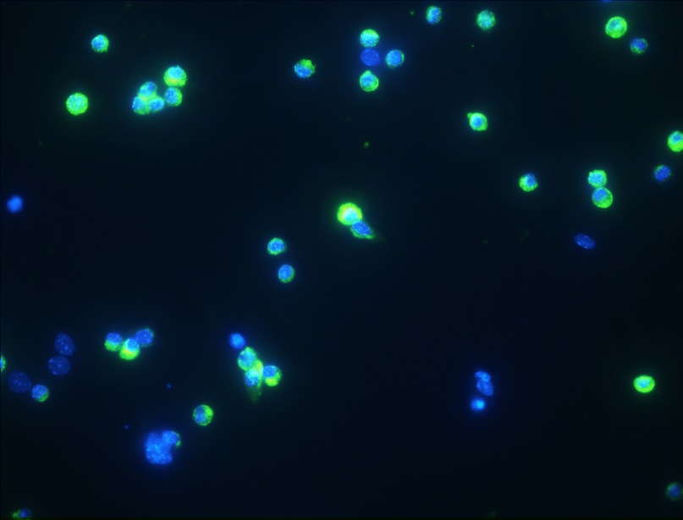
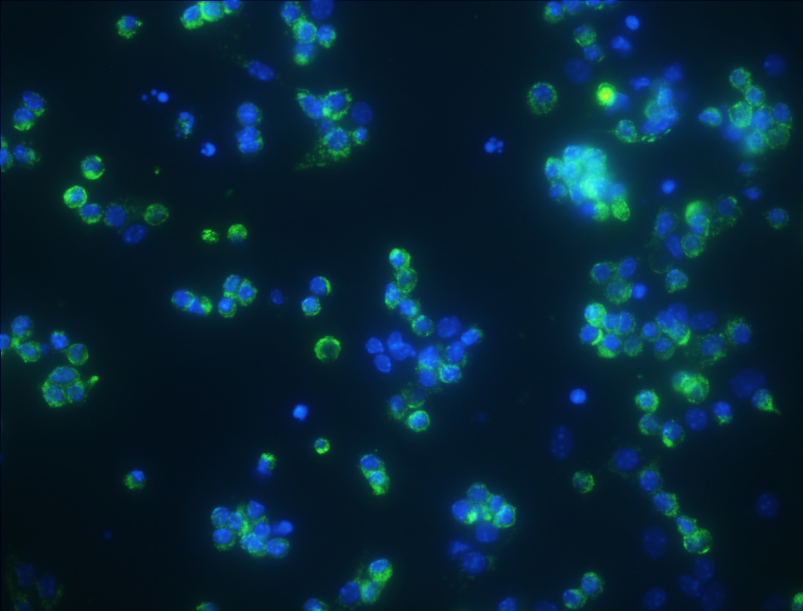
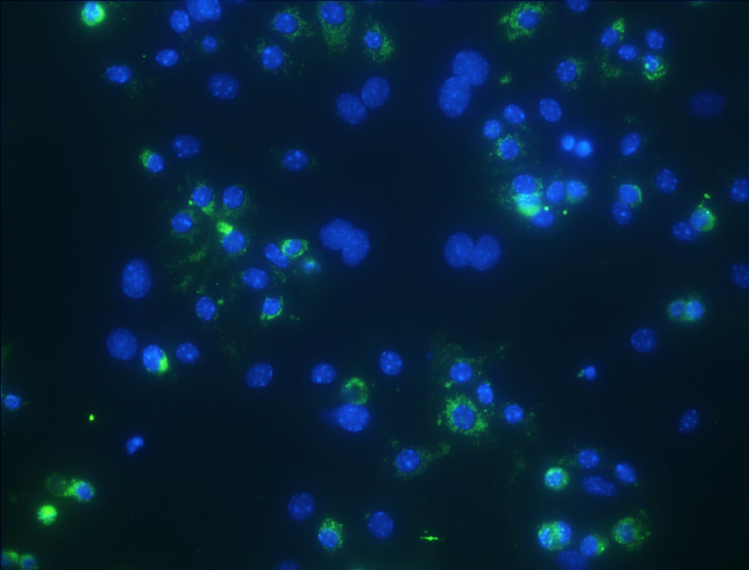
% LBP180 +:
Freshly Isolated
89.2 ± 1.5
Plated 16 h
80.6 ± 2.2
Plated 24 h
81.2 ± 1.9
Plated 48 h
62.5 ± 3.8

