Slide 1
Supporting information

Slide 2
Tabl S1. Kinase inhibitory activities of GZD824 and drugs
nM | GZD824 | Quizartinib | Gilteritinib | AP24534
Flt3 | 1.33±0.074 | 5.95±1.89 | 13.32±0.13 | 1.70±0.047
Flt3-D835Y | 223.8±55.6 | 6486±1669 | 3.71±1.36 | 958.2±219.2
FGFR1 | 4.14±0.96 | >10000 | >1000 | 8.37±1.89
PDGFRα | 2.08±0.51 | 96.05±4.11 | 147.9±7.78 | 1.85±0.010
Kinase activity assays were performed using the FRET-based Z′-Lyte assay according to the manufacturer’s instructions. The compounds were incubated with the kinase reaction mixture for 1.5 hrs before measurement. The data are means from two independent experiments and the variations are below 20%.

Slide 3
Tabl S2. Blood analysis of mice harboring MV4-11 cancer cells treated by GZD824 or quizartinib for 18 days
Parameters | Vehicle 10mg/kg qd | GZD824 10mg/kg q2d | GZD824 20mg/kg q2d | Quizartinib 10mg/kg qd
WBC（10⁹/L） | 6.30±1.91 | 5.13±1.48 | 3.80±1.12 | 3.20±0.51
Lymph（10⁹/L） | 3.07±1.47 | 3.37±1.80 | 2.00±0.78 | 1.97±0.53
Mon（10⁹/L） | 0.23±0.05 | 0.33±0.24 | 0.27±0.17 | 0.27±0.12
Gran（10⁹/L） | 3.00±0.80 | 1.43±0.38 | 1.53±0.90 | 0.97±0.29
Lymph（%） | 45.77±12.25 | 60.30±19.54 | 54.40±20.94 | 61.60±12.98
Mon（%） | 4.07±0.97 | 7.73±3.01 | 7.23±3.19 | 8.00±3.24
Gran（%） | 50.17±11.39 | 31.97±16.71 | 38.37±17.94 | 30.40±9.75
RBC（10¹²/L） | 8.10±0.39 | 8.88±0.17 | 10.18±0.51 | 8.36±0.07
HGB（g/l） | 122.00±2.16 | 133.67±1.25 | 141.00±2.16 | 131.67±2.36
HCT（%） | 48.80±1.39 | 47.13±0.69 | 51.73±1.94 | 44.13±0.33
MCV （fl） | 60.37±2.10 | 53.13±0.31 | 50.93±0.68 | 52.90±0.29
MCH （pg） | 15.07±0.76 | 15.00±0.14 | 13.87±0.92 | 15.73±0.21
MCHC （g/l） | 249.67±11.12 | 283.33±1.70 | 272.33±14.38 | 298.00±2.83
RDW（%） | 16.93±0.73 | 15.50±0.24 | 15.80±00.00 | 16.10±0.24
PLT（10⁹/L） | 2061.33±405.22 | 1984.00±44.50 | 2639.00±922.09 | 1818.67±39.20
MPV （fl） | 5.37±0.26 | 4.80±0.08 | 5.53±0.45 | 4.73±0.05
PDW | 16.90±0.29 | 16.03±0.12 | 17.20±0.65 | 15.90±0.08
Mice were treated with vehicle or GZD824 for 18 days, then the total blood were collected blood routine analysis.

Slide 4
Tabl S3. Biochemical analysis of liver and kidney function in mice harboring MV4-11 cancer cells treated by GZD824 or quizartinib for 18 days
Parameters | Vehicle 10mg/kg qd | GZD824 10mg/kg q2d | GZD824 20mg/kg q2d | Quizartinib 10mg/kg qd
ALT(U/L) | 53.00±8.54 | 33.79±9.80 | 34.00±2.47 | 28.85±3.15
AST(U/L) | 104.45±5.64 | 98.44±19.64 | 93.12±5.70 | 87.93±5.36
BUN(mg/dL) | 26.28±3.80 | 21.67±3.41 | 23.17±4.10 | 24.08±1.99
CREA(μmol/L) | 131.64±4.34 | 135.84±0.89 | 135.41±18.71 | 143.52±1.68
Mice were treated with vehicle or GZD824 for 18 days, then the total blood were harvested, centrifuged and the serum on the upper layer were collected to biochemical analysis.

Slide 5
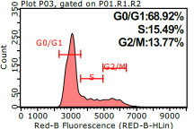
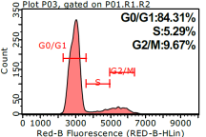
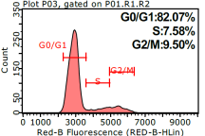
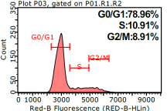
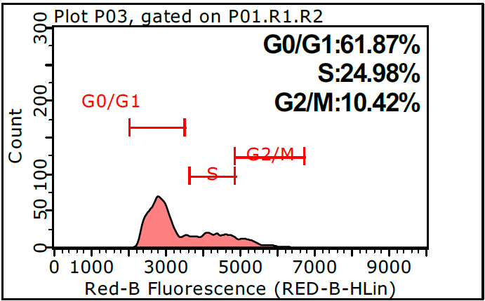
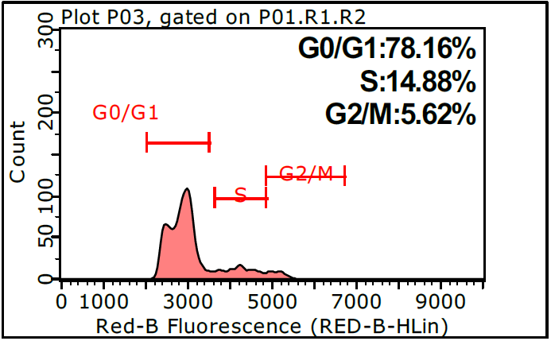
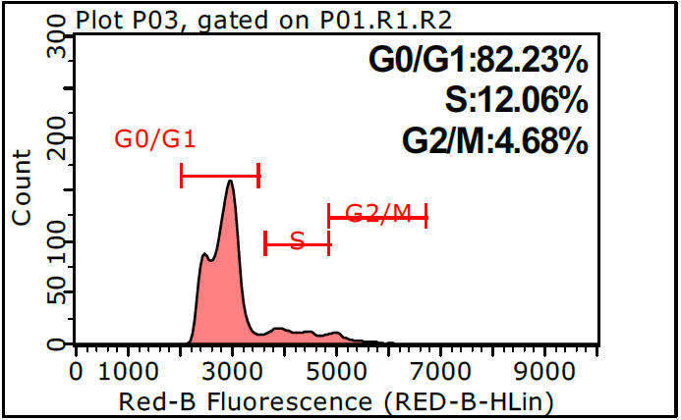
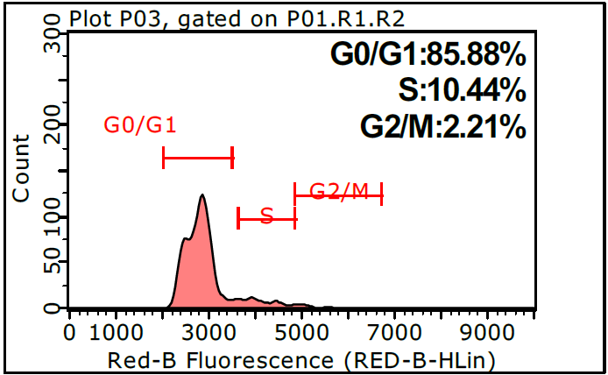
0
4
20
100 nM
MV4-11
EOL-01
Fig S1. GZD824 induces G0/G1 cell cycle arrest and apoptosis in MV4-11 and EOL-01 cells.
GZD824 cells were treated with 4, 20 or 100nM for 24 hrs before DNA labeling by propidium iodide and cell cycle analysis by flow cytometry.

Slide 6
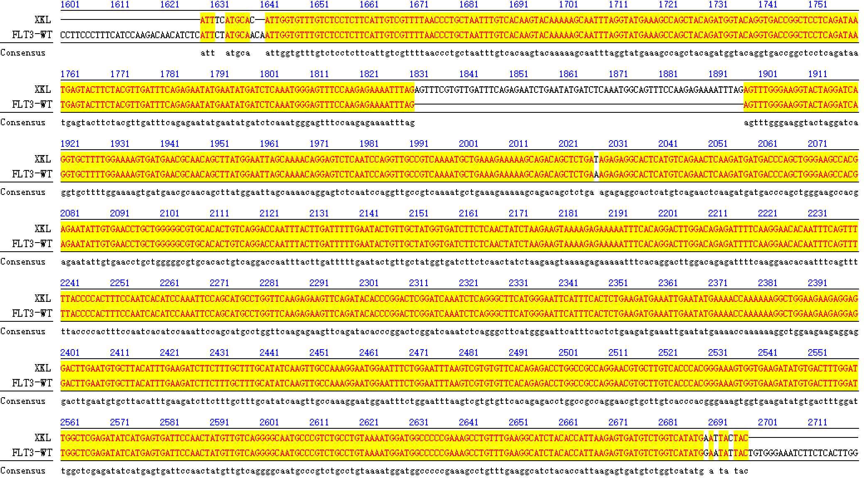
Fig S2. FLT3 gene sequence blast results of primary blood samples from patient 1#
The human primary AML cells were isolated from bone marrow (BM) of patients. Samples were enriched in leukemic cells by performing density-gradient separation to yield a mononuclear fraction according to the guidelines (P8610, Solarbio). Part of the primary cells were extracted RNA by the Trizol method, reverse transcripted to cDNA and the gene sequence of the PCR product was performed to identify gene fusion or mutation.

