Slide 1
Supplementary Figure 1
A
B
C
D
r² = 0.15
Supplementary Figure 1: Summary of neoantigen reactivities
(A) Distribution of patients with different types of GI cancers.
(B) Percentage of patients from whom neoantigen reactive TIL fragments were identified for each type of GI cancer.
(C) Percentage of patients from whom neoantigen reactive TIL fragments were identified recognizing the indicated number of neoantigens in the entire cohort of patients with GI cancers.
(D) For each patient, the number of identified neoantigens was plotted as a function of the number of screened variants, and a linear regression was performed.

Slide 2
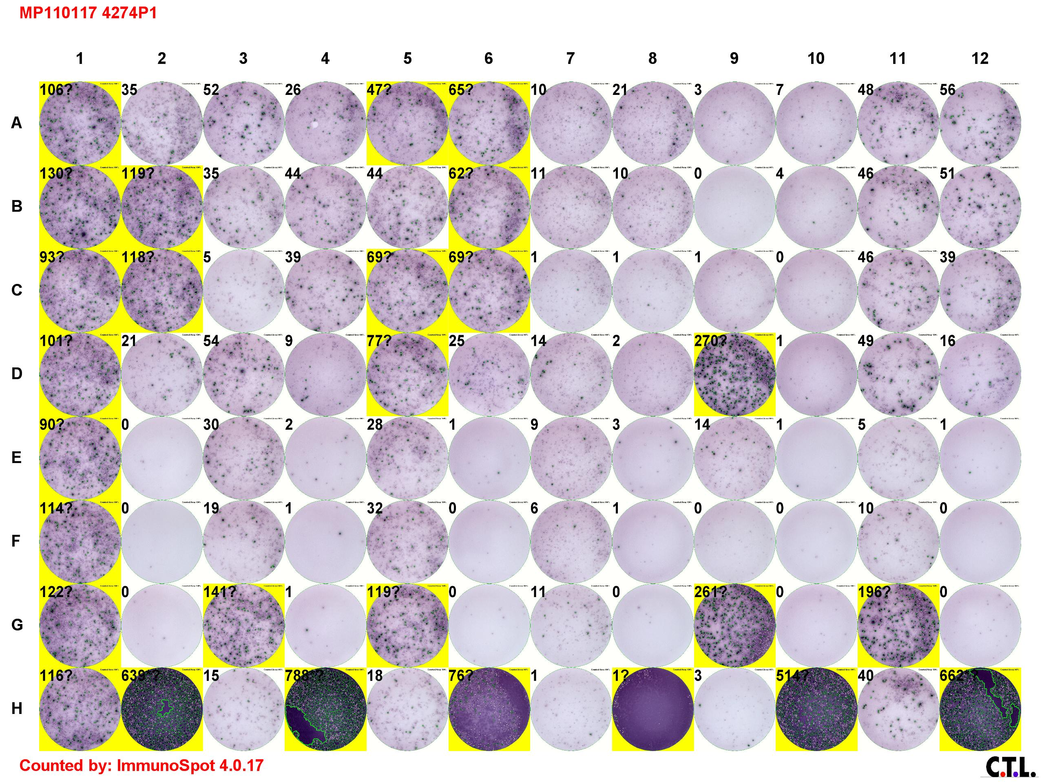
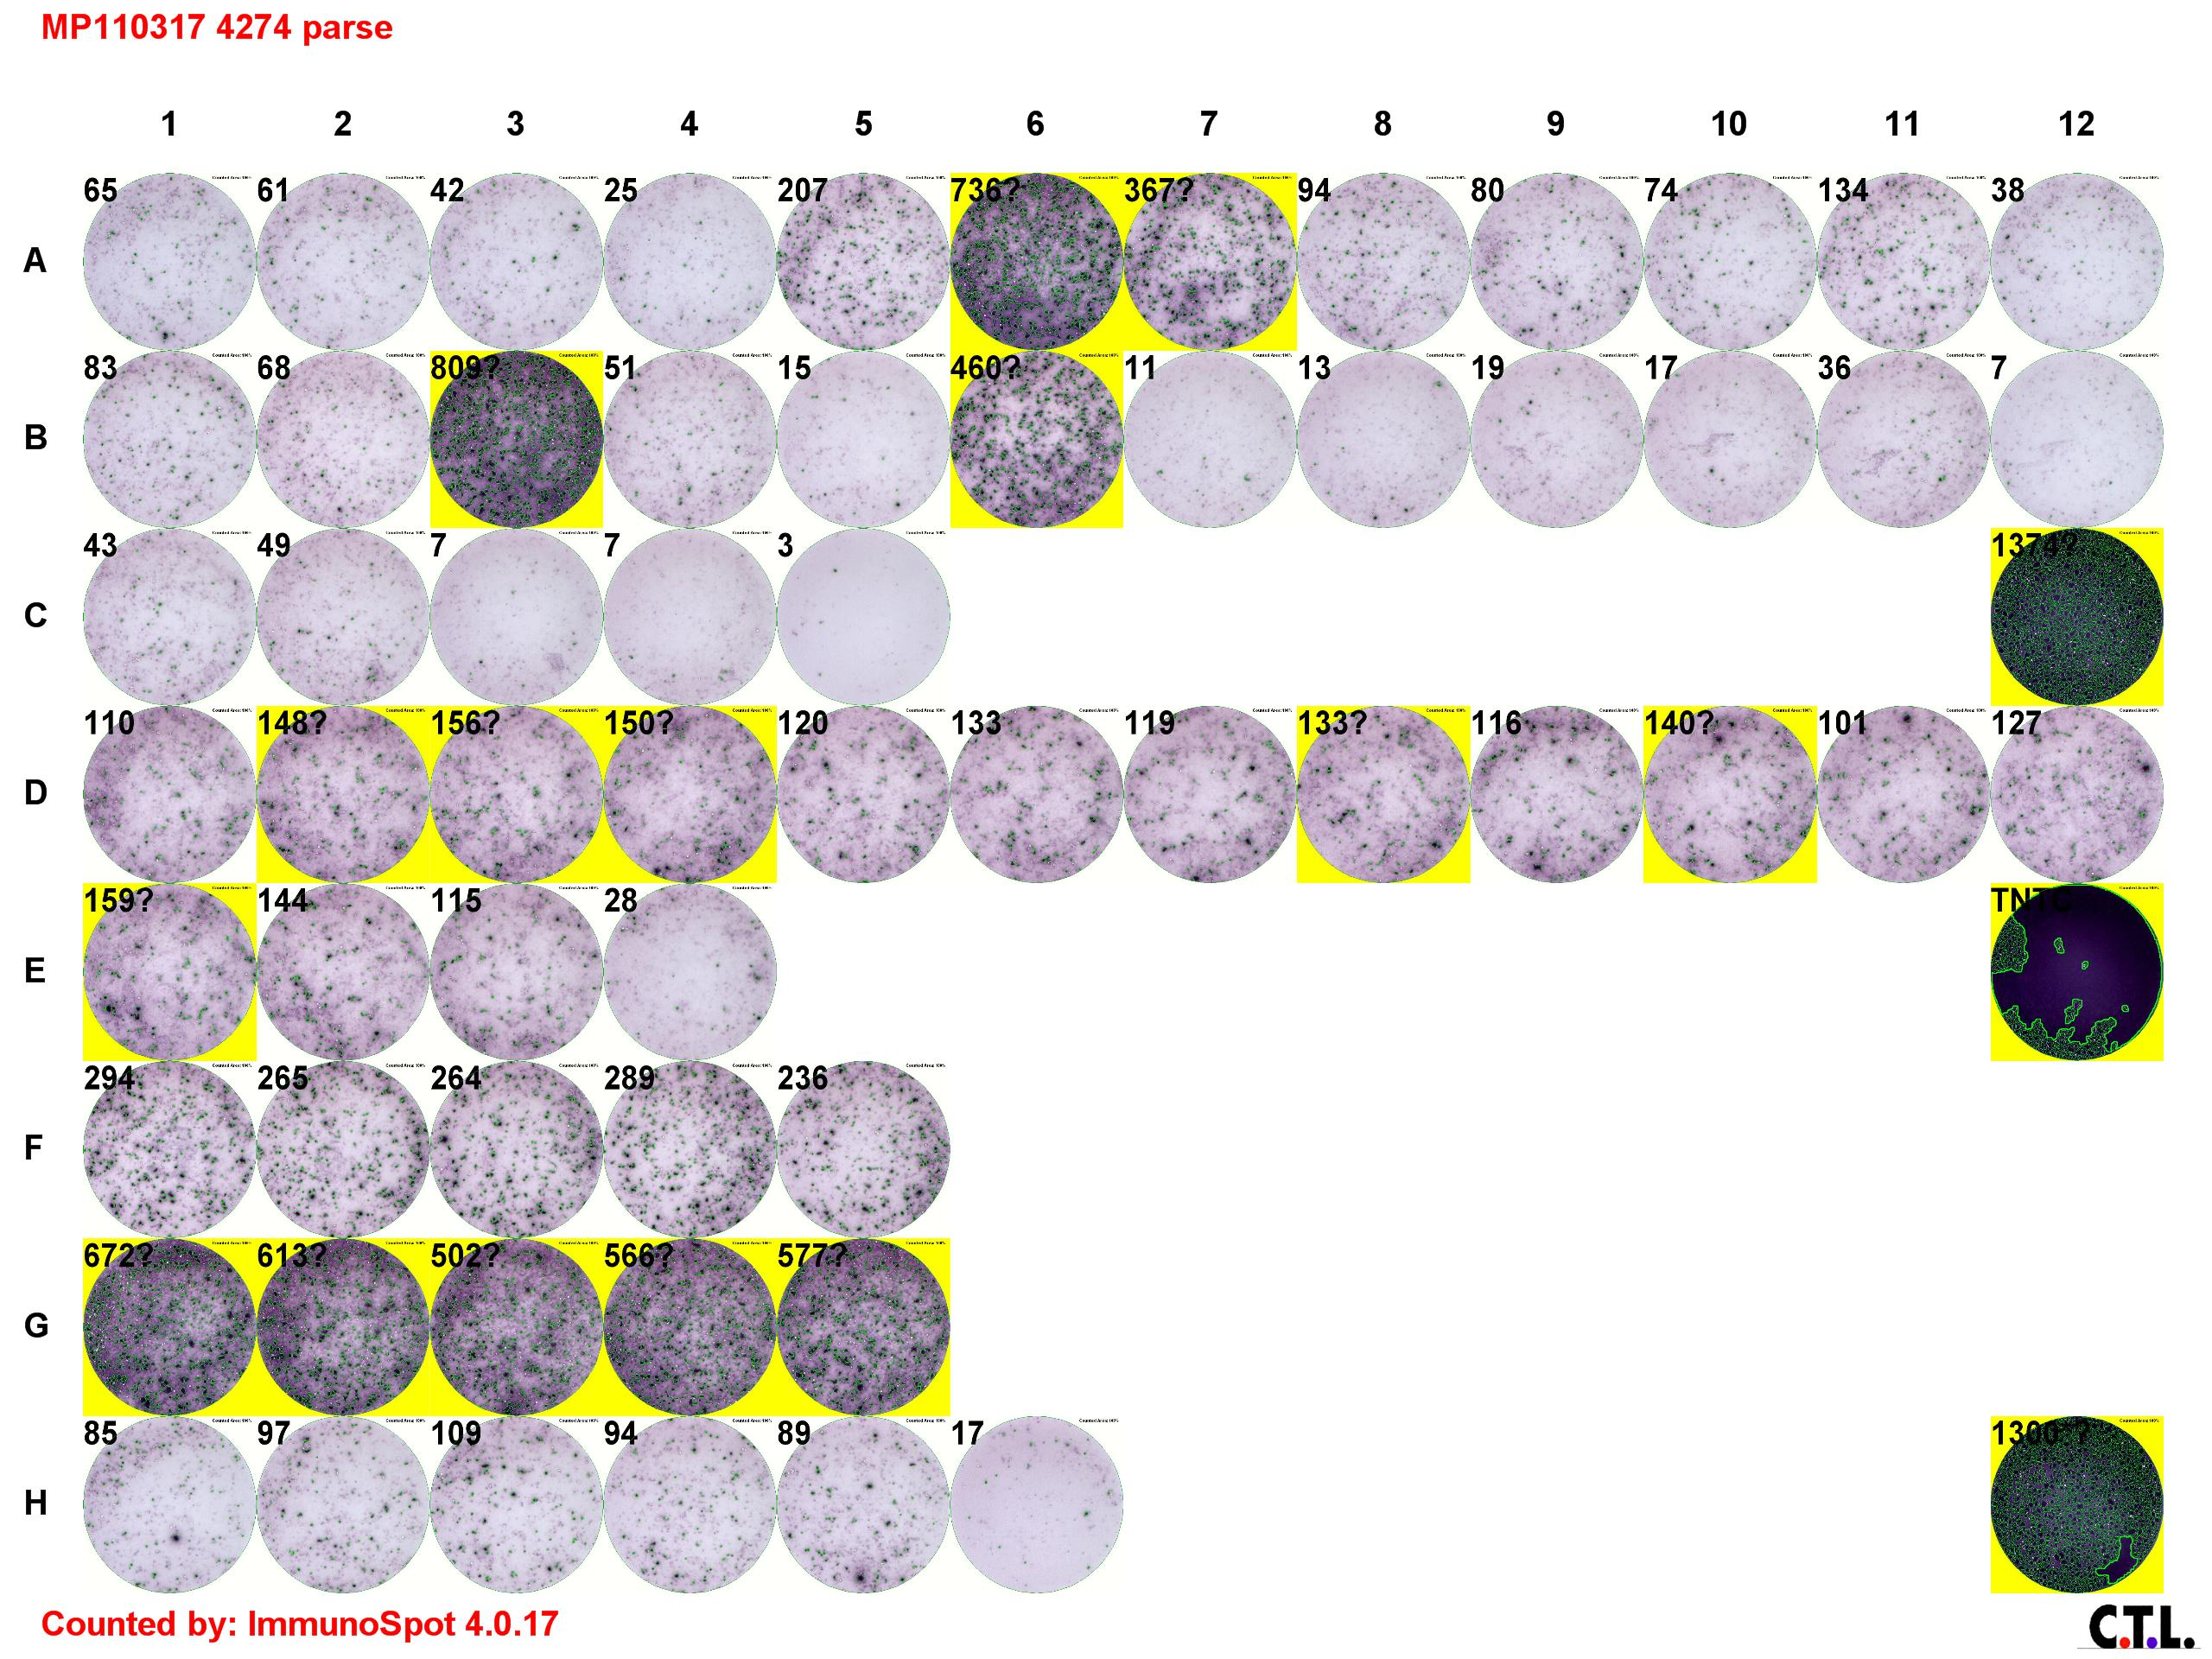
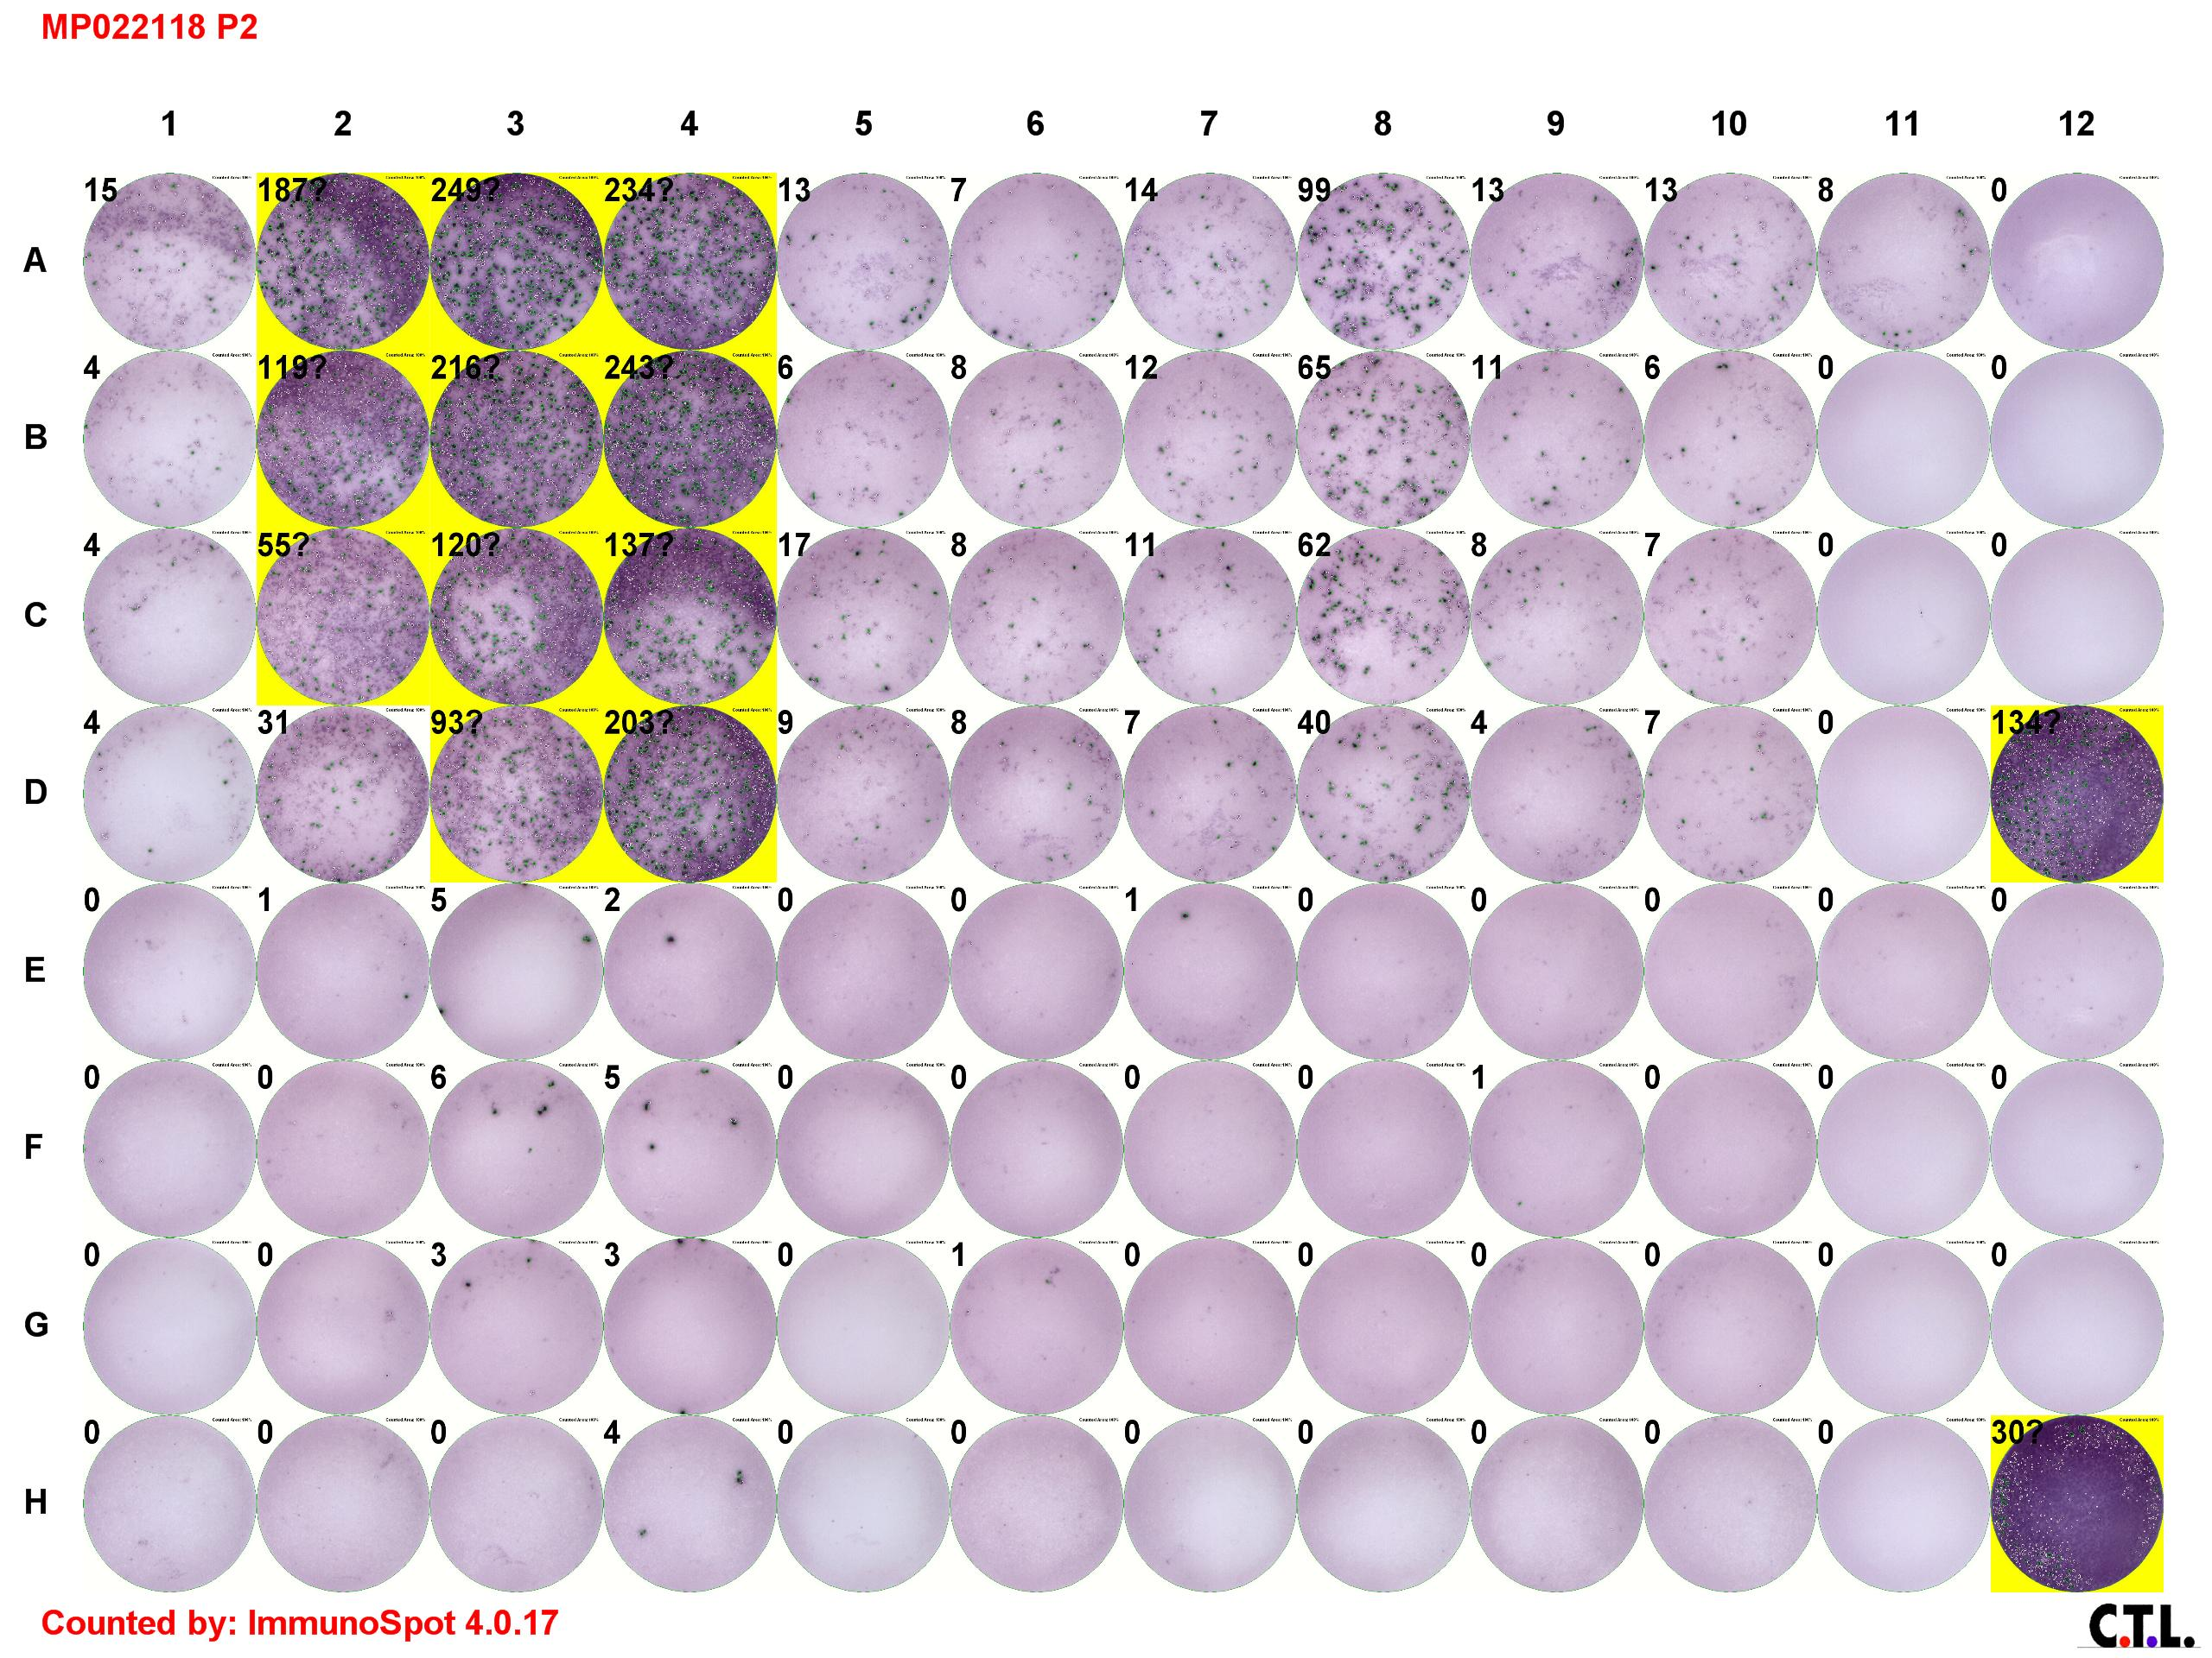
Supplementary Figure 2
A
Patient 4274 F5 preliminary screen: 51.8% CD8, 47.5% CD4
PP7
DMSO
media
%41BB of CD8: 16.2 2.2 1.9
%41BB of CD4: 13.3 2.4 0.2
B
Patient 4274 F5 vs. PP7 peptide parse
TARS
DMSO
media
C
Patient 4274 F5 recognition of mutant TARS with bead separated CD4+ and CD4- T cells
TARS
wt
TARS
mut
TARS
wt
TARS
mut
25 μg/ml
25 μg/ml
1 μg/ml
1 μg/ml
4274 F5 CD4+ (86.7% CD4, 12.6% CD8)
4274 F5 CD4- (0.1 % CD4, 99.7 % CD8)
0.1 μg/ml
0.1 μg/ml
0.01 μg/ml
0.01 μg/ml
Supplementary Figure 2: Example of the “bystander” effect in which specific activation of CD4+ T cells may non-specifically activate CD8+ T cells masking the true reactivity
TIL fragment cultures from patient 4274 were screened for recognition of 8 peptide pools (PPs). In the preliminary screening assay, F5 appeared to recognize PP7 by both IFNγ ELISPOT and 4-1BB assays. However, it appeared as though both CD8+ and CD4+ T cells expressed 4-1BB after stimulation in the preliminary screening assay (A). In the deconvolution assay, we determined F5 recognized mutated TARS (B). To determine if the reactivity was mediated by CD8 or CD4 T cells, we performed a CD4+ cell selection using anti-CD4 coated beads (BD Biosciences) and collected both the CD4+ and CD4- cell fractions. We evaluated recognition of mut and wt TARS 25 mer peptides and determined that only CD4+ T cells mediated recognition of the neoantigen (C).

Slide 3
Supplementary Figure 3
Supplementary Figure 3: Phenotype of TIL fragment cultures.
TIL fragment cultures were established from resected metastatic lesions from 75 patients with GI cancers. Cells were allowed to expand for 2-4 weeks in the presence of 6000 IU/ml IL2. Expression of CD3, CD56, CD8 (gated on CD3+ cells), and CD4 (gated on CD3+ cells) on each individual culture was evaluated by flow cytometry. Each dot represents the median percentage of the indicated phenotypic marker expressed on all fragment cultures from a single patient. Bars on each graph represent the median percentage of the indicated phenotypic marker for all patients within the indicated group and the interquartile range.

Slide 4
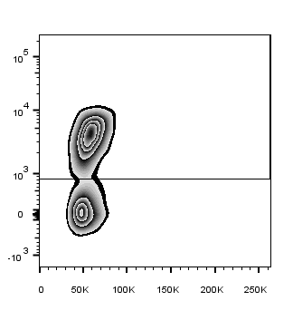
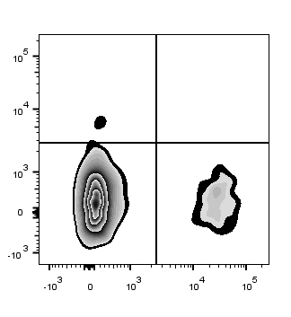
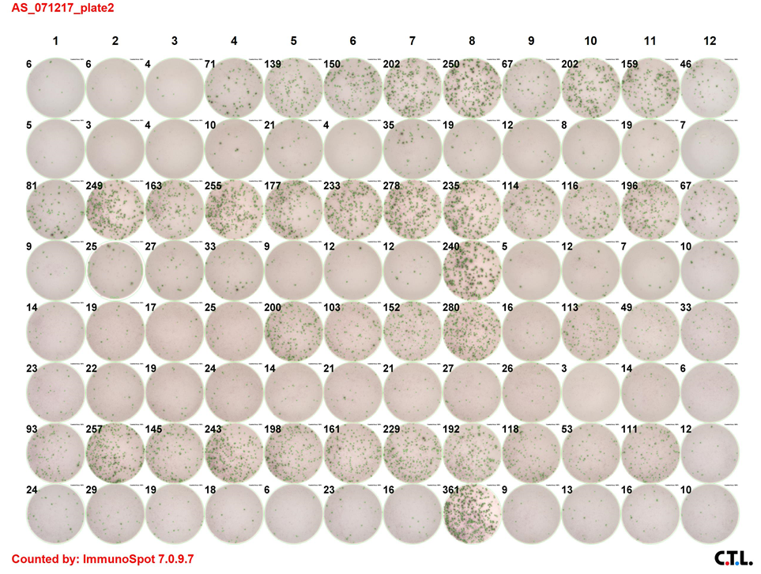
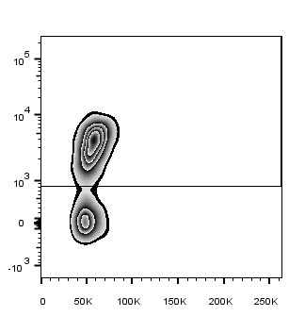
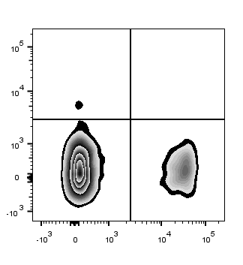
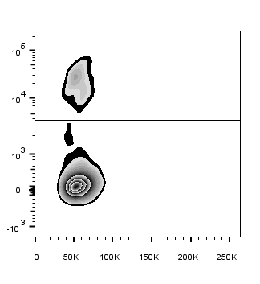
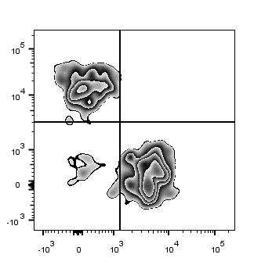
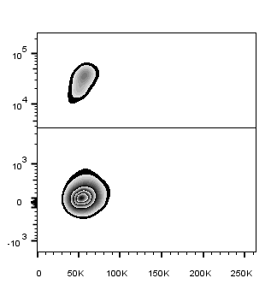
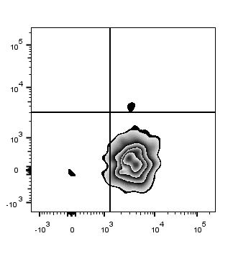
Supplementary Figure 4
A
Patient 4257 TIL F11
66.5%
0.3%
mut NAV2
mut NAV2
anti-CD3*APC-Cy7
anti-4-1BB*APC
4.7%
73.7%
0.1%
irrel. peptide
anti-CD3*APC-Cy7
anti-4-1BB*APC
9.2%
FSC-A
anti-CD4*PE
B
Patient 4257 TIL F11
5.4%
38.0%
0.7%
mut NAV2
anti-4-1BB*APC
anti-CD4*PE
6.3%
55.1%
6.9%
0%
1.5%
irrel. peptide
anti-4-1BB*APC
anti-CD4*PE
2.8%
95.7%
FSC-A
anti-CD3*APC*Cy7
Supplementary Figure 4: Example of loss of CD3 expression after neoantigen stimulation
TIL fragment cultures from patient 4257 were screened for recognition of peptide pools, and F11 appeared to recognize a mutant NAV2 peptide upon deconvolution by ELISPOT by not by our traditional 4-1BB assay in which we first gated on CD3+ T cells and subsequently analyzed 4-1BB expression on CD4+ T cells (A). We reanalyzed the data, gating first on CD4+ T cells and subsequently analyzed 4-1BB expression on CD3+ T cells and found that 38% of the CD4+ cells expressed 4-1BB in response to the relevant peptide, but those cells did not express CD3 (B).

Slide 5
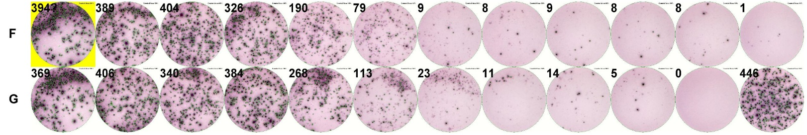
Supplementary Figure 5
Recognition of peptide pools 15 and 16 by F24 from patient 4252
A
Peptide concentration (μg/ml)
10¹
10⁰
10⁻¹
10⁻²
10⁻³
10⁻⁴
10⁻⁵
10⁻⁶
10⁻⁷
10⁻⁸
PP15
DMSO
media
PP16
X
PMA/Io
B
C
Supplementary Figure 5: Use of high peptide concentrations in screening assays may misrepresent percentages of reactive T cells by 4-1BB analysis
TIL fragment cultures from patient 4252 were screened for recognition of 16 peptide pools (PPs) encompassing 254 variant transcripts. In the preliminary screening assay, F24 appeared to recognize PPs 15 and 16 by IFNγ ELISPOT assay, but percentages of 4-1BB+ T cells were not above background. In a subsequent assay, we evaluated recognition of additional dilutions of the PPs, and T cell responses were measured by IFNγ ELISPOT (A) and flow cytometric analysis of 4-1BB on CD4+ T cells (C). We also evaluated the overall percentages of CD4+ T cells in the cocultures (B). Peptide concentrations are the estimated concentrations of any one peptide within the pool. There were fewer CD4+ T cells when high concentrations of peptide were used. For 4-1BB analyses, the optimal individual peptide concentration was 0.01 μg/ml for PP15 and 0.0001 μg/ml for PP16.

Slide 6
Supplementary Figure 6
Supplementary Figure 6: Number of neoantigens identified by screening both TMGs and PPs.
We screened 62 patients for neoantigen reactive TIL using both TMGs and PPs. From these patients we identified 55 CD4 epitopes and 43 CD8 neoantigens that were included in both TMGs and PPs in the original screening. This graph represents the numbers of CD4 and CD8 neoantigens that were originally detected using both TMG and PP formats or using TMG or PP formats alone in the preliminary screening assays. 26 (47%) of the CD4 neoantigens and 28 (65%) of the CD8 neoantigens were recognized in both TMG and PP formats. 28 (51%) of the CD4 neoantigens were only detected using PPs, and 10 (23%) of the CD8 neoantigens were only detected using TMGs in the preliminary screening assays. In subsequent assays, individual 25 amino acid peptides were pulsed onto autologous DCs at ~10-20 fold higher concentrations than in the original screening assays, and all neoantigens could be detected, including the CD8 neoantigens that were only detected using TMGs in the preliminary screening assays.

Slide 7
Supplementary Figure 7
A
Patient 3971 TIL F2
B
pre-REP d18
pre-REP d31
post-REP d14
%TMG1 reactive
cells (of total CD3):
~30.9%
~2.5%
Not Detected
Supplementary Figure 7: TIL composition can change over time, and mutation reactive T cells may only be present at low frequency in the expanded cell product.
As previously reported, T cells from F2 of a patient with metastatic colorectal cancer (3971) specifically recognized mutated CASP8, encoded by TMG1 (Tran et al. Science. 2015). This fragment was cultured in vitro for 29 days and cryopreserved. It was later thawed and cultured for 2 additional days (pre-REP d31) at which point it was put into a rapid expansion protocol (REP) with irradiated PBMC feeder cells, anti-CD3 (OKT3), and IL2 and allowed to expand for 14 days (post-REP d14). (A) The percentages of CD8+ and CD4+ T cells in F2 were measured by flow cytometry after gating for live CD3+ T cells at the indicated time points. (B) F2 was cocultured ~20 hours with autologous DCs electroporated with TMG1 at the indicated time points, and 41BB expression on CD8+ T cells was measured by flow cytometry. To estimate the percent of TMG1 reactive T cells at each time point, the background %41BB+ (of CD8+ T cells) was subtracted from that in response to TMG1, and that percentage was multiplied by the %CD8+ T cells.

Slide 8
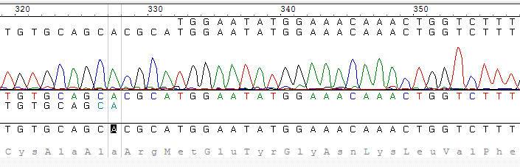
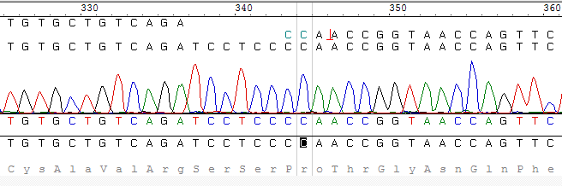
Supplementary Figure 8
Published TRAJ47 sequence
A
TRAV25 sequence
Published TRAV25
Consensus sequence
CDR3 translation
B
Published TRAJ49 sequence
Published TRAV41
TRAV41 sequence
Consensus sequence
CDR3 translation

Slide 9
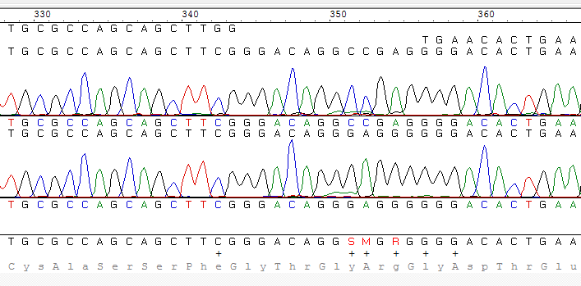
Supplementary Figure 8 (continued)
C
Published TRBV5-1 sequence
Published TRBJ1-1 sequence
TRBV5-1 sequence paired with TRAV41
TRBV5-1 sequence paired with TRAV25
Consensus sequence
CDR3 translation
Supplementary Figure 8: Nucleotide sequences of 1α1 and 1α2 TCRs from patient 4289
From patient 4289, we identified 3 TCRs that specifically mediated recognition of mutated, but not wild-type RAD21 (Fig. 2D). Interestingly, the β chains of the 2 TCRs with the highest avidities were identical in terms of amino acid sequence (Fig. 2C). (A) Nucleotide sequence of the CDR3 region for the TRAV25 sequence with CDR3 CAARMEYGNKLVF aligned with published TRAV25 and TRAJ47 sequences. (B) Nucleotide sequence of the CDR3 region for the TRAV41 sequence with CDR3 CAVRSSPTGNQFYF aligned with published TRAV41 and TRAJ49 sequences. (C) Partial nucleotide sequences of the CDR3 regions for the two TRBV5-1 sequences with CDR3 CASSFGTGRGDTEAFF aligned with published TRBV5-1 and TRBJ1-1 sequences indicating that the CDR3 regions were slightly different, containing 3 silent base pair differences noted in the red boxes.

Slide 10
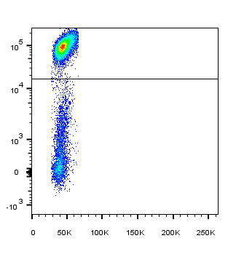
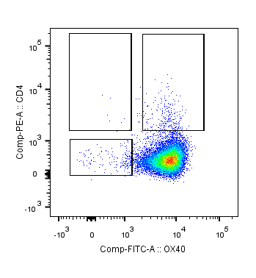
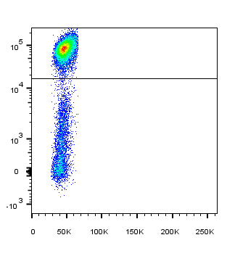
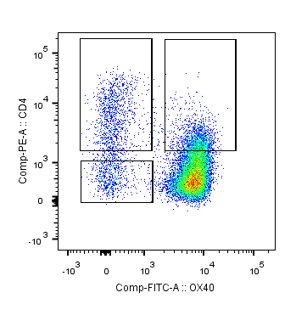
Supplementary Figure 9
A
Patient 4257 TIL vs. mut NAV2
83.2%
0.0%
1.4%
DMSO
4-1BB PE
CD4 APC
0.8%
80.5%
7.4%
12.8%
mut NAV2
4-1BB PE
CD4 APC
3.9%
FSC-A
CD3 FITC
B
4-1BB+ CD3-: 20 productive in-frame α/β combinations:
9 TRBV30 CAWSAQTSGGHYNEQFF / TRAV12 CVVSGYDYKLSF (TCR1)
5 TRBV15 CATSREVSHTIYF / TRAV9 CALSEQTGANNLFF (TCR2)
4-1BB- CD3-: 8 productive in-frame α/β combinations:
4 TRBV30 CAWSAQTSGGHYNEQFF / TRAV12 CVVSGYDYKLSF (TCR1)
4-1BB+ CD3+: 24 productive in-frame α/β combinations:
11 TRBV3 CASSHLAVDTQYF / TRAV41 RGGGADGLTF (TCR3)
5 TRBV3 CASSHLAVDTQYF / TRAV36/DV7 CAAHNTNAGKSTF (TRCR4)
2 TRBV28 CASSGYRVGYEQYF / TRAV13 CAEPPERGRRALTF (TCR5)
C

Slide 11
Supplementary Figure 9: Identification of neoantigen reactive TCRs from a patient with colon cancer (4257)
TIL fragment cultures from patient 4257 were screened for recognition of peptide pools and some were found to recognize a mutant NAV2 peptide. In order to identify neoantigen reactive TCRs, we first gated on CD4+ T cells and subsequently analyzed 4-1BB expression on CD3+ T cells after stimulation with the mutant NAV2 peptide compared to DMSO as a negative control. We sorted 48 single cells into 96 well plates and performed single cell RT-PCR on the contents of each well to amplify TCR α and β chains from the following three different populations: CD3- 4-1BB+, CD3- 4-1BB-, and CD3+ 4-1BB+ (A). We identified the most dominant TCR α and β chains and constructed retroviral vectors encoding these (B). Allogeneic open-repertoire PBL were genetically modified via retroviral transduction to express these TCRs and were then co-cultured overnight with DCs pulsed with titrated amounts of the wild type and mutant peptides. T cell responses were measured by IFNγ ELISA (C). Only TCRs #1 and #2, derived from the CD3- cell populations mediated specific recognition of the mutant peptide. TCRs 3, 4, and 5 showed no peptide recognition (data not shown since all IFNγ levels were zero).

