Slide 1
Online resource, Supplementary figures for ”Novel hemizygous IL2RG p.(Pro58Ser) mutation impairs IL-2 receptor complex expression on lymphocytes causing X-linked combined immunodeficiency” in Journal of Clinical Immunology
Elina A. Tuovinen^{1,2,3}, Juha Grönholm^{*2,3}, Tiina Öhman⁴, Sakari Pöysti⁵, Raine Toivonen⁵, Anna Kreutzman^{2,6}, Kaarina Heiskanen³, Luca Trotta⁷, Sanna Toiviainen-Salo⁸, John M. Routes⁹, James Verbsky⁹, Satu Mustjoki^{2,6,10}, Janna Saarela^{7,11,12}, Juha Kere^{1,13,14}, Markku Varjosalo⁴, Arno Hänninen⁵, Mikko R.J. Seppänen^{2,3}
1Folkhälsan Research Center, Helsinki, Finland; 2Translational Immunology Research Program, University of Helsinki, Helsinki, Finland; 3Rare Diseases Center and Pediatric Research Center, New Children´s Hospital, University of Helsinki and HUS Helsinki University Hospital, Helsinki, Finland; 4Systems Biology Research Group and Proteomics Unit, Institute of Biotechnology, HiLIFE, University of Helsinki, Helsinki, Finland; 5Department of Clinical Microbiology and Immunology, Turku University Hospital and Institute of Biomedicine, University of Turku; Turku, Finland; 6Hematology Research Unit Helsinki, Helsinki University Hospital Comprehensive Cancer Center, Helsinki, Finland; 7Institute for Molecular Medicine Finland, HiLIFE, University of Helsinki, Helsinki, Finland; 8Department of Pediatric Radiology, HUS Medical Imaging Center, Radiology, University of Helsinki and HUS Helsinki University Hospital, Finland; 9Division of Pediatric Rheumatology, Department of Pediatrics, Medical College of Wisconsin, Milwaukee, WI, United States.; 10Department of Clinical Chemistry and Hematology, University of Helsinki, Helsinki, Finland; 11Department of Medical Genetics, Helsinki Central University Hospital, Helsinki, Finland; 12Centre for Molecular Medicine Norway, University of Oslo, Oslo, Norway; 13Department of Biosciences and Nutrition, Karolinska Institutet, Stockholm, Sweden; 14Stem Cells and Metabolism Research Program, University of Helsinki
*Correspondence: Juha Grönholm, Room C412a, Biomedicum 1, Haartmaninkatu 8, 00290 Helsinki, juha.gronholm@helsinki.fi, Tel: +358294125104

Slide 2
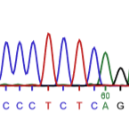
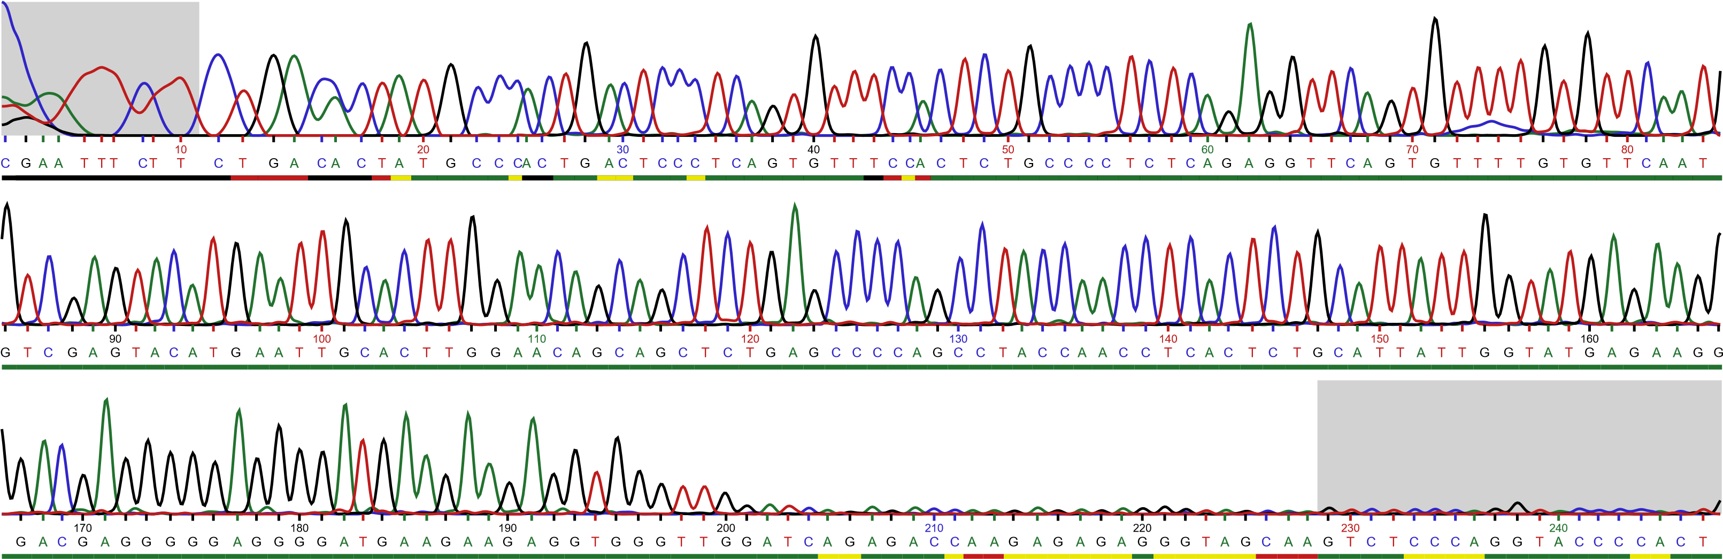
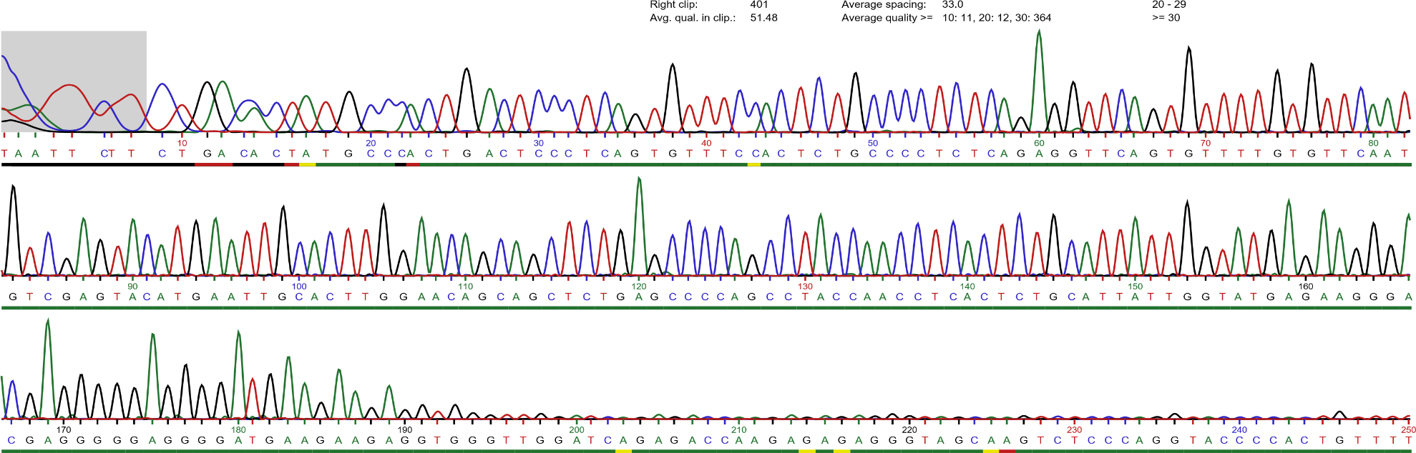
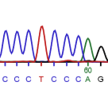
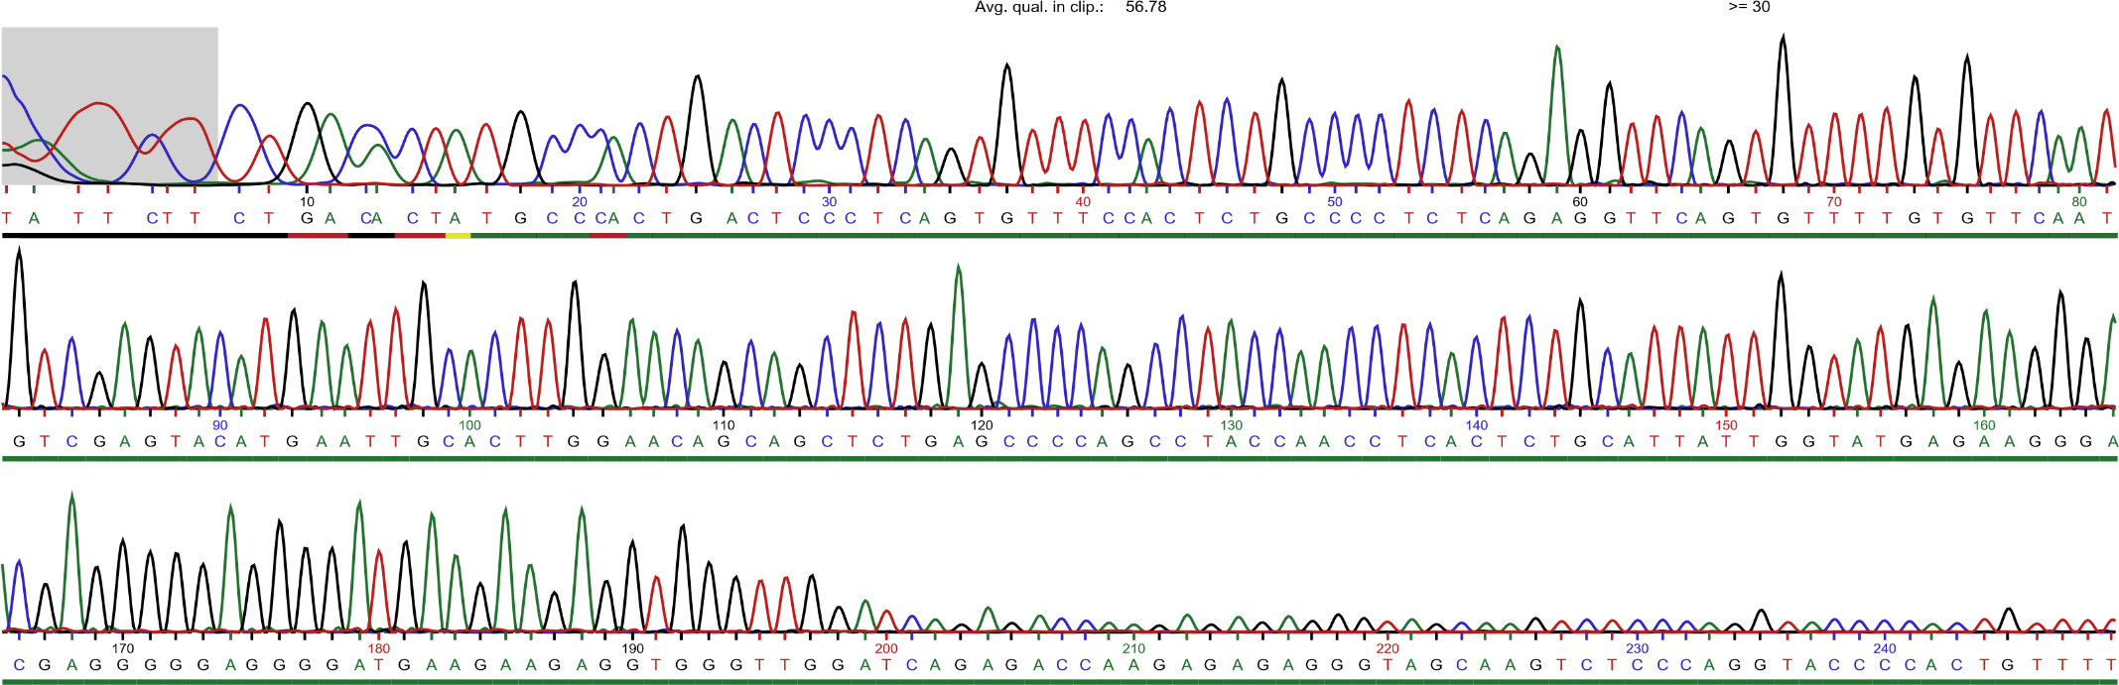
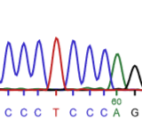
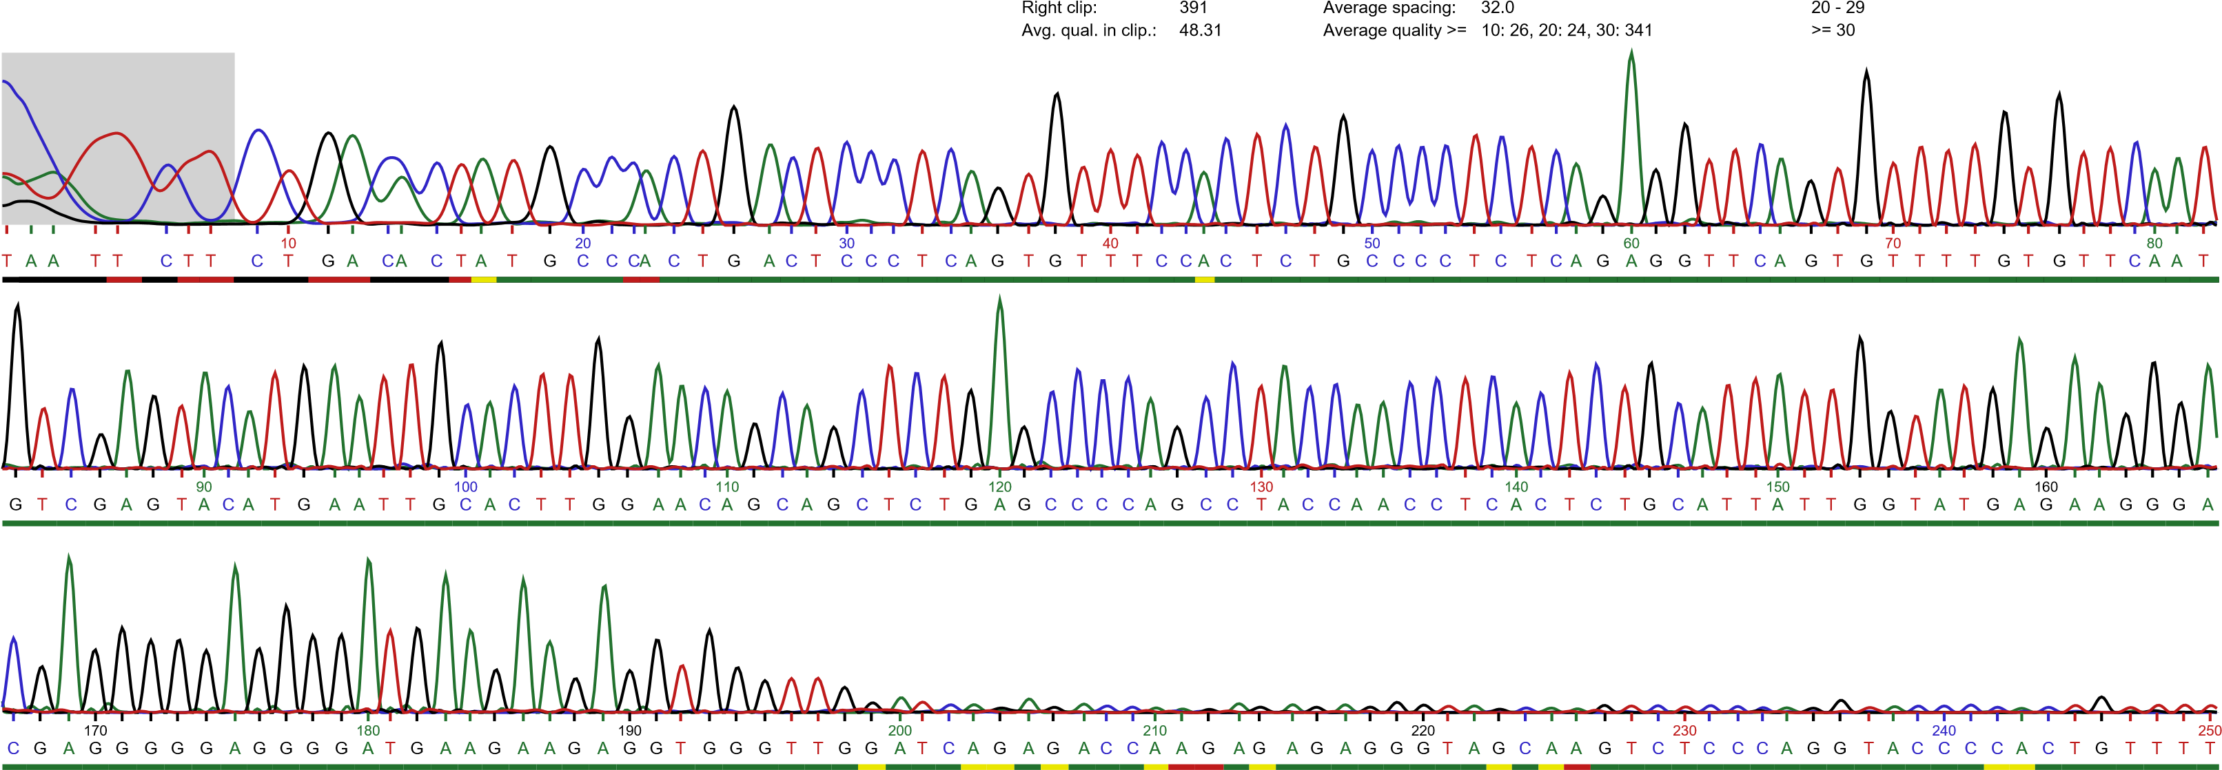
Fig.S1
a
b
Patient
CD4+
Mother
CD8+
Father
CD19+
CD56+

Slide 3
Fig.S2
**
ns

Slide 4
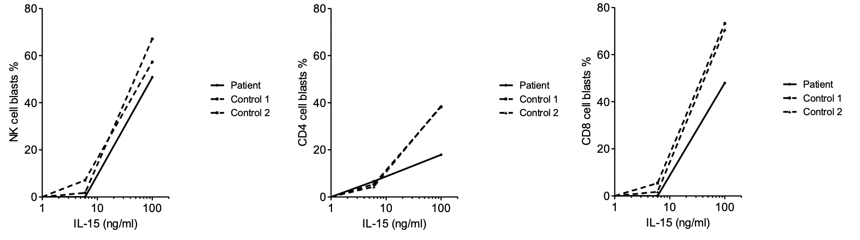
Fig.S3
a
b
c

Slide 5
Fig.S4

