Slide 1
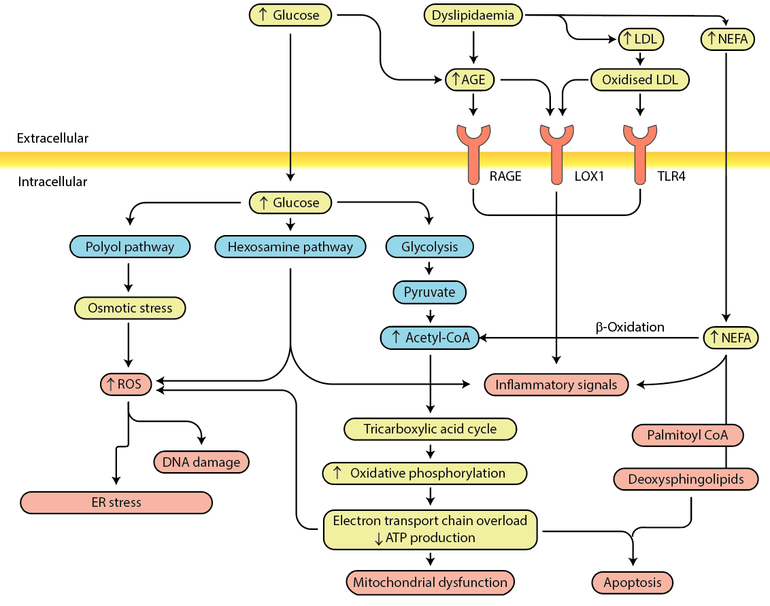
Diabetic neuropathy pathogenesis
Callaghan et al (2020) Diabetologia DOI 10.1007/s00125-020-05085-9
©2019, Springer Nature. Adapted from Feldman et al with permission

