Slide 1
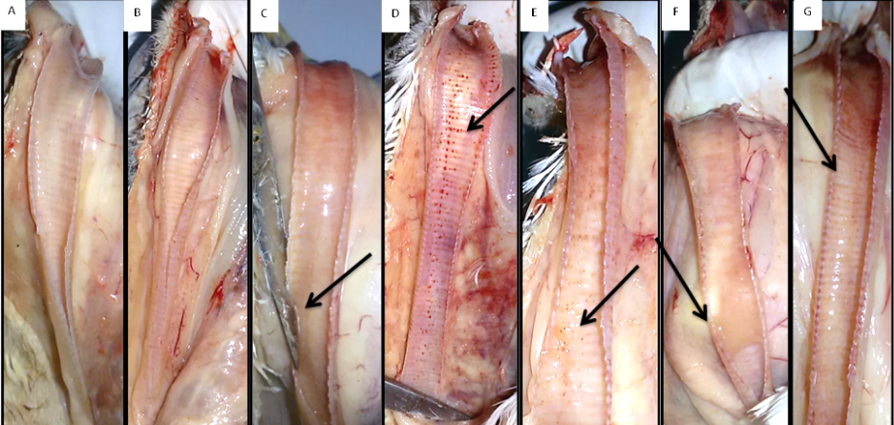
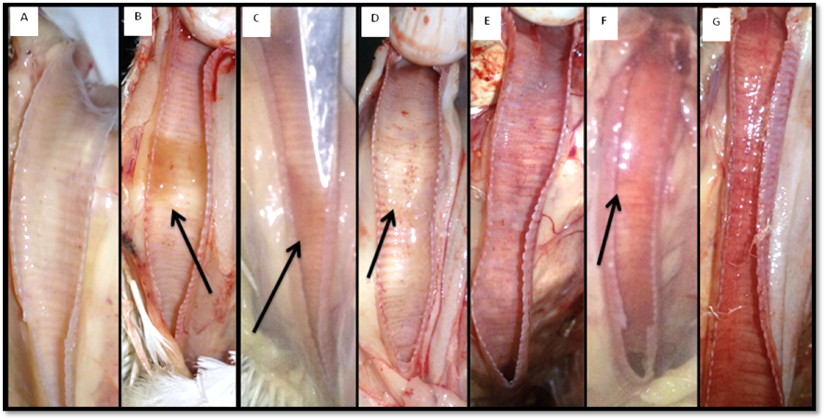
Supplementary figure 1: Tracheal lesions in control and challenged broiler chicks. At 2 DPI, Negative control (A) and variant IBV infected group (B), slight mucous in trachea of birds challenged classical IBV (C), petechial hemorrhage in trachea of birds with AIV-H9N2 (D), AIV-H9N2 and variant IBV (E), AIV-H9N2 and classical IBV (F), and AIV-H9N2 and vaccine IBV (G) infections. At 7 DPI, Negative control group (H), mucous in trachea of challenged variant IBV group (I) and classical IBV group (J), petechial hemorrhage in trachea of challenged AIV-H9N2 group (K), severe congestion in the trachea of challenged AIV-H9N2 and variant IBV (L) AIV-H9N2 and classical IBV (M) and AIV-H9N2 and IBV vaccine (N) groups .
A
B
C
D
E
F
G
H
I
J
K
L
M
N

