Slide 1
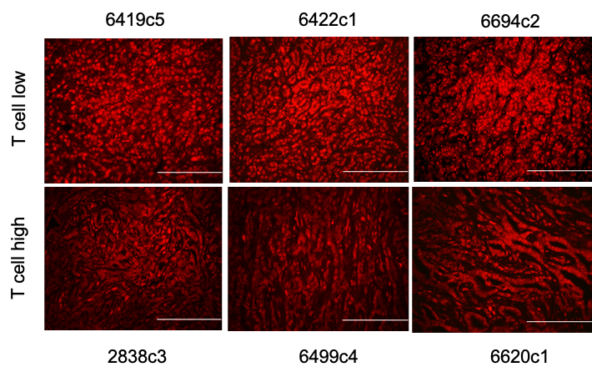
A
B
C
D
E
F
G
H
I
J
K
L
Supplementary Figure 1. Deletion of USP22 in tumor cells increases T cell infiltration and decreases myeloid cell infiltration.

Slide 2
A
B
C
D
E
Supplementary Figure 2. USP22 loss promotes anti-tumor immunity in orthotopic PDA tumors and suppresses lung metastasis.

Slide 3
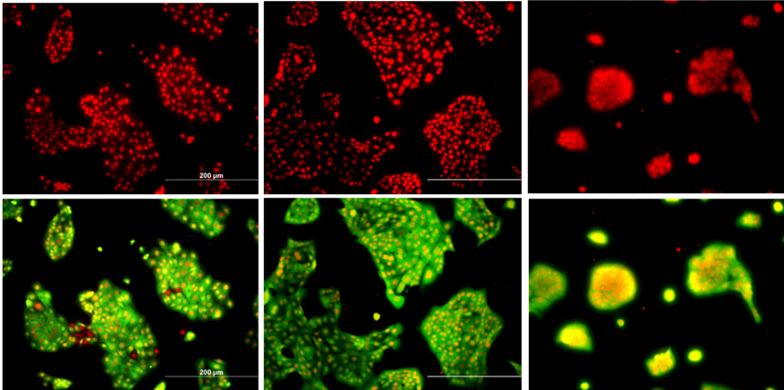
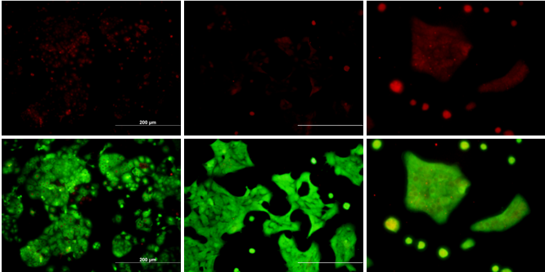
A
6419c5
6422c1
6694c2
WT cells
YFP USP22
Usp22-KO cells
B
C
D
E
Supplementary Figure 3. Knockdown of ATXN7L3 in tumor cells increases T cell infiltration and decreases myeloid cell infiltration.

Slide 4
A
B
C
D
E
F
Supplementary Figure 4. USP22 loss leads to transcriptional reprogramming of tumor cells.

