Slide 1
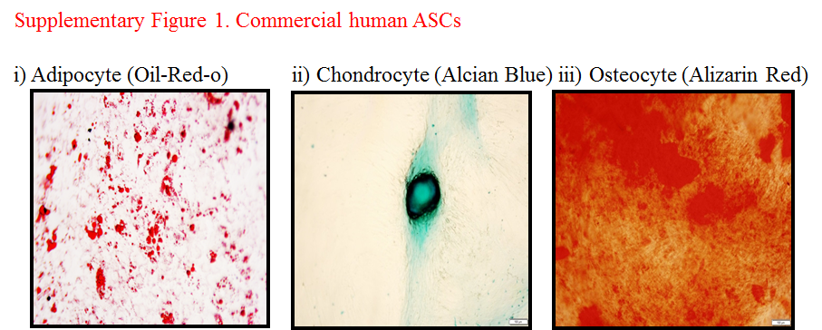
Supplementary Figure 1. Commercial human ASCs differentiated into different lineages

