Slide 1




Reducing motion-correction-induced variability in ⁸²rubidium myocardial blood flow quantification
Journal of Nuclear Cardiology | Official Journal of the American Society of Nuclear Cardiology
  Alexis Poitrasson-Rivière, PhD (1); Jonathan B. Moody, PhD (1); Tomoe Hagio, PhD (1); Richard L. Weinberg, MD, PhD (2); James R. Corbett, MD (2); Venkatesh L. Murthy, MD, PhD* (2); Edward P. Ficaro, PhD* (1)
  (1) INVIA Medical Imaging Solutions, Ann Arbor, MI;
  (2) Frankel Cardiovascular Center, University of Michigan, Ann Arbor, MI
Copyright American Society of Nuclear Cardiology

Slide 2
BACKGROUND
Journal of Nuclear Cardiology | Official Journal of the American Society of Nuclear Cardiology
1- MBF and MFR are increasingly used to improve diagnostic and prognostic assessment in patients with known or suspected CAD
2- Motion affects MBF and MFR values and should be corrected to obtain maximally accurate results
3- Manual motion correction may decrease precision due to inter-user variability.
4- An automatic motion correction algorithm is investigated to reduce user-related variability
Copyright American Society of Nuclear Cardiology

Slide 3
METHODS
Journal of Nuclear Cardiology | Official Journal of the American Society of Nuclear Cardiology
Study type: Blinded Randomized Controlled Trial on the use of automatic dynamic motion correction to reduce inter-user variability
Study subjects: 100 randomly selected patients processed twice (with and without automatic correction) by two technologists with no exclusions.
Study endpoints:
  Primary end point: Inter-user variability in MBF and MFR quantifications
  Secondary end point: Amount of motion-correction and time spent processing by the technologists
Copyright American Society of Nuclear Cardiology

Slide 4
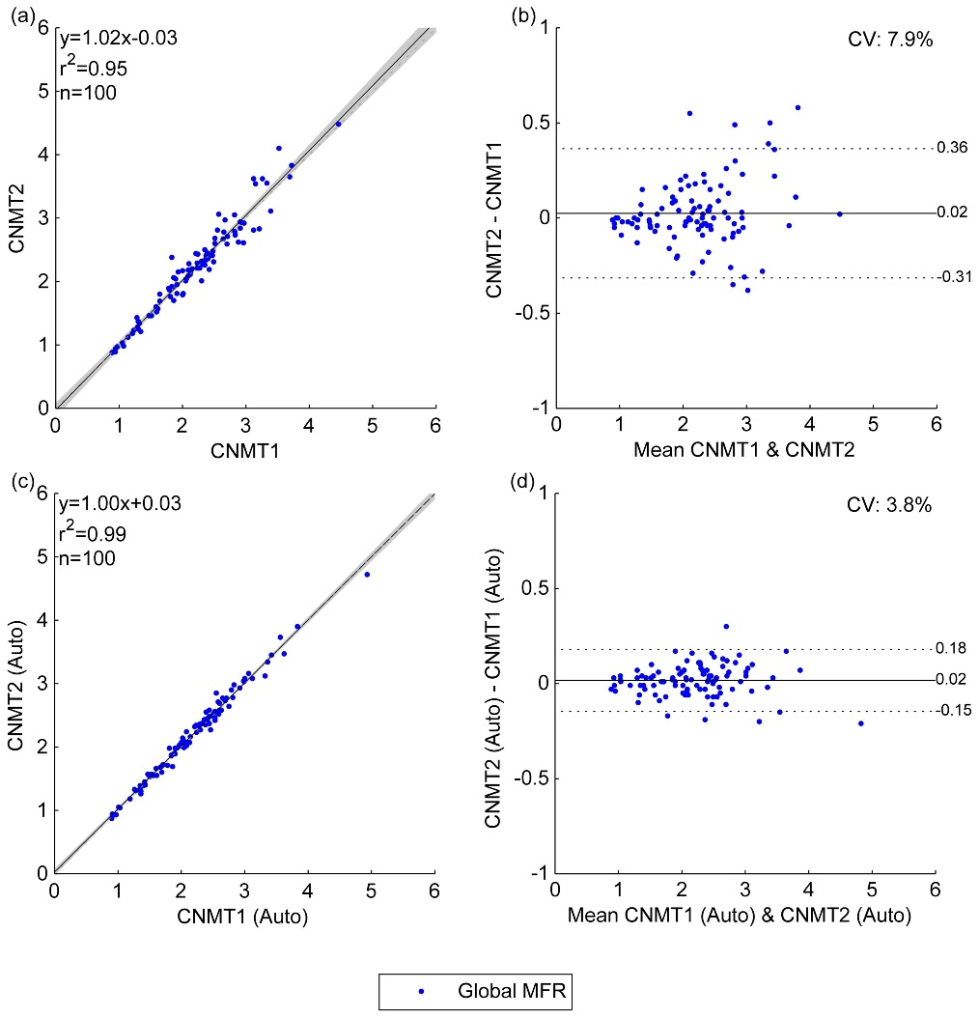
RESULTS
Journal of Nuclear Cardiology | Official Journal of the American Society of Nuclear Cardiology
Figure: Global MFR correlations between manual motion correction of uncorrected studies (a and b) and manual adjustments of automatic motion correction (c and d) from the two technologists. The shaded area on the correlation plots shows the 95% confidence interval of the linear regression.
Summary of the correlation parameters between both technologists (N = 100)
 |  | Manual | Adjusted Auto | p-Value
Global MBF | R | 0.993 | 0.997 | < 0.0001
 | LOA | -0.22 0.22 | -0.12 0.15 | 0.002
Global MFR | r | 0.973 | 0.993 | < 0.0001
 | LOA | -0.31 0.36 | -0.15 0.18 | < 0.0001
Vascular MBF | r | 0.990 | 0.996 | < 0.0001
 | LOA | -0.29 0.28 | -0.15 0.18 | < 0.0001
Vascular MFR | r | 0.960 | 0.989 | < 0.0001
 | LOA | -0.38 0.43 | -0.19 0.22 | < 0.0001
Copyright American Society of Nuclear Cardiology

Slide 5
RESULTS
Journal of Nuclear Cardiology | Official Journal of the American Society of Nuclear Cardiology
Number of frames shifted by more than 3 mm by the technologists
 |  | Blood Pool Phase |  |  | Tissue Phase
 |  | Manual | Auto | p-Value | Manual | Auto | p-Value
Rest | CNMT1 | 3.95 ± 3.13 | 2.17 ± 2.31 | <0.0001 | 0.42 ± 1.33 | 0.44 ± 1.53 | 0.80
 | CNMT2 | 4.13 ± 3.71 | 1.49 ± 2.68 | <0.0001 | 1.48 ± 3.08 | 1.50 ± 3.23 | 0.87
Stress | CNMT1 | 5.27 ± 3.93 | 2.10 ± 2.68 | <0.0001 | 0.72 ± 1.58 | 0.40 ± 1.61 | 0.01
 | CNMT2 | 6.89 ± 5.26 | 1.92 ± 3.19 | <0.0001 | 1.95 ± 3.30 | 1.32 ± 2.96 | 0.002
Average time to correct for motion, in minutes:seconds, for the two technologists
 | Manual Motion Correction | Manual Adjustment of Automatic Motion Correction | p-Value
Combined | 5:21 ± 3:12 | 4:21 ± 1:58 | 0.001
CNMT 1 | 5:01 ± 4:21 | 4:03 ± 1:48 | 0.08
CNMT 2 | 5:35 ± 1:49 | 4:30 ± 1:45 | 0.0001
Copyright American Society of Nuclear Cardiology

Slide 6
CONCLUSIONS
Journal of Nuclear Cardiology | Official Journal of the American Society of Nuclear Cardiology
1- A randomized controlled trial was performed to analyze the effect of automatic motion correction on the variability in dynamic motion correction between users
2- The results demonstrate significant improvement in limits of agreement between the two users
3- The use of the algorithm also results in a modest reduction in processing time
4- The algorithm can also be used with no user input to remove user variability while maintaining accurate quantification of MBF and MFR
Copyright American Society of Nuclear Cardiology

