Slide 1
Infective Endocarditis of an Asymptomatic Congenital Aorta-Right Atrial Tunnel: A Case Report
October 2019
EHJ-CR-D-19-00522R1

Slide 2
Introduction
Aorto-Right Atrial Tunnel (ARAT), firstly described in 1980 by Coto et al. (1), is a rare congenital anomaly characterized by an extracardiac tunnel-like vascular communication arising from any of the aortic sinuses and emptying into the right atrium (RA) (2-5).
The etiology is unknown; one hypothesized mechanism is a congenital deficiency of the elastic lamina in aortic media which gradually enlarges under the influence of high aortic pressure to form an extracardiac tunnel.
We report a case of an asymptomatic ARAT complicated by infective endocarditis (IE), diagnosed by noninvansive multimodality imaging and successfully treated with a catheter-based approach.

Slide 3
Case Presentation
History and Examination Findings
A 23-year-old male patient was admitted for a month-long fever, weight loss, mild cough and dyspnea.
A continuous murmur was heard since childhood.
Otherwise past medical history was unremarkable.
Electrocardiogram and chest X-ray were normal.
Blood cultures were positive for a multi-sensitive streptococcus mitis strain confirming the diagnosis of sepsis.

Slide 4
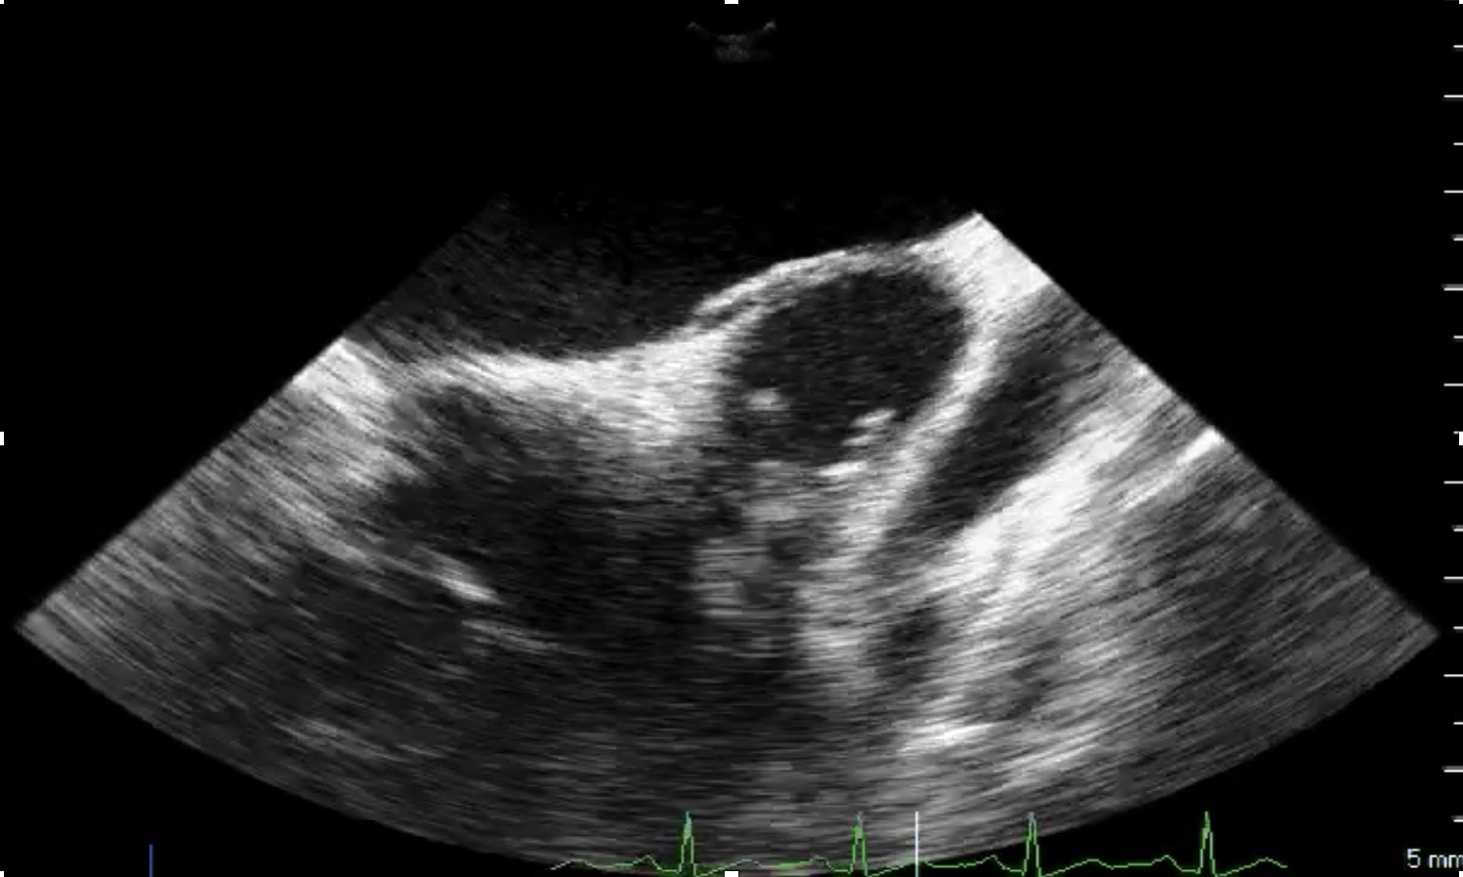
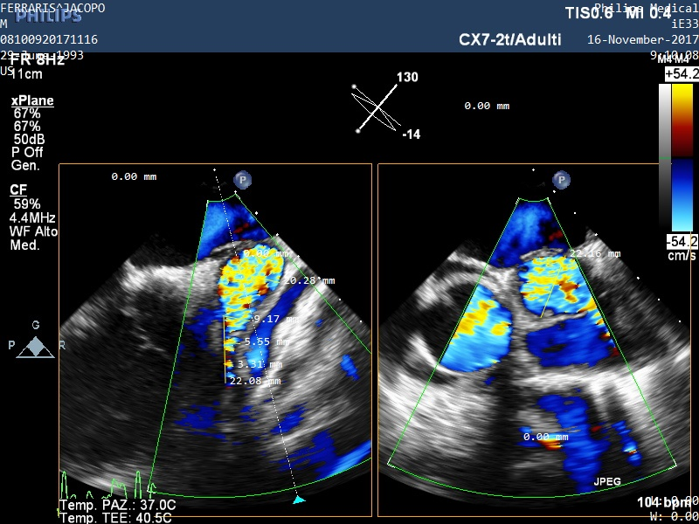
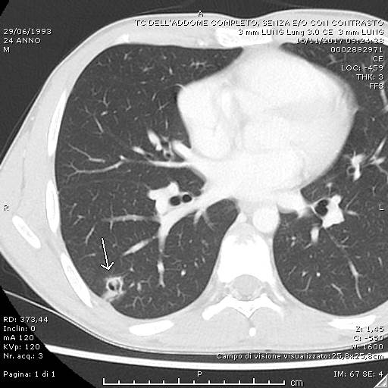
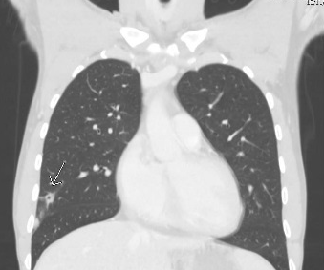
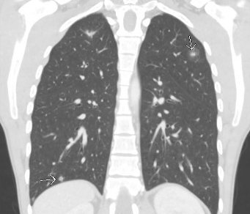
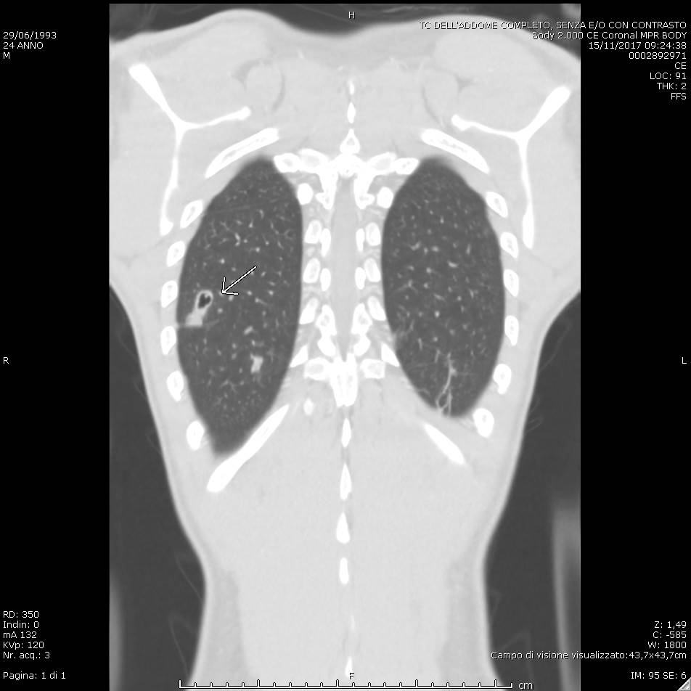
Case Presentation
TEE, 2D color MPR images and chest CT scans
_{Figure 1A.}
_{Figure 1B.}
_{a}
_{b}
_{A}
_{B}
A
C
_{Ao}
_{RCA}
RCA
_{C}
_{D}
_{RA}
_{Tunnel}
_{tunnel}
_{vegetations}
_{tunnel}
Figure 1A. a) TEE showed right atrial dilation and bacterial vegetations (orange arrows) inside the tunnel-like structure; b) 2D color MPR images showing high velocity flow within the tunnel (white arrowhead) originating from the right coronary sinus and running parallel to the RCA (red arrow). Figure 1B. Chest CT scans (A, axial plane, B-D, coronal planes) showing multiple pseudo-nodular cavitations (yellow arrows) and bilateral pneumonia, hilar adenopathy, and pronounced right atrial profile. TEE: transesophageal echocardiography; MPR: multiplanar reconstruction; Ao: aorta; RA: right atrium; RCA: right coronary artery; CT: computed tomography.

Slide 5
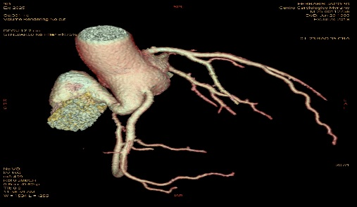
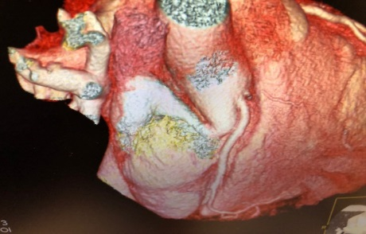
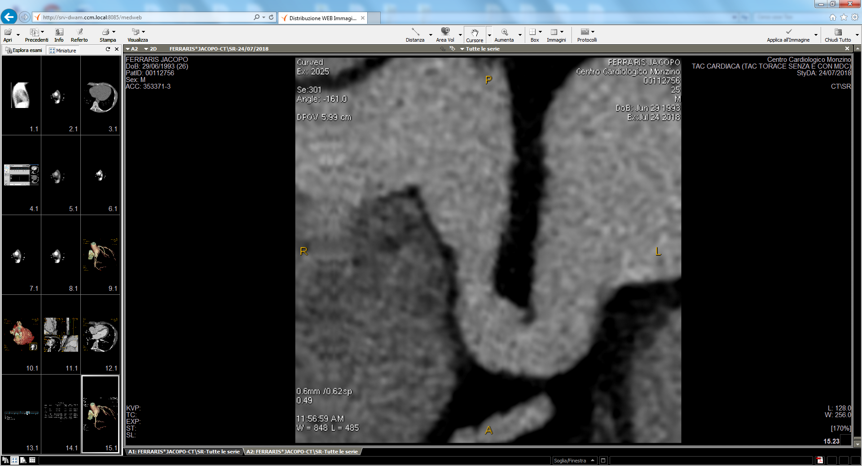
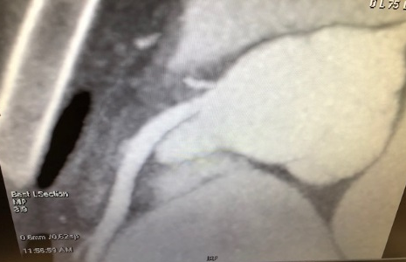
Case Presentation
Pre-operative assessment by 3D-MDCTA
_{Figure 2.}
_{A}
_{B}
_{side branch}
_{RA}
_{ARAT}
_{side branch}
_{ARAT}
_{C}
_{D}
D
_{RA}
_{Aorta}
_{side branch}
_{Aorta}
_{RCA}
_{ARAT}
_{ARAT}
Three-dimensional multidetector computed tomography angiography (3D-MDCTA) (A-B), with curved multiplanar (C) and maximum intensity projection (D) reconstructions confirmed the presence of ARAT and better defined its anatomy, excluding that RCA and small coronary branch arose from the tunnel (Figure 2).

Slide 6
Case Presentation
Management
The patient was treated for 28 days with ceftriaxone achieving normalization of inflammatory markers and marked improvement of the lung lesions.
After heart team discussion, catheter-based closure was recommended. The procedure was performed under general anesthesia with angiographic and TEE guidance.
Using a right femoral vein and artery approach, an artero-venous (AV) loop was established across the ARAT and the fistulous communication was closed using a patent ductus arteriosus closure device (PDA Long Shank 10/8 mm, 10.5 mm in length, Occlutech International AB, Sweden) (Figure 3).
Ascending Aorta angiography and TEE confirmed device stability at the entrance of the tunnel with moderate residual shunt. The patient was discharged two days after the procedure in good clinical conditions.

Slide 7
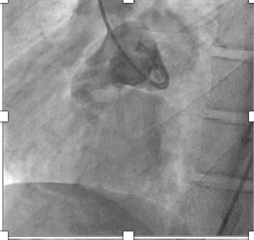
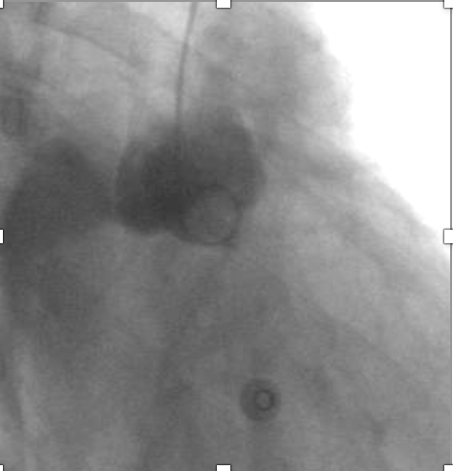
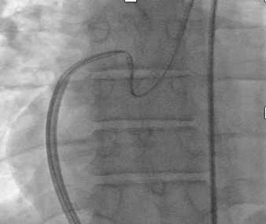
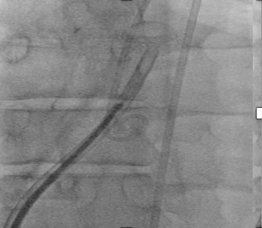
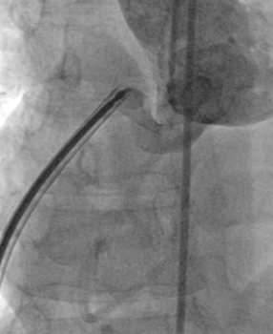
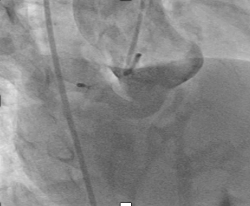
Case Presentation
Procedural steps of the catheter-based ARAT closure
_{Figure 3.}
_{A}
_{ARAT}
_{B}
_{C}
_{RA}
_{AV loop}
_{ARAT}
_{7Fr long sheath}
_{D}
_{E}
_{F}
_{distal disc device}
Panels A-B: aortic angiograpy showing the ARAT (white arrows) originating from the right coronary sinus and draining into the RA. Panel C: advancement from the inferior vena cava of a 7Fr long sheath over the artero-venous (AV) loop towards the ascending aorta. Panel D: opening of the distal disc of the closure device (black arrow). Panel E: control angiography before full device deployment. Panel F: occlusion device correctly positioned inside the ARAT (arrowhead)

Slide 8
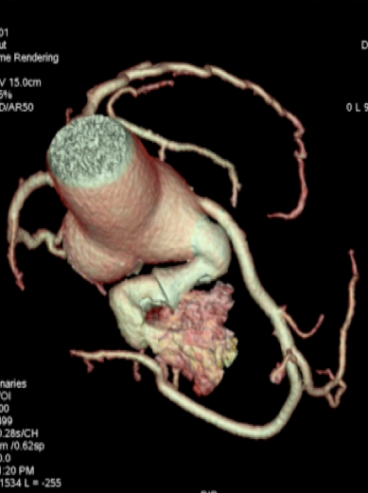
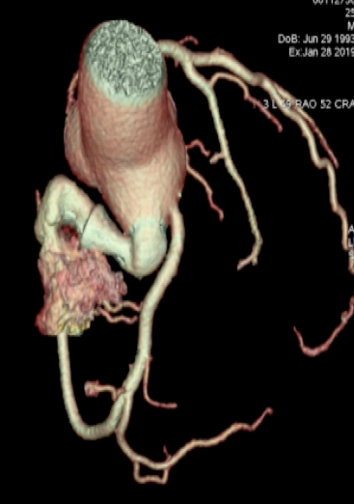
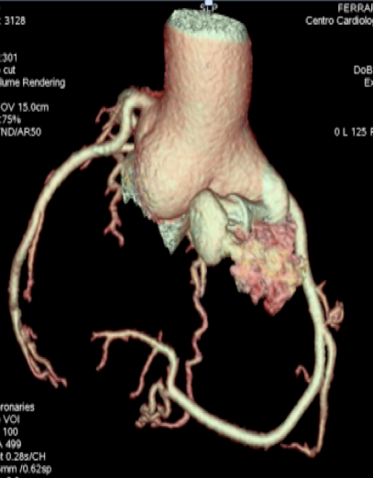
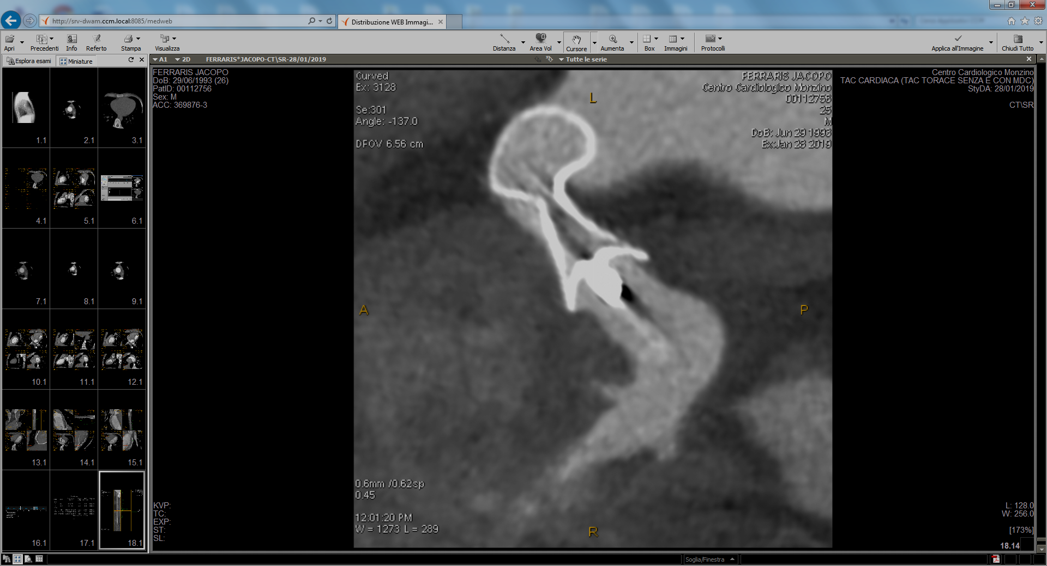


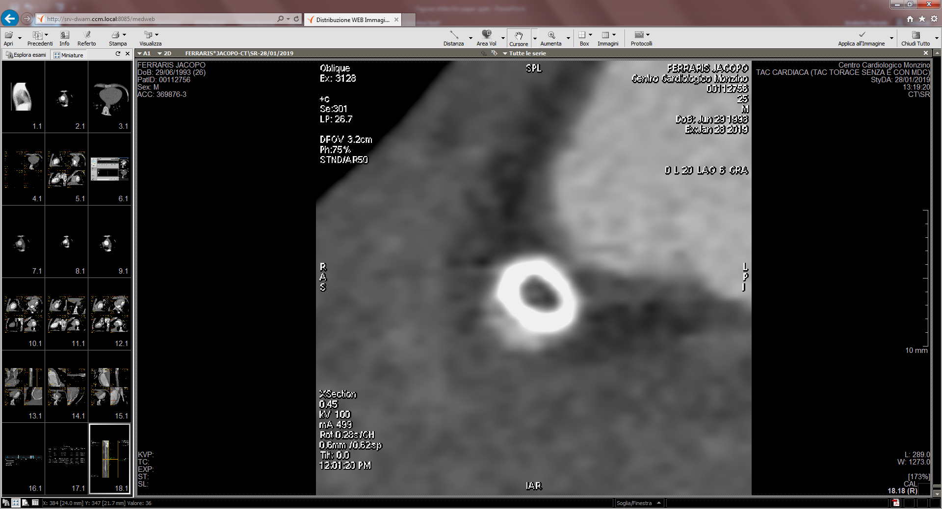
Case Presentation
Follow-Up
_{Figure 4.}
_{A}
_{B}
_{C}
_{D}
_{E}
_{Occlusion device}
3D-MDCTA was performed at 6 months (Figure 4.) Volume rendering 3D reconstruction showed correct position of the occluder device (Panels A-C). Panels D-E: Curved multiplanar reconstructions showing an almost complete occlusion of the ARAT. Note the ipodense region (stars) inside the occluder device visible in the longitudinal (Panel D) and cross section views (Panel E) indicating neo-intimal growth.

Slide 9
Discussion
IE resulted in multiple embolic focal pneumonia and bacterial vegetations prompting noninvasive multimodality imaging evaluations that diagnosed the underlying congenital anomaly, successfully corrected by a catheter-based procedure.
The need of ARAT operative closure in asymptomatic patients is still a matter of debate.
However, in order to prevent the development of symptoms and serious complications such as ventricular overload, bacterial endocarditis, cardiac failure, aneurysm formation and particularly the risk of spontaneous rupture, ARAT closure might be recommended soon after diagnosis.
Catheter-based closure might be a less invasive treatment provided that the opening of the right atrial end is small, the appropriate device according to the size is available, and there is a constriction in the course of the fistula.

Slide 10
Learning Points
Aorta-Right Atrial Tunnel (ARAT) is a rare congenital anomaly that may have serious complications.
Different imaging modalities (TEE, ascending aorta angiography, coronary angiography and 3D-MDCTA) provided useful anatomical and functional information and played a key role in planning and performing a successful interventional procedure.
Transcatheter closure might represent a safe and effective alternative to the traditional surgical approach.
EHJ-CR-D-19-00522R1

Slide 11
References
Coto EO, Caffarena JM, Such M, Marques JL. Aorto-right atrial communication. J Thorac Cardiovasc Surg 1980; 80: 941 – 944.
Kalangos A, Beghetti M, Vala D, Chraibi S, Faidutti B. Aortico-right atrial tunnel. Ann Thorac Surg 2000; 69: 635 – 637.
Gajjar T, Voleti C, Desai N. Aorta-right atrial tunnel: Clinical presentation, diagnostic criteria, and surgical options. J Thorac Cardiovasc Surg 2005; 130: 1287 – 1292.
Sai Krishna C, Baruah DK, Reddy GV, Panigrahi NK, Suman K, Kumar PV. Aorta-right atrial tunnel. Tex Heart Inst J 2010; 37: 480 – 482.
Omeroglu SN, Goksedef D, Balkanay OO, Ipek G. Aorta-right atrial tunnel in an adult. Eur J Cardiothorac Surg 2014; 45: 580 – 581.
EHJ-CR-D-19-00522R1

