Slide 1
Cervical spinal cord injury by a low-energy trauma as an unnoticed cause of cardiorespiratory arrest: a case series of two patients
October 2019
EHJ-CR-D-19-00321
Notes:
It will be reviewed by a supplementary materials editor.
<11 slides long, 3-4 key learning points , <6 references, 3-5 bullet points per slide of ~10 words long each. UK spellings.

Slide 2
Introduction
Traumatic cervical spinal cord injury is a rare cause of cardiorespiratory arrest (CA).
The mechanism is a disruption of the sympathetic nervous system pathway.
We report two patients with CA suspected to be cardiogenic but later found to be related to an unnoticed traumatic cervical spinal cord injury.

Slide 3
Case Presentation
Case 1
76 year-old woman found in cardiac arrest (CA, asystole) after collapsing and falling down a few steps with a lucid period before losing consciousness
- Normal cardiac and pulmonary studies and head CT-scan
- EEG: delta-theta slowing with intermittent frontal bilateral sharp waves
- SSEP: bilateral absence of N19 waves with low amplitude N13 wave
- Brain and cervical MRI: fracture-luxation of C2 with spinal cord injury
- Death due to severe hemodynamic instability

Slide 4
Case Presentation
Case 2
65 year-old man found in CA (asystole) lying in the street next to his bicycle
- Normal cardiac and pulmonary studies and head CT-scan
- EEG: generalized periodic discharges
- Myoclonus involving only the face.
- SSEP: bilateral absence of N19 and N13 waves
- Brain MRI: severe post-anoxic lesions and cervical spinal cord hyperintensity
- Cervical MRI: fracture-luxation of C2 with spinal cord lesion.
- Severe sepsis and death

Slide 5
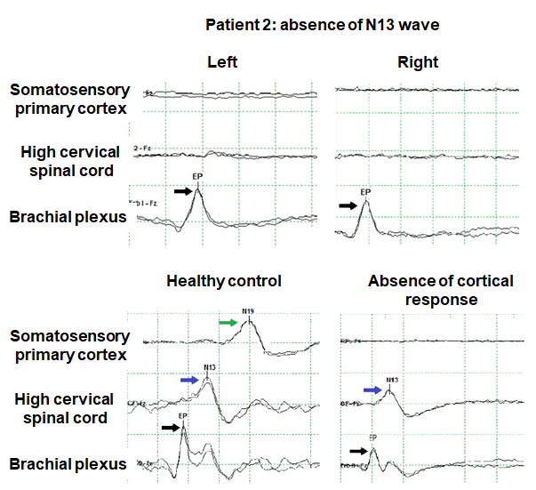
Case Presentation
Relevant investigations
Median nerve Somatosensitive Evoked Potentials (SSEPs) of patient 2 showing absence of the evoked potential at the cervicomedullary junction (N13 wave) despite preservation of a peripheral response in the brachial plexus indicating that the stimulation of the median nerve in the wrists was correct.

Slide 6
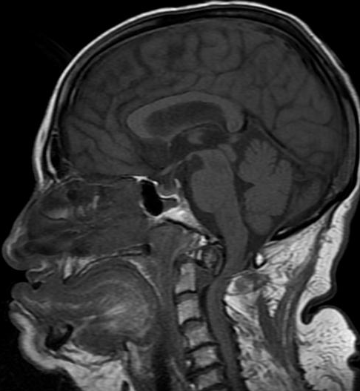
Case Presentation
Relevant investigations
Brain and cervical MRI of patient 2 showing odontoid fracture with luxation with secondary spinal cord injury (white arrow).

Slide 7
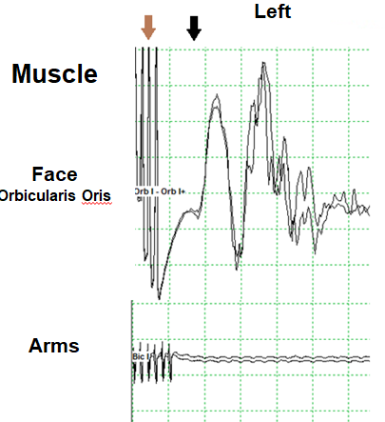

Case Presentation
Relevant investigations
Motor Electrical Evoked Potentials (MEEPs) of left side of patient 2 showing facial but no limbs response (black arrow) after stimulus (brown arrow).

Slide 8
Discussion
Mechanism
Disruption of the spinal cord sympathetic pathway with preserved parasympathetic outflow of the vagus nerve
Sudden and massive adrenergic mediators released from sympathetic nerves and suprarenal glands after a traumatic accident
Bradycardia/asystole

Slide 9
Discussion
Why unnoticed?
The pharmacologically-induced coma and neuromuscular blocking agents during the hypothermia protocol limit the neurological examination and mask the classical signs of cervical spinal cord injury
A low-impact trauma can be difficult to detect and it is not usually suspected to produce a spinal cord injury

Slide 10
Learning Points
Cardiac arrest can be associated with traumatic cervical spine injury and in some cases may be the cause of the arrest
Low-energy trauma occurring in the setting of minor accidents can cause a cervical spinal cord injury leading to subsequent CA
Red flags to suspect this condition:
1. Previous low-energy trauma
2. Lucid period between trauma and CA
3. Abnormal N13 wave
4. Isolated face myoclonus

Slide 11
References
Teasell RW, Arnold JMO, Krassioukov A, Delaney GA. Cardiovascular consequences of loss of supraspinal control of the sympathetic nervous system after spinal cord injury. Archives of Physical Medicine and Rehabilitation 2000;81:506–16.
Miyata K, Mikami T, Koyanagi I, Mikuni N, Narimatsu E. Cervical spinal cord injuries associated with resuscitation from fatal circulatory collapse. Acute Med Surg 2016;3(2):86–93.
Lehmann KG, Lane JG, Piepmeier JM, Batsford WP. Cardiovascular abnormalities accompanying acute spinal cord injury in humans: Incidence, time course and severity. J Am Coll Cardiol 1987;10:46–52.
Brown EN, Lydic R, Schiff ND. General Anesthesia, Sleep, and Coma. N Engl J Med 2010;363(27):2638–50.
Rossetti AO, Rabinstein AA, Oddo M. Neurological prognostication of outcome in patients in coma after cardiac arrest. Lancet Neurol 2016;15(6):597–609.

