Slide 1
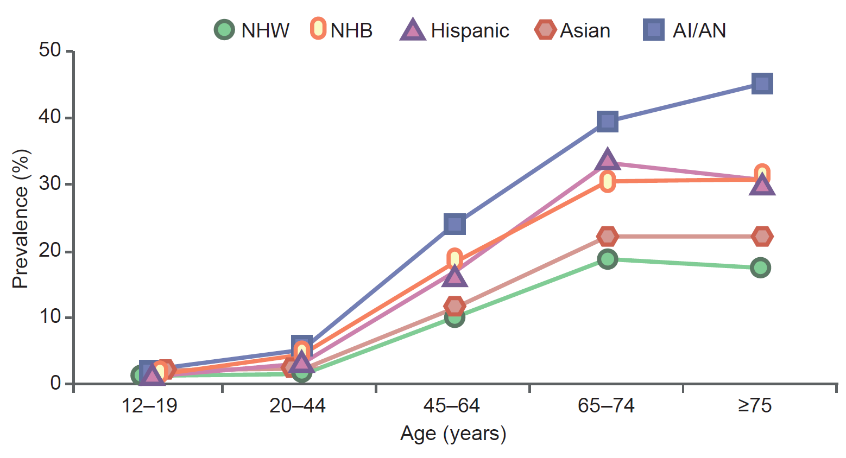
Age-specific prevalence of diagnosed diabetes in the USA by race/ethnicity
Golden et al (2019) Diabetologia DOI 10.1007/s00125-019-4968-0
© Springer-Verlag GmbH Germany, part of Springer Nature 2019

Slide 2
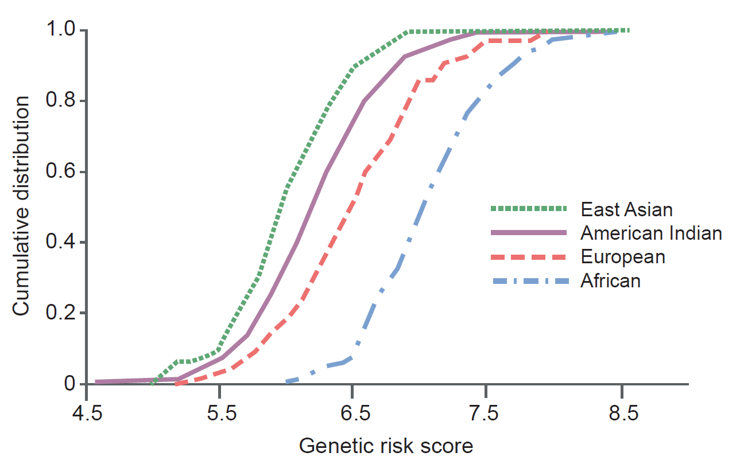
Cumulative distribution of genetic risk score for type 2 diabetes, calculated by summing the number of risk alleles weighted by the published effect size across 63 established variants, in different racial/ethnic groups
Golden et al (2019) Diabetologia DOI 10.1007/s00125-019-4968-0
© ADA 2015 (adapted from Hanson et al, Role of established type 2 diabetes-susceptibility genetic variants in a high prevalence American Indian population). Copyright and all rights reserved. Material from this publication has been used with the permission of ADA

Slide 3
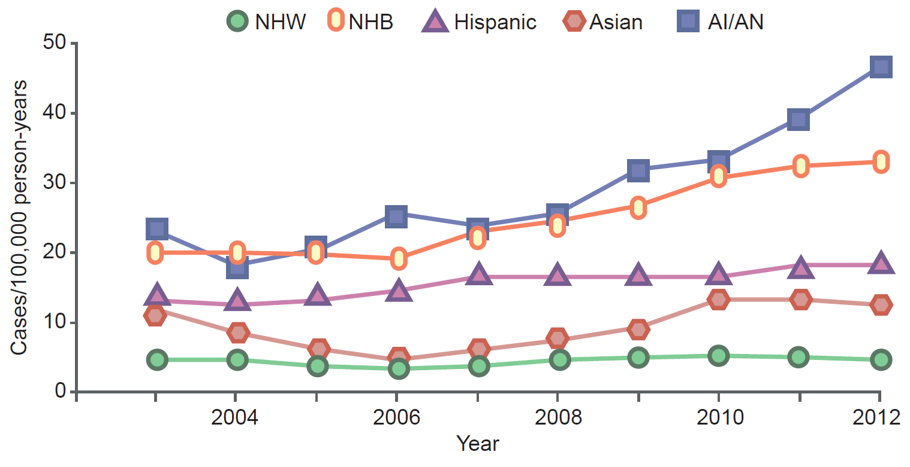
Incidence of diagnosed type 2 diabetes in youth (aged 10–19 years) in the USA by race/ethnicity according to the SEARCH study
Golden et al (2019) Diabetologia DOI 10.1007/s00125-019-4968-0
© Springer-Verlag GmbH Germany, part of Springer Nature 2019

Slide 4
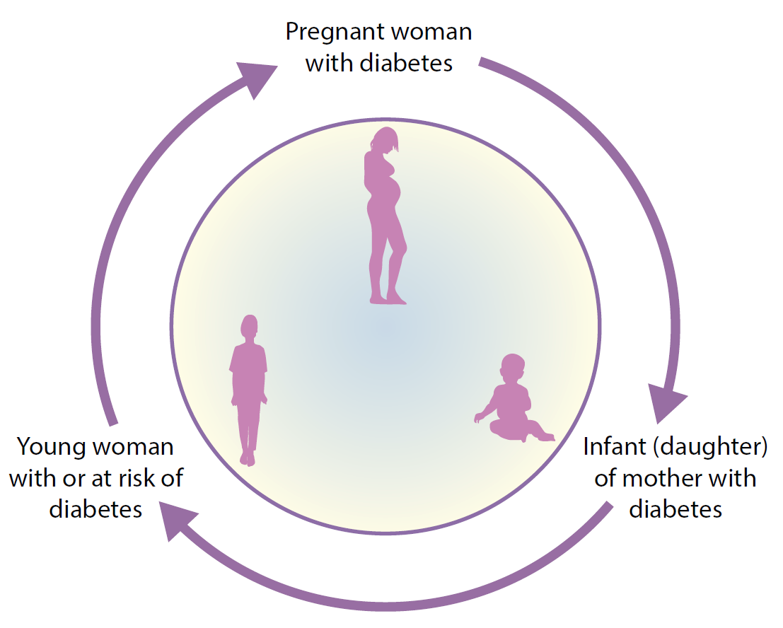
The vicious cycle of transgenerational inheritance of diabetes risk
Golden et al (2019) Diabetologia DOI 10.1007/s00125-019-4968-0
© John Wiley & Sons Ltd. Adapted with permission from Knowler et al (1990)

