Slide 1
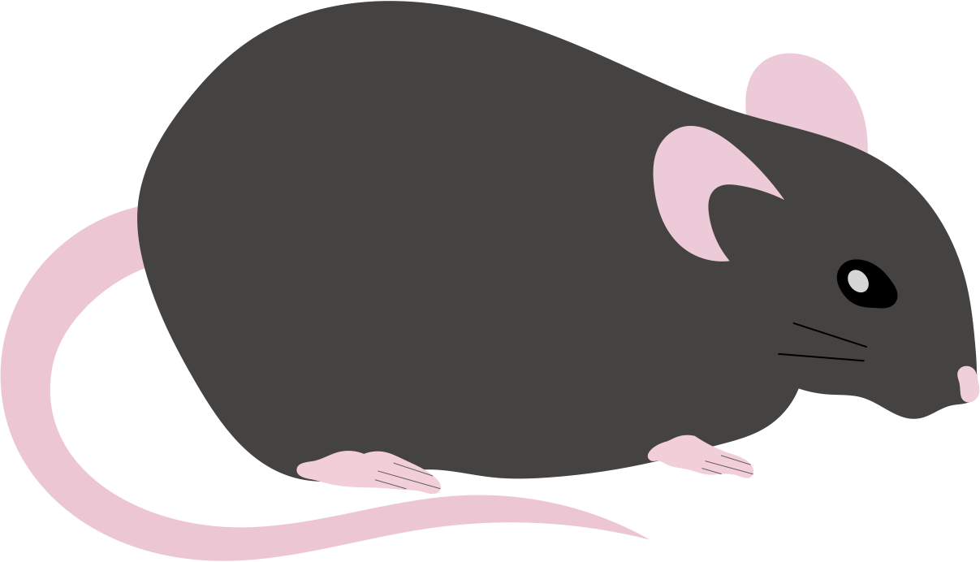
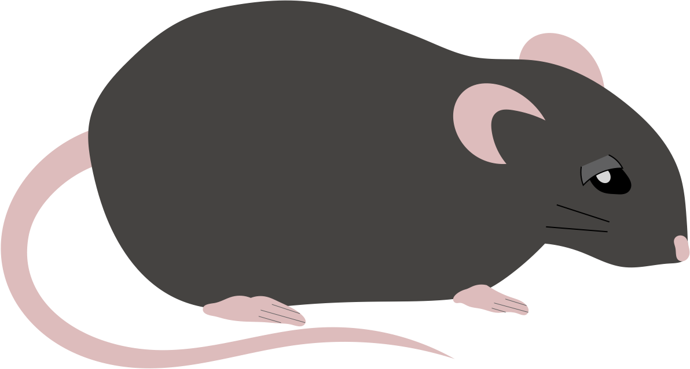
Supplemental Figure 1
Protocol 1
Surgery
1
3
7
14 days
Sham
(n = 6)
MI
(n = 68)
(n = 6)
Sham
(n = 12)
MI
Randomly
divided
(n = 25)
(n = 25)
Day 1
Day 3
Day 7
Day 14
Measurements
Skeletal muscle fibrosis | ✓ | ✓ | ✓ | ✓
Echocardiogram | ✓ | ✓ | ✓
Immunoblotting | ✓ | ✓ | ✓
Protocol 2
Surgery
1
3
7
14 days
Sham + Veh
(n = 24)
(n = 6)
Sham
(n = 6)
MI + Veh
(n = 6)
MI + Lis
Randomly
divided
(n = 6)
MI
(n = 52)
(n = 23)
(n = 6)
Randomly
divided
(n = 7)
(n = 8)
(n = 8)
Measurements
Skeletal muscle fibrosis |  |  |  | ✓
Echocardiogram | ✓ | ✓ | ✓ | ✓
Immunoblotting | ✓ | ✓ | ✓ | ✓
Survival rate |  |  |  | ✓
Day 1
Day 3
Day 7
Day 14

Slide 2
Supplemental Figure 2
(n = 6 in survivors)
(n = 23 in survivors)
(n = 8 in survivors)
＊

