Slide 1
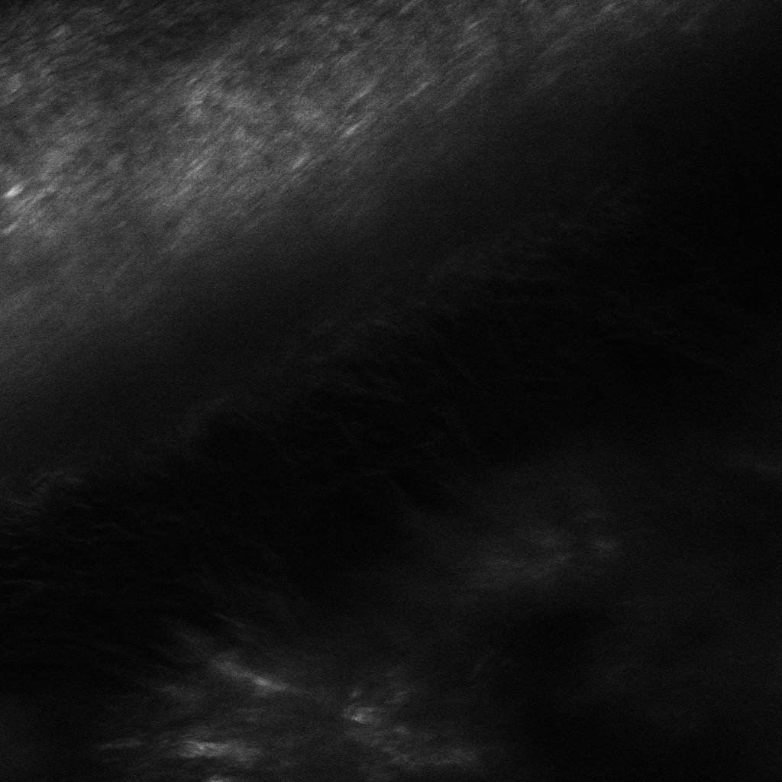

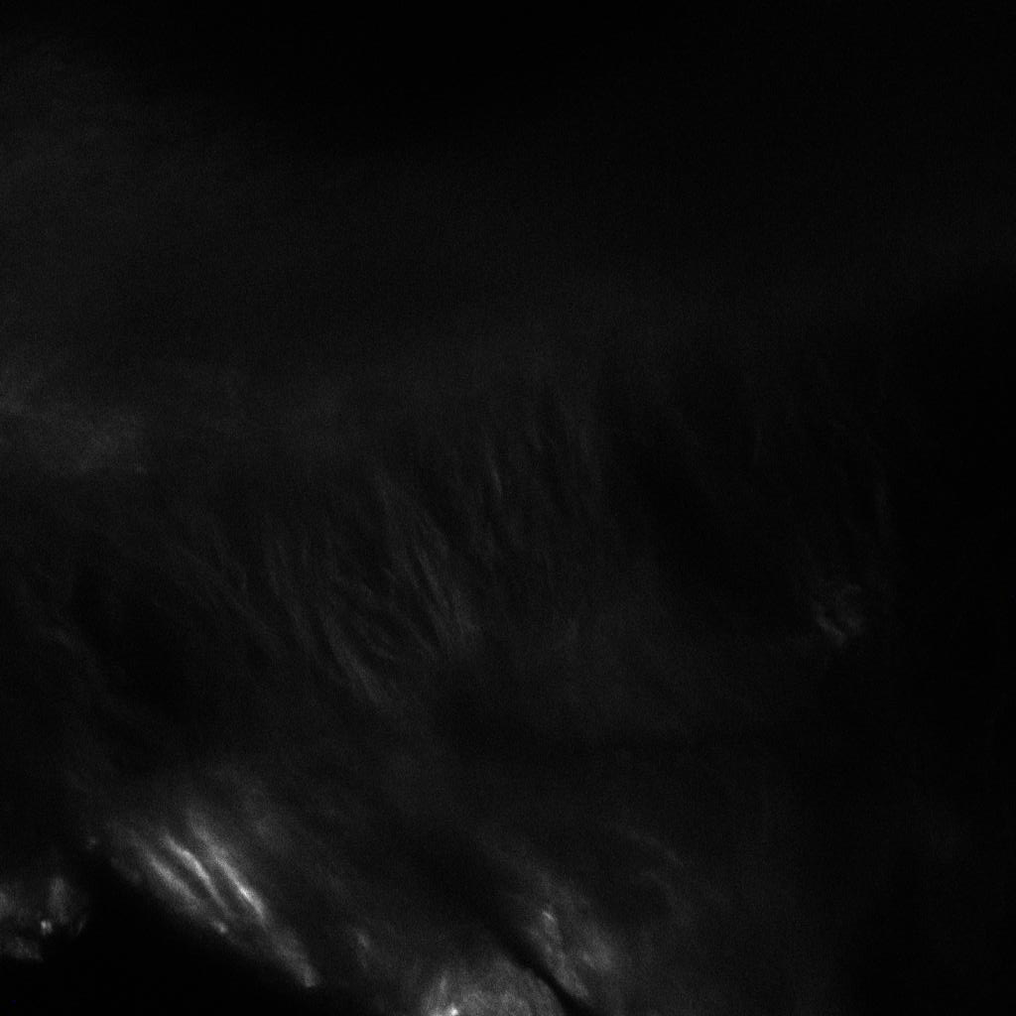
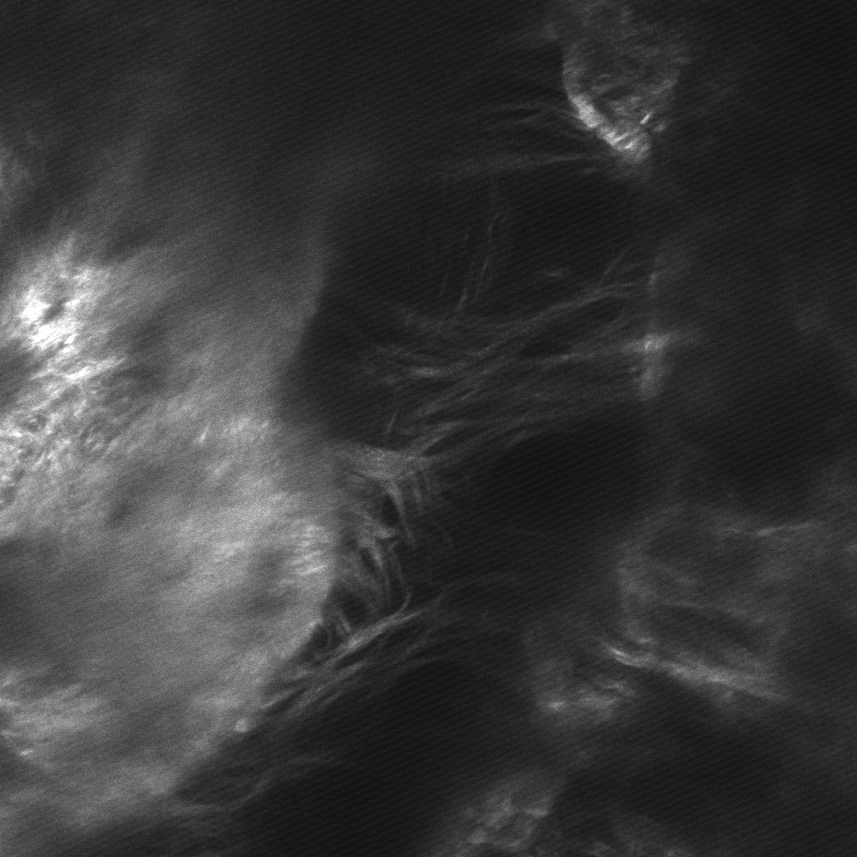
A.
DMSO Ctrl
B.
DMSO Ligature (5D)
C.
BPA Ctrl
D.
BPA Ligature (5D)
A.
Notes:
Supplemental Fig. 1: Inhibition of TG by BPA increases thick collagen fiber bundles in native PDL following 5 day ligature. Second-Harmonic Generation z-stack images taken at 0.2μm/slice for depths of up to 60μm of native WT PDL +/- DMSO/BC injections following 5-day ligature treatment. . Apparent increases in collagen fiber thickness and organization are observable in BC-treated PDL (C) and (D) compared to DMSO-treated PDL (A) and (B). Following 5-day ligature, reappearance of thick collagen fiber bundles are apparent in BC-treated PDL (D) compared to DMSO-treated PDL (B). DMSO = vehicle control; BPA = 5-(Biotinamido) pentylamine; 5D = 5-day.

Slide 2
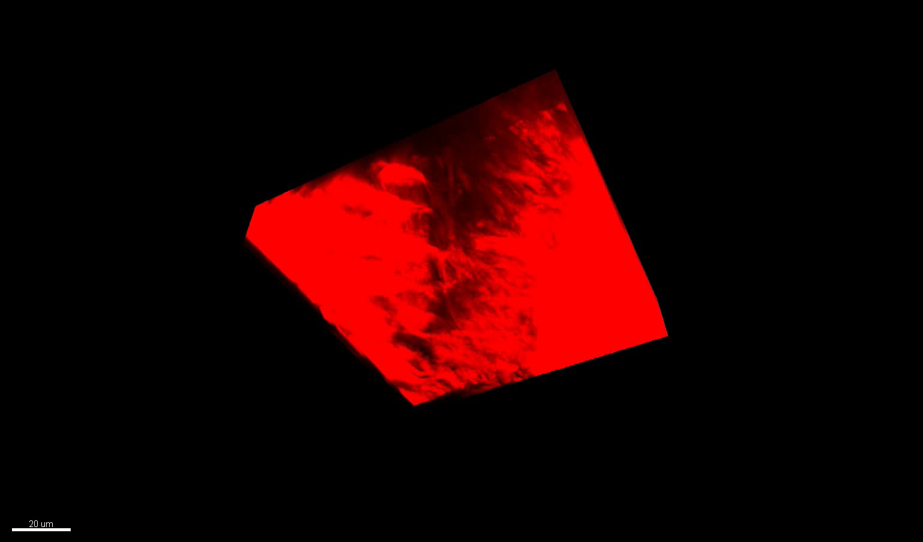
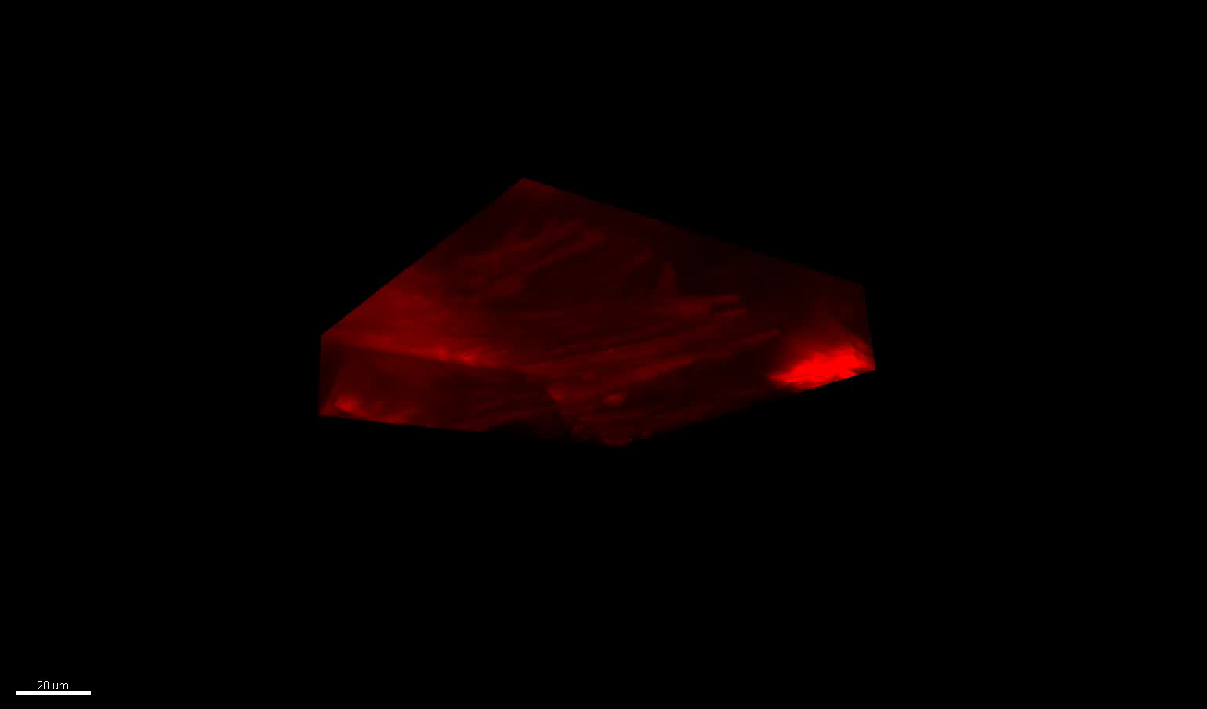
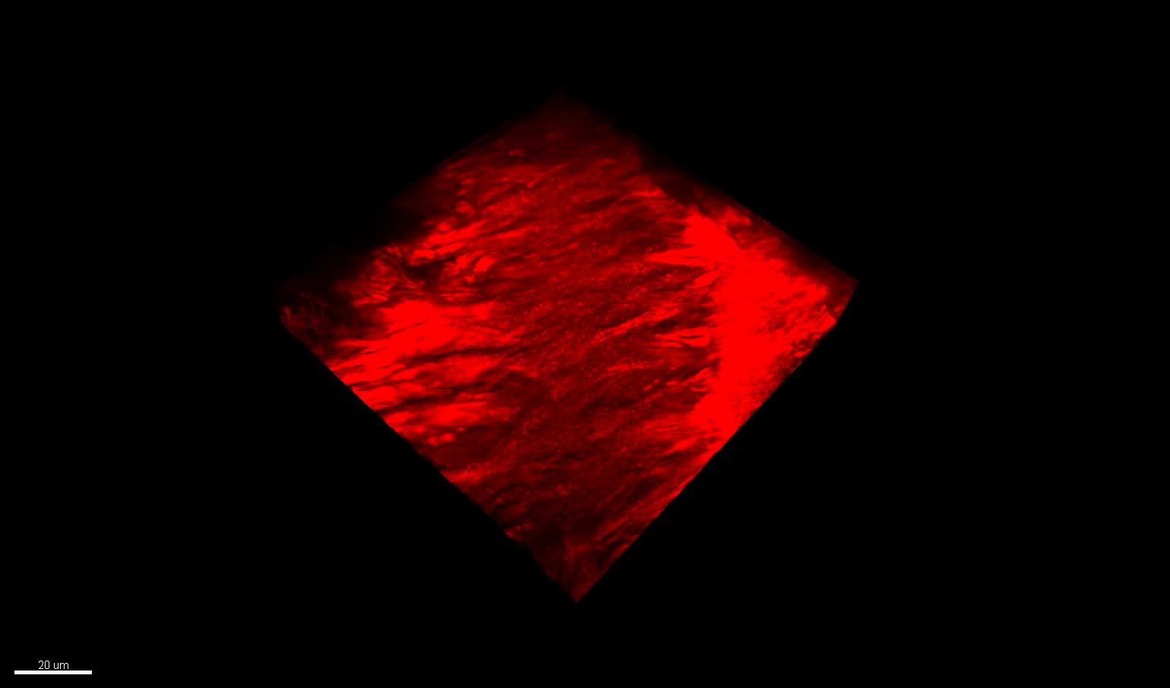
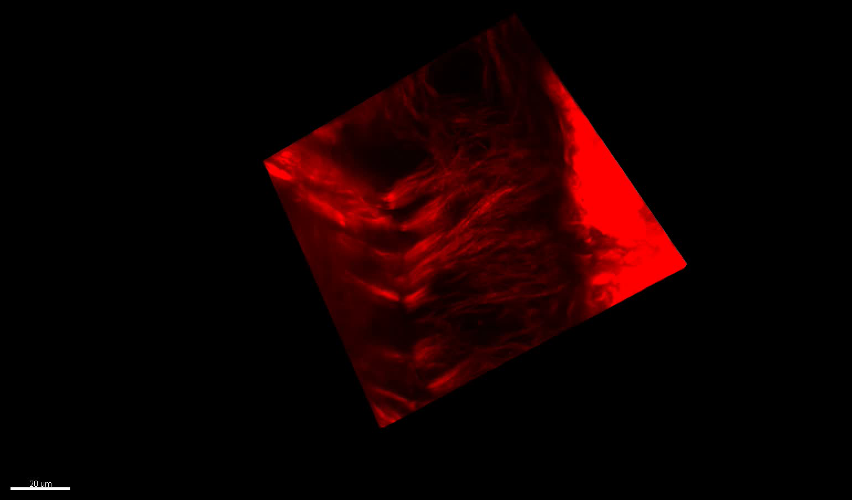
DMSO Ctrl
A
DMSO Ligature (5D)
B
BPA Ctrl
C
BPA Ligature (5D)
D
Notes:
Supplemental Fig. 2: Inhibition of TG by BPA increases thick collagen fiber bundles in native PDL following 5 day ligature. Second-Harmonic Generation 3D orthogonal volume reconstructions of native WT PDL +/- DMSO/BC injections following 5-day ligature treatment. . Apparent increases in collagen fiber thickness and organization are observable in BC-treated PDL (C) and (D) compared to DMSO-treated PDL (A) and (B). Following 5-day ligature, reappearance of thick collagen fiber bundles are apparent in BC-treated PDL (D) compared to DMSO-treated PDL (B). DMSO = vehicle control; BPA = 5-(Biotinamido) pentylamine; 5D = 5-day.

