Slide 1
A
B
Figure S1
C
Effector : Target
D
MDSC : NK
Effector : Target
MDSC : NK

Slide 2
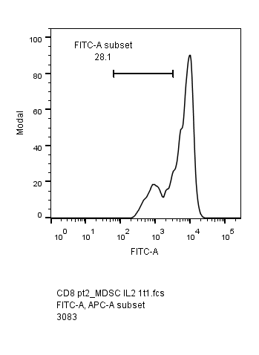

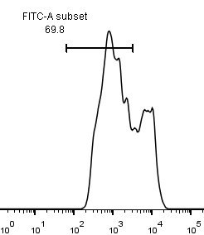
A
Figure S2
n=6
B
C
MDSC+T cell
1:1
MDSC+T cell
1:2
T cells alone
CFSE
MDSC : T cell

Slide 3
A
B
Figure S3
n=3
p<0.05
C
D
E
MDSC : NK
n=4
p<0.01

Slide 4
Figure S4

Slide 5
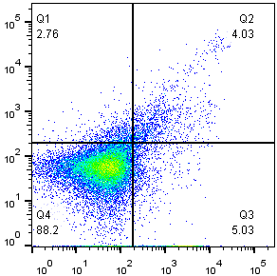
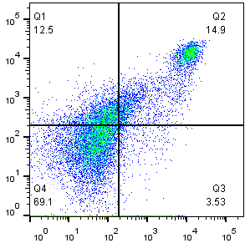
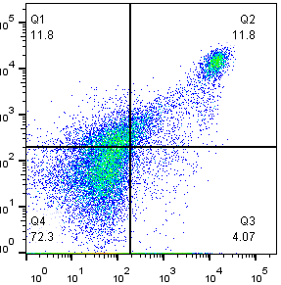
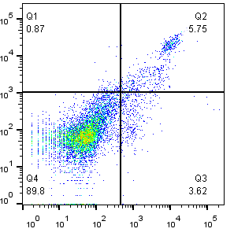
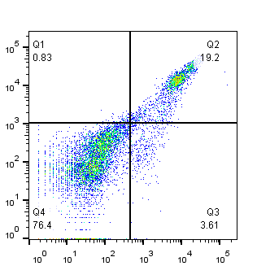
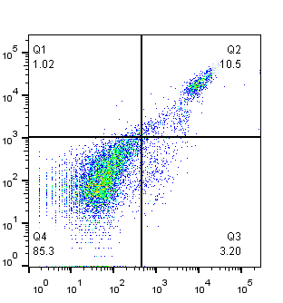

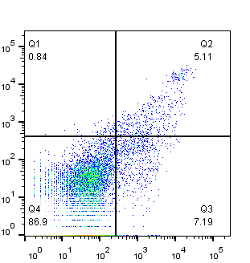
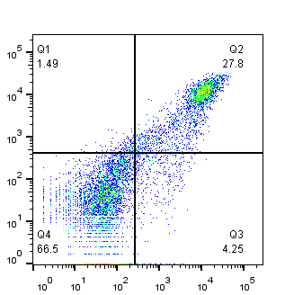
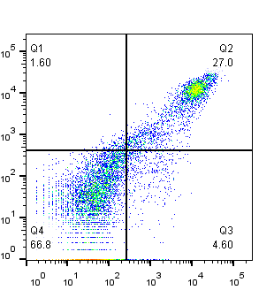
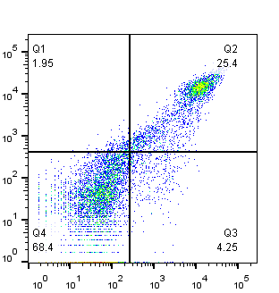
A
Gr-1
Figure S5
Control
PBS
NIL
4.03%
14.9%
11.8%
CD11b
Gr-1
B
Control
PBS
nor-NOHA
3-MT
5.75%
19.2%
10.5%
21.0%
CD11b
Gr-1
C
Control
PBS/IgG
anti-TGF-β
anti-IL-10
5.11%
27.8%
27.0%
25.4%
D
CD11b

Slide 6
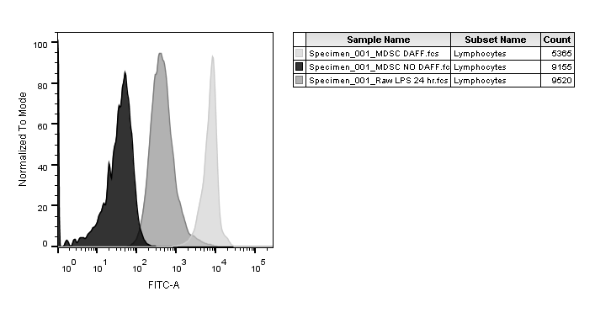
A
B
Figure S6
RAW
RAW-LPS
MDSC
% Max
NK
T
MDSC
DAF-FM
C
D
n=5
n=2
E
p =0.0299
p =0.0156

Slide 7
A
Figure S7
10 ng/ml IL-12
n=2
B
C

Slide 8
Figure S8

Slide 9
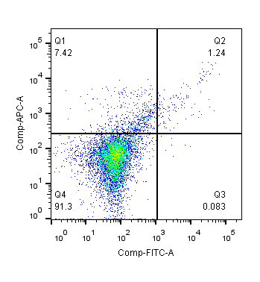
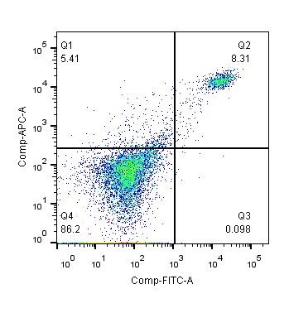

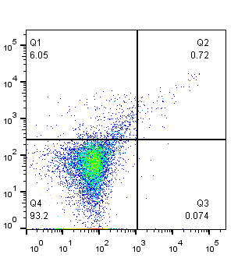
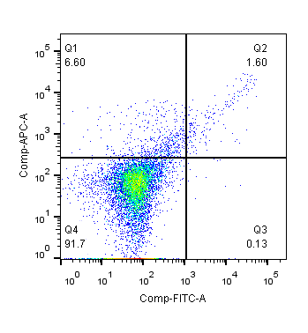
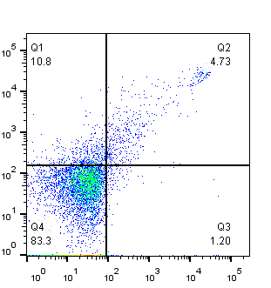
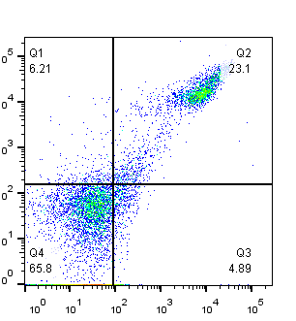
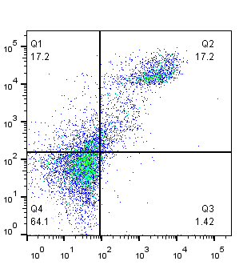
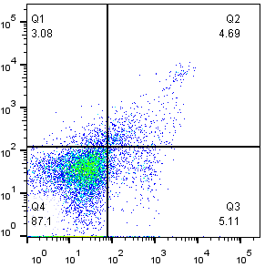
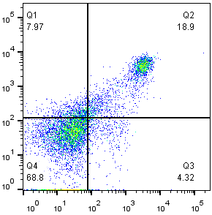
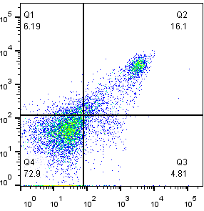
Figure S9
Gr-1
A
No-tumor
PBS
Gemcitabine
1.24%
8.31%
1.00%
CD11b
Gr-1
B
No tumor
PBS
5-FU
0.72%
8.31%
1.60%
Gr-1
CD11b
C
Control
IgG
anti-Gr-1
D
4.73%
23.1%
17.2%
CD11b
Gr-1
E
Control
PBS
NIL
4.69%
18.9%
16.1%
CD11b

Slide 10
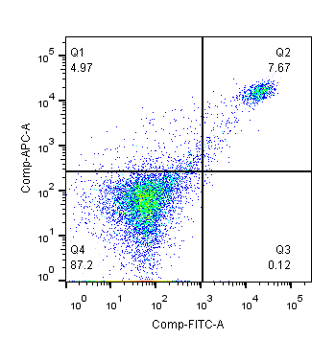
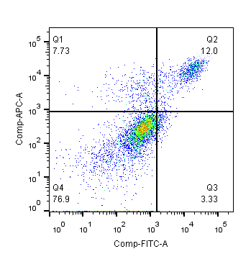
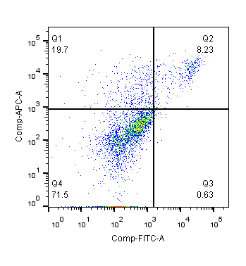
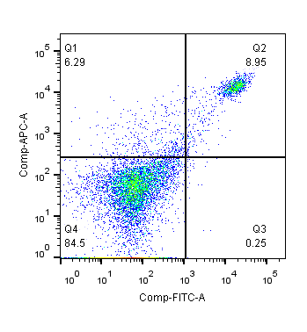
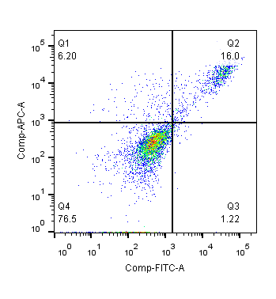
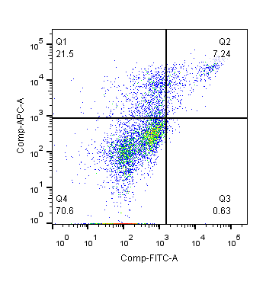
A
Figure S10
Spleen
Tumor
PBS/IgG
5-FU
Trastuzumab
Trastuzumab
+ 5- FU
Gr-1
CD11b
B

Slide 11
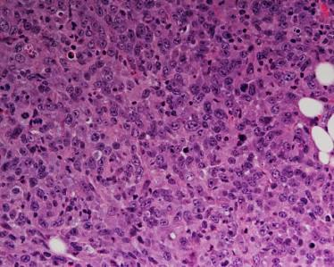
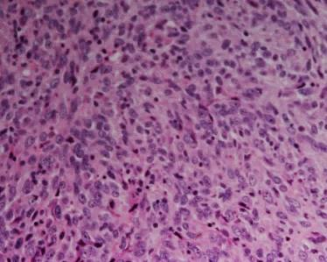
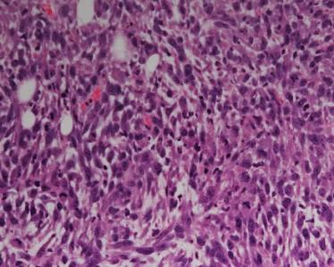
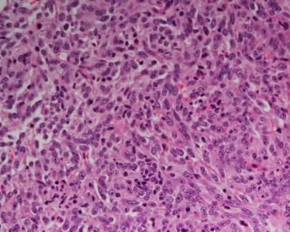
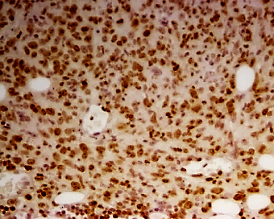
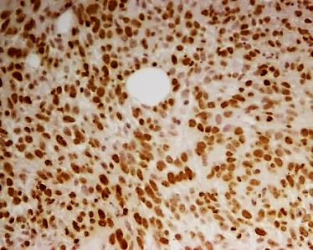
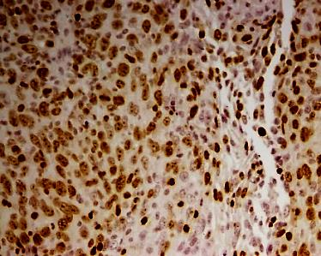
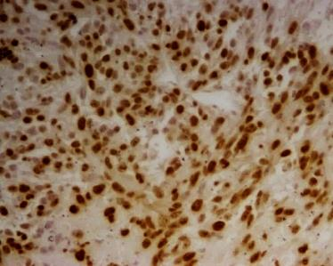
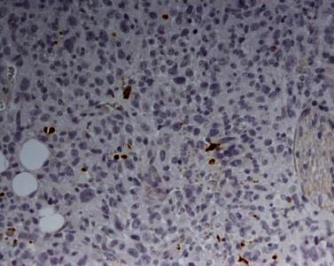
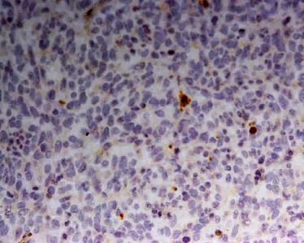
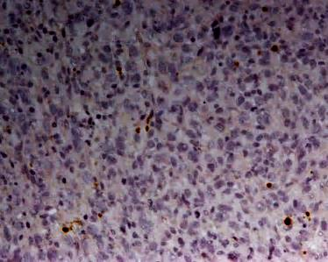
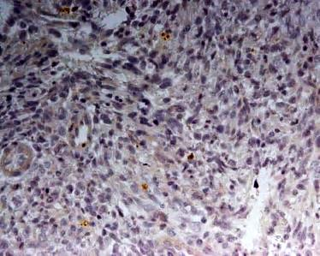
Figure S11
PBS/IgG
Trastuzumab
5-FU
5-FU+Trastuzumab
HE
Ki67
Caspase-3

Slide 12
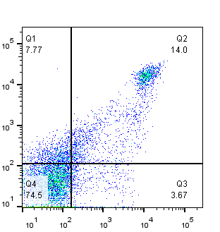
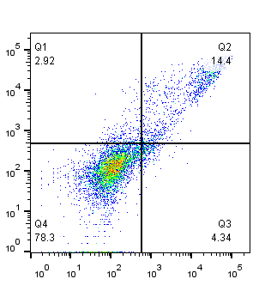
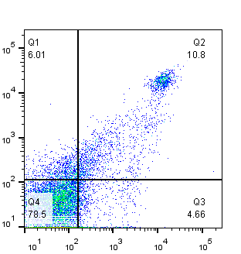
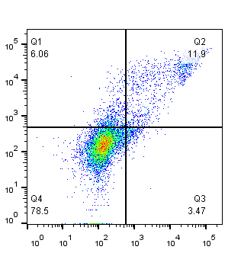

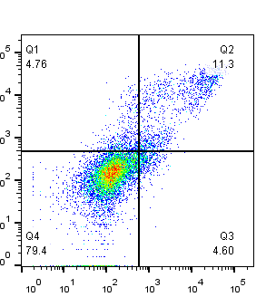

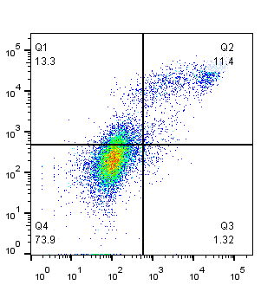
Figure S12
Spleen
Tumor
PBS/IgG
NIL
Trastuzumab
Gr-1
Trastuzumab + NIL
CD11b

Slide 13
A
Figure S13
B
C

