Slide 1
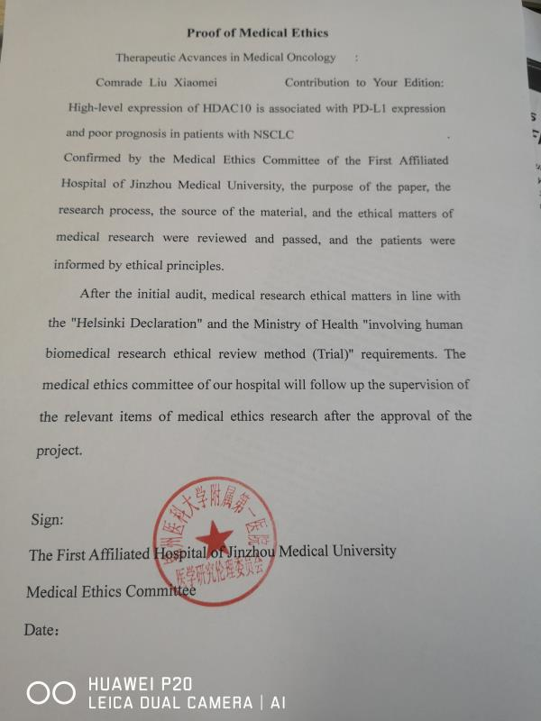
Fig.S1 Proof of Medical Ethics

Slide 2
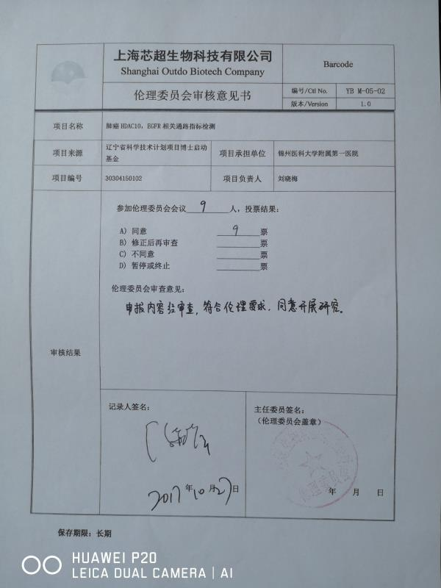
Fig.S2 Approve of Ethics committee

Slide 3
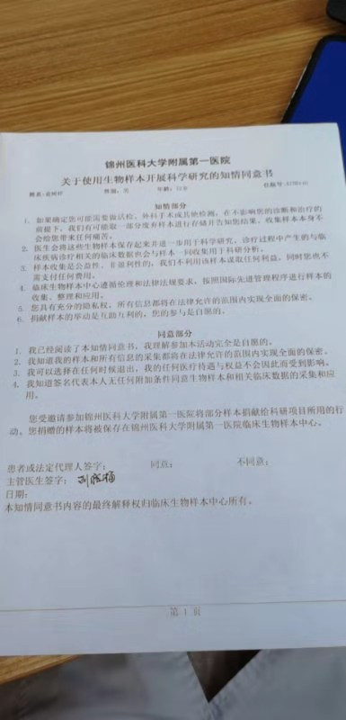
Fig.S3 Biomedicine Research Informed consent form

Slide 4
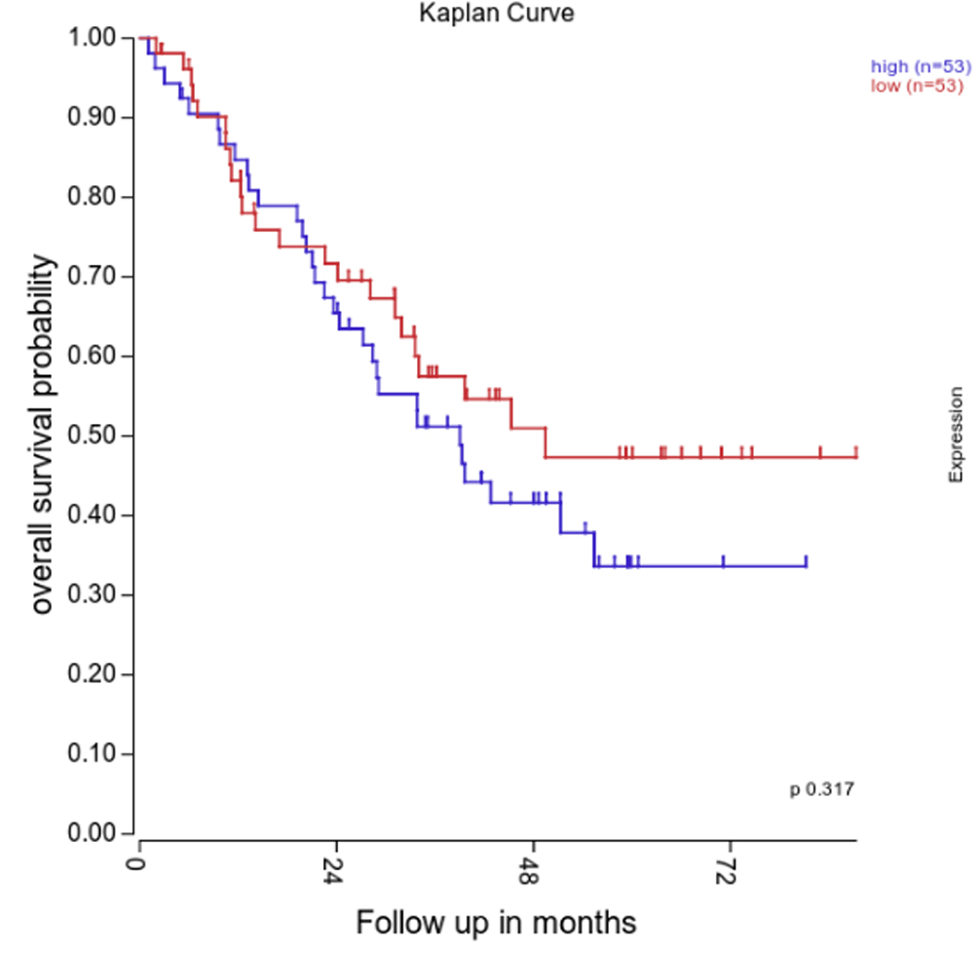
Figure.S4 Kaplan-Meier survival curve of patients with NSCLC

