Slide 1
A 24-week multicentre, randomised, open-label, parallel-group study comparing the efficacy and safety of ixekizumab vs. fumaric acid esters and methotrexate in patients with moderate-to-severe plaque psoriasis naïve to systemic treatment
  K. Reich,¹ M. Augustin,² D. Thaçi,³ A. Pinter,⁴ A. Leutz,⁵ C. Henneges,⁵ E. Schneider,⁵ A. Schacht,⁵ M. Dossenbach,⁵ U. Mrowietz⁶
¹Dermatologikum Berlin and SCIderm Research Institute, Hamburg, Germany
²Institute for Health Services Research in Dermatology and Nursing (IVDP), University Medical Center Hamburg-Eppendorf (UKE), Hamburg, Germany
³Institut and Comprehensive Center Inflammation Medicine, University zu Lübeck, University Hospital Schleswig-Holstein, Campus Lübeck, Lübeck, Germany
⁴University Clinic of Frankfurt am Main Department of Dermatology, Frankfurt am Main, Germany
⁵Eli Lilly and Company and/or one of its subsidiaries, Indianapolis, IN, USA
⁶Psoriasis-Center, Department of Dermatology, University Medical Center Schleswig-Holstein, Campus Kiel, Kiel, Germany
British Journal of Dermatology. DOI: 10.1111/bjd.18384

Slide 2


Lead Authors
Professor Kristian Reich
Professor Ulrich Mrowietz

Slide 3
Introduction
What is already known?
Fumaric acid esters (FAE) and methotrexate are two commonly used conventional systemic therapies for chronic plaque psoriasis
Interleukin-17 antagonists such as ixekizumab have received a first-line label for moderate-to-severe plaque psoriasis
Objective
To assess if ixekizumab is superior to FAE and methotrexate in treating adult patients with chronic moderate-to-severe plaque psoriasis

Slide 4
Method
162 patients were randomised 1:1:1 to FAE (N=54), methotrexate (N=54) or ixekizumab (N=54) treatment over 24 weeks
Comparison of proportion of patients that achieved:
  Psoriasis Area and Severity Index (PASI): Improvement of 75%, 90%, 100%
  Static Physician’s Global Assessment (sPGA): score of 0 or 1
  Dermatology Life Quality Index (DLQI): score of 0 or 1
Safety events at week 24 were analysed using Fisher’s exact test

Slide 5
Method

Slide 6
Dosing Regimens
Fumaric Acid Esters
Daily oral administration of dimethyl fumarate (DMF)
Daily dosage reduced to individual maintenance dose if appropriate
Week | Daily Dose (mg)
1 | 30
2 | 60
3 | 90
4 | 120
5 | 240
6 | 360
7 | 480
8 | 600
9 - 24 | 720

Slide 7
Dosing Regimens
Methotrexate
Weekly oral administration
Starting dose of 7.5 mg/week with a stepwise increase in dosage of 5 – 7.5 mg/week until ≥ 15 mg/week reached
Increase to 20 mg/week if PASI 50 not reached by week 8
Increase to 25 mg/week if PASI 50 not reached by week 16
Maximum dose of 30 mg/week
Daily dosage reduced to individual maintenance dose after PASI 75 achieved if appropriate

Slide 8
Dosing Regimens
Ixekizumab
Subcutaneous injection
Starting dose: 160 mg
Week 2 – 12: 80 mg every 2 weeks
Week 16 – 24: 80 mg every 4 weeks

Slide 9
Results
In patients with chronic moderate-to-severe plaque psoriasis, ixekizumab treatment was superior to both FAE and methotrexate treatment in inducing PASI 75, PASI 90, PASI 100, sPGA (0,1) and DLQI (0,1) responses at Week 24
Safety profiles for all treatments were consistent with prior studies

Slide 10
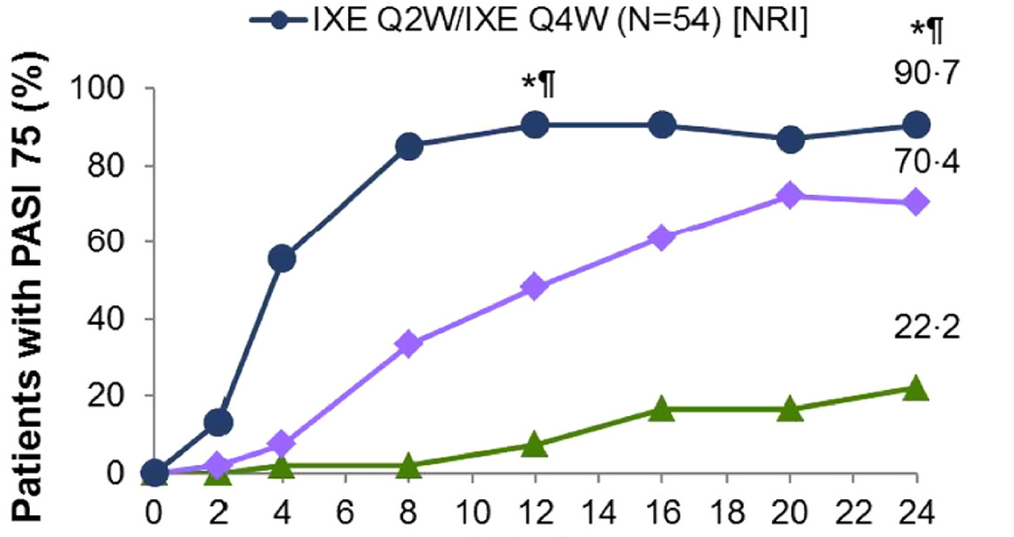
PASI 75 response rates at Week 24 (NRI)
IXE (N=54)
MTX (N=54)
FAE (N=54)
Weeks
Abbreviations: FAE=fumaric acid esters; IXE=ixekizumab; MTX=methotrexate; NRI=nonresponder imputation; PASI=Psoriasis Area Severity Index
Note: p-values are calculated using NRI only; in the intent to treat population; *p<.05 vs. FAE; ¶p<.05 vs. MTX; ^{ǂ}p<.05 MTX vs. FAE

Slide 11
PASI 90 and PASI 100 response rates at Week 24 (NRI)
IXE (N=54)
MTX (N=54)
FAE (N=54)
PASI 90
PASI 100
*^{¶ ǂ}
*^{¶ ǂ}
*¶
Percentage of Patients
Percentage of Patients
*¶
Weeks
Abbreviations: FAE=fumaric acid esters; IXE=ixekizumab; MTX=methotrexate; NRI=nonresponder imputation; PASI=Psoriasis Area Severity Index
Note: p-values are calculated using NRI only; in the intent to treat population; *p<.05 vs. FAE; ¶p<.05 vs. MTX; ^{ǂ}p<.05 MTX vs. FAE

Slide 12
DLQI (0,1) and sPGA (0,1) response rates at Week 24 (NRI)
IXE (N=54)
MTX (N=54)
FAE (N=54)
DLQI (0,1)
sPGA (0,1)
*^{¶ ǂ}
*^{¶ ǂ}
*^{¶ ǂ}
*^{¶ ǂ}
Percentage of Patients
Percentage of Patients
Weeks
Weeks
Abbreviations: FAE=fumaric acid esters; IXE=ixekizumab; MTX=methotrexate; NRI=nonresponder imputation; DLQI=Dermatology Life Quality Index; sPGA=static Physician’s Global Assessment
Note: p-values are calculated using NRI only; in the intent to treat population (sPGA graph: sPGA ≥3 at baseline); *p<.05 vs. FAE; ¶p<.05 vs. MTX; ^{ǂ}p<.05 MTX vs. FAE.

Slide 13
Week 24 Safety Summary
ADVERSE EVENTS | FAE (N=52) n (%) | MTX (N=52) n (%) | IXE (N=54) n (%)
≥ 1 TEAE | 46 (88.5) | 43 (82.7) | 46 (85.2)
≥ 1 TEAE related to study drug | 39 (75.0) | 30 (57.7) | 23 (42.6)
Nasopharyngitis | 9 (17.3) | 18 (34.6) | 21 (38.9)
Diarrhoea | 23 (44.2) | 6 (11.5) | 0 (0)
Upper abdominal pain | 19 (36.5) | 6 (11.5) | 1 (1.9)
Discontinuation due to AE | 20 (38.5) | 0 (0) | 2 (3.7)
Death | 0 (0) | 0 (0) | 0 (0)
  Abbreviations: FAE=fumaric acid esters; IXE=ixekizumab; MTX=methotrexate;
  TEAE=treatment-emergent adverse event; AE=adverse event

Slide 14
Conclusion
What does this study add?
This study is the first randomised, head-to-head trial comparing a biologic treatment to two common conventional therapies in a systemic treatment-naïve population of patients with moderate-to-severe plaque psoriasis
The results demonstrate the tolerability, faster onset-of-action and higher efficacy of ixekizumab in an unbiased comparison to FAE and methotrexate in this population

Slide 15









Authors

Slide 16
Call for correspondence
Why not join the debate on this article through our correspondence section?
Rapid responses should not exceed 350 words, four references and one figure
Further details can be found here

