Slide 1
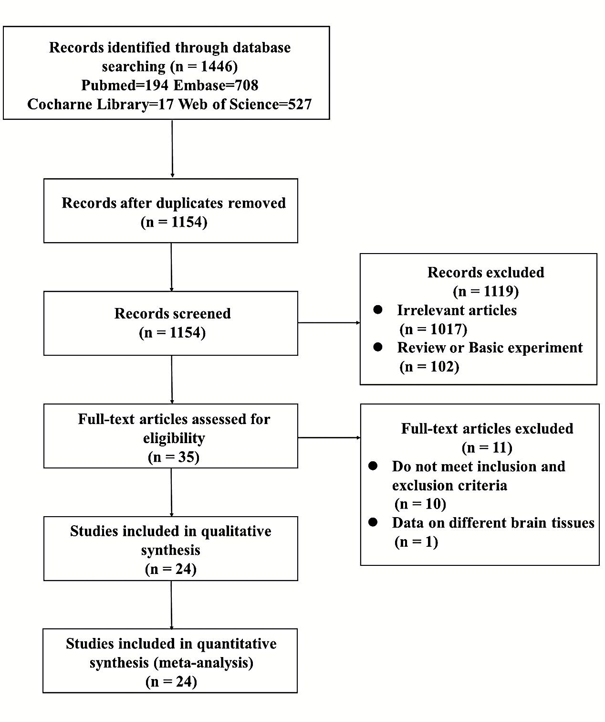
Fig. S1 PRISMA Flow Diagram of search strategy for Systematic reviews and Meta-Analysis. PRISMA, Preferred Reporting Items for Systematic Reviews and Meta-analysis.

