Slide 1
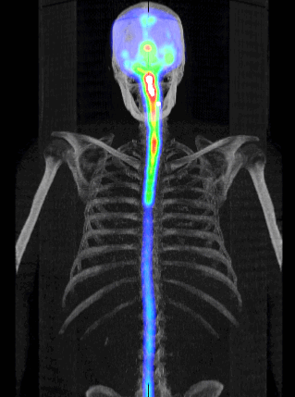
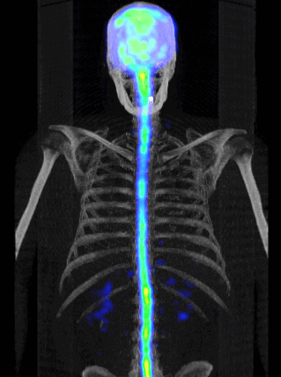
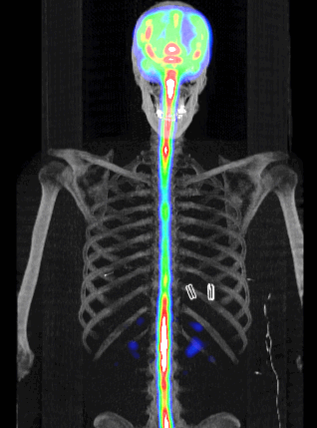
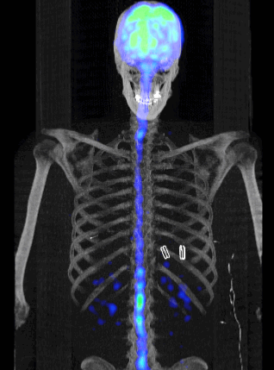
SUPPLEMENTAL VIDEO S2
5 ml dose volume
15 ml dose volume
8hr
22hr
8hr
22hr
Notes:
Supplemental Video S2. 3D maximum intensity projection SPECT (rainbow) and CT (gray) of lumbar ITH dose 99mTc-DTPA in representative subjects of the 5mL and 15mL groups. Subjects are shown on relative color scales with within-subject data decay corrected to 8 hours post-administration. Color scales were selected for similarity in visual assessment across subjects.

