Slide 1
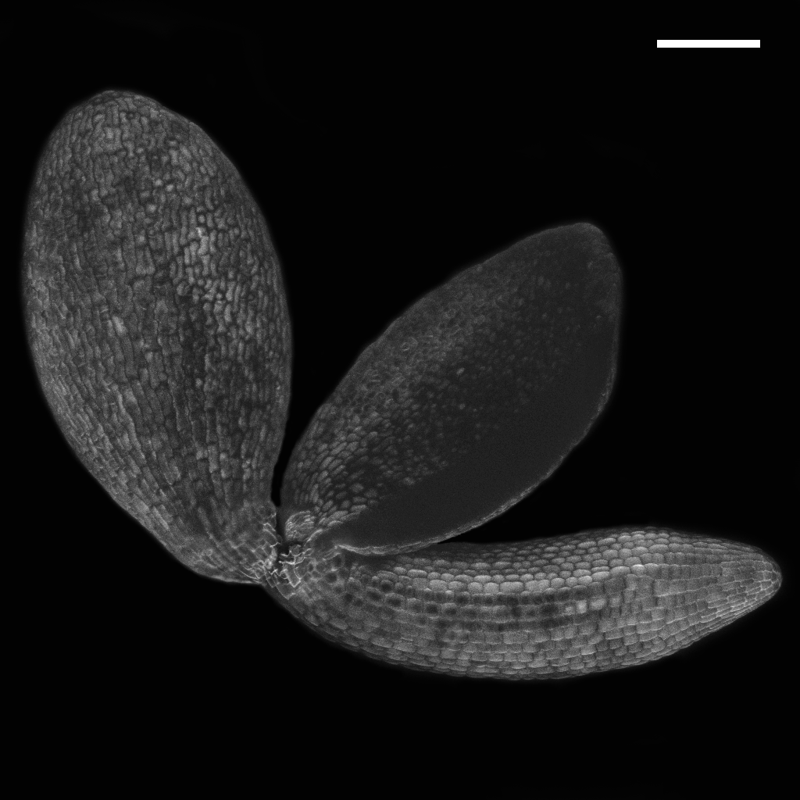
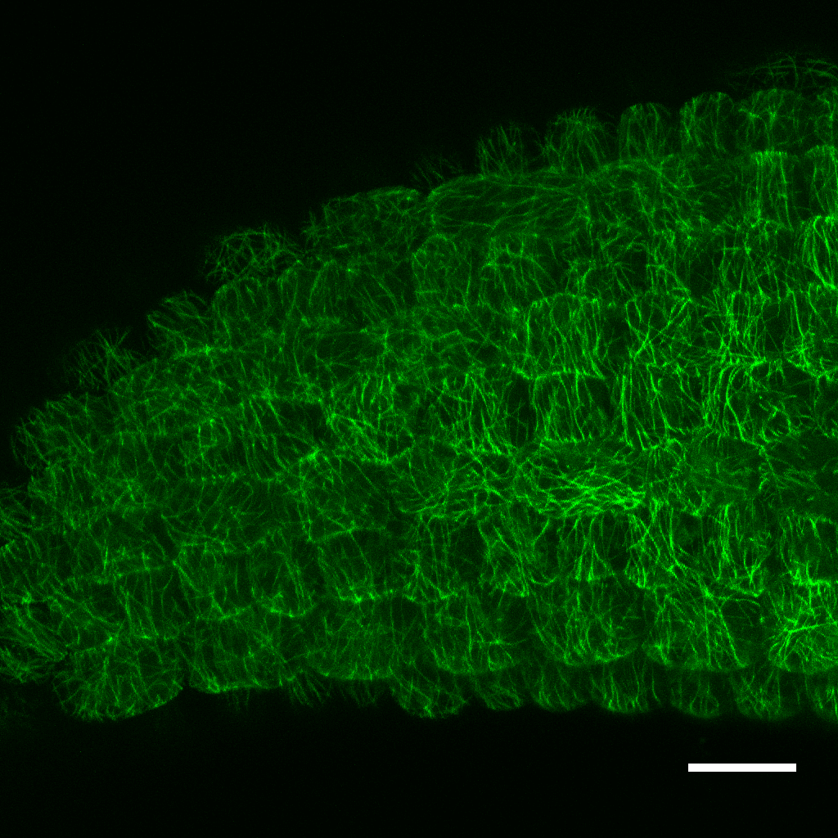
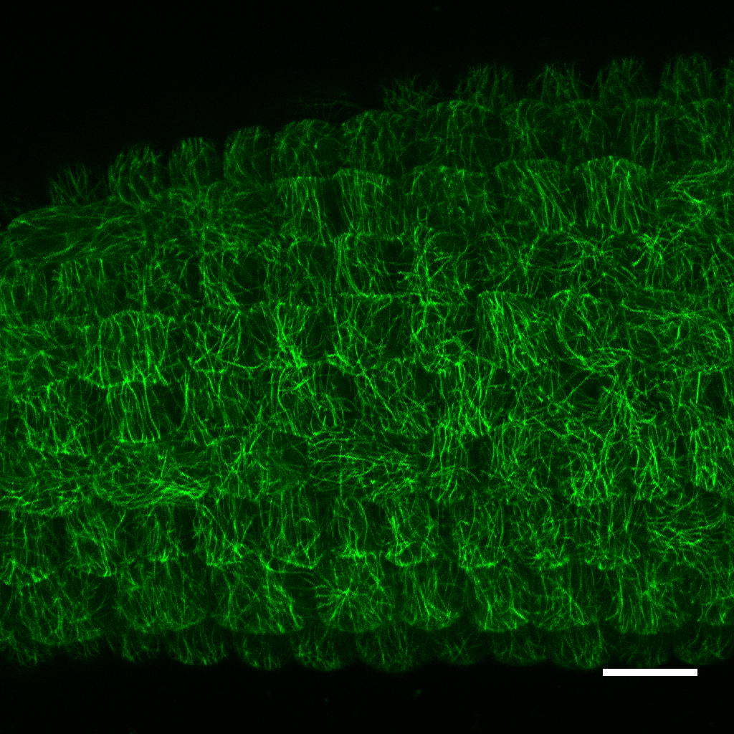
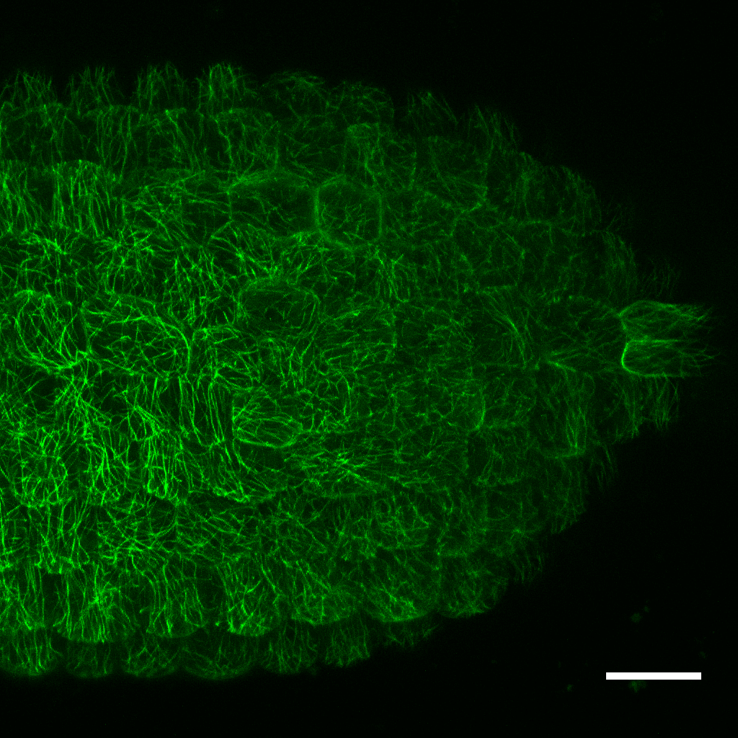
A
Cotyledons
B
Hypocotyl: shootward region
Hypocotyl: rootward region
Radicle
Fig. S2. Overview of the experimental model. A, Anatomy of a whole Arabidopsis embryo extracted from an imbibed seed and stained using calcofluor (scale bar, 20 μm). B, Localisation of cortical microtubules in different areas of Arabidopsis embryo using p35S::GFP-MBD. Embryos were extracted from germinating seeds imbibed for 48 h at 25°C in darkness in the presence of 1 mM GA₃ (scale bars, 20 μm).

