Slide 1
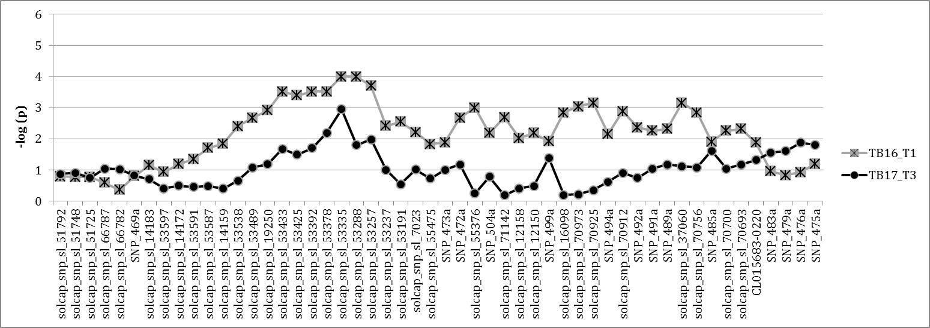
Supplementary Figure S2. Significance of χ2 test expreses as –log(p) for markers in chromosome 7 in the 16T1 and 17T3 experiments.

