Slide 1
Supplementary Table 1
Genes | Primer/probe | Oligonucleotide sequence (5’-3’)
MITF | Forward Reverse | 5’-CATCGCATAAAACCTGATGGC-3’ 5’-GTCGTCACCCTGAAAATCCTAACT-3’
TYR | Forward Reverse | 5’-TGGGTCATCTTGTCTTGCTG-3’ 5’-TACCATCTGTTGTGGCTGGA-3’
TRP-1 | Forward Reverse | 5’-ACCCACACTGTGCCCATCTA-3’ 5’-CGGAACCGCTCATTGCC-3’
TRP-2 | Forward Reverse | 5’-GTCCAATAGGTGCGTTTTCC-3’ 5’-ACCCATTTGTCTCCCAATGA-3’
MMP-2 | Forward Reverse | 5'-CAGGGAATGAGTACTGGGTCTATT-3’ 5'-ACTCCAGTTAAAGGCAGCATCTAC-3
MMP-9 | Forward Reverse | 5'-AATCTCTTCTAGAGACTGGGAAGGAG-3 5'-AGCTGATTGACTAAAGTAGCTGGA-3'
IL-1β | FAM | 5'CTGTGTAATGAAAGACGGCACACCCACC-3'

Slide 2
Supplementary Table 2
Days | pH
1 | 5.67
7 | 5.54
15 | 5.62
30 | 5.70

Slide 3
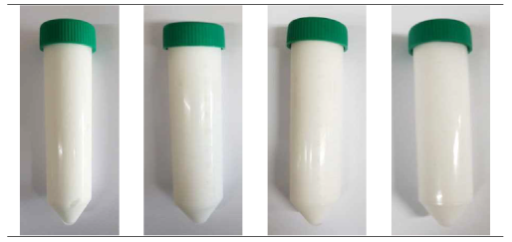
Supplementary Fig. 1
1 Day 7 day 15 day 30 day

Slide 4
Supplementary Table 3
A
Clinical signs | Clinical score
No erythema | 0
Very mild erythema (only visible to the naked eye) | 1
Clear erythema | 2
Severe erythema | 3
Severe erythema (blushing redness) and a slight degree of scarring | 4
B
Clinical signs | Clinical score
No oedema | 0
light oedema (only visible to the naked eye) | 1
Light oedema (pronounced swelling to make sure the marginal zone is clear If differentiated) | 2
Normal swelling (about 1mm swollen) | 3
Severe oedema (swelling greater than 1 mm and extending beyond the exposed area condition) | 4

Slide 5
Supplementary Table 4
Primary skin irritation index (P.I.I.) | Description of skin condition
0.0-0.5 | Non irritant
0.6-2.0 | Mild irritant
2.1-5.0 | Moderate irritant
5.1-8.0 | Severe irritant

Slide 6
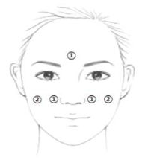
Supplementary Fig. 2

