Slide 1
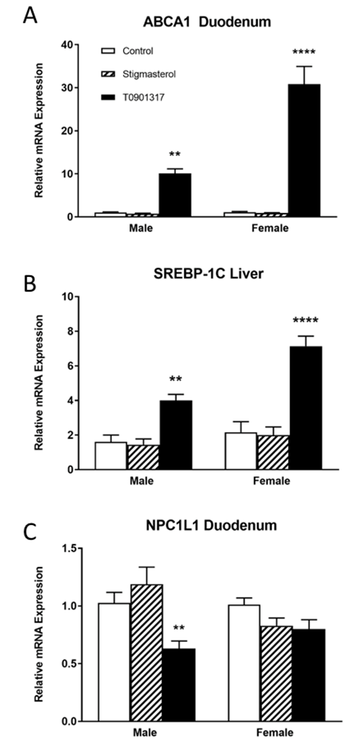
Figure S1.
Figure S1. Hepatic (A) and Intestinal (B) expression of LXR-regulated and cholesterol metabolizing genes within biological sex. RNA was isolated from liver and duodenal tissue and the relative abundance of transcripts determined by rtPCR. Transcript levels were normalized to GAPDH. The relative abundance of transcripts was calculated by the ΔΔCt method and are expressed relative to the control group. Data are mean ± SEM (n=16). Data were analyzed by one way ANOVA within sex. Dunnet’s post-hoc tests were used to determine significant differences from control. At ** p < 0.01, **** p < 0.0001

Slide 2
Figure S2.
Magnification
4X
20X
Control
T0901317
Stigmasterol
Figure S2. Histological analysis of proximal small intestine sections reveals no effect of LXR agonist or stigmasterol. Sections of the proximal small intestine were dissected, fixed in 10% buffered formalin, paraffin embedded, sectioned (5μM), and processed for staining with Haemotoxylin and Eosin. Sections were imaged on a Zeiss 200IM microscope with 4X and 20X objectives. Images are representative of 3 female mice imaged from each treatment group.

