Slide 1
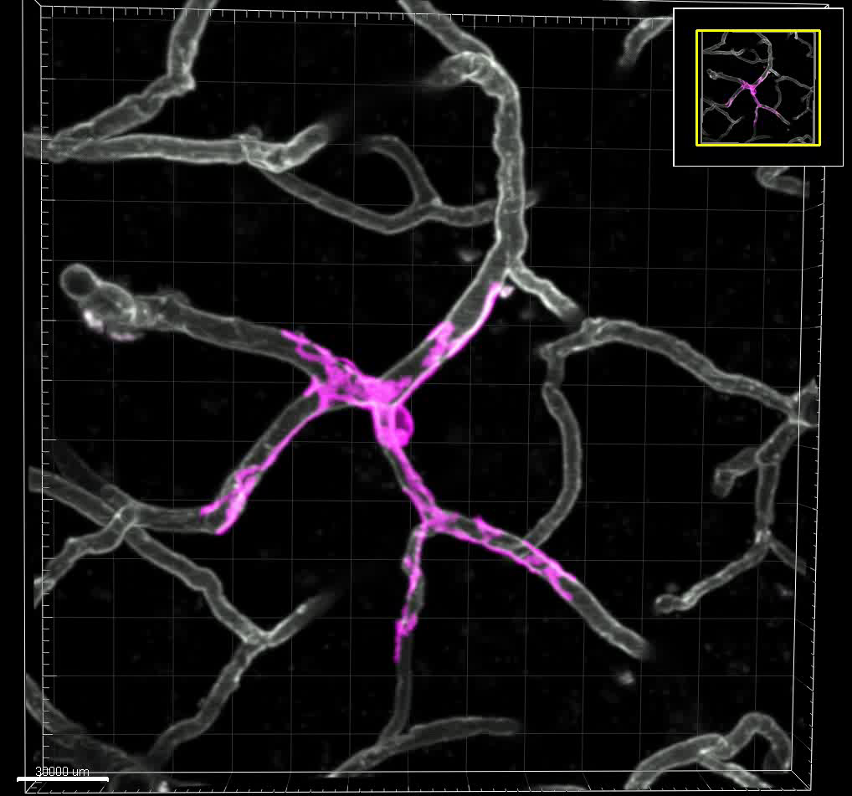
Video 1
25 μm

Slide 2

Video 2

Slide 3

Video 3

