Slide 1
Supplementary file
Telomeric and sub-telomeric regions undergo rapid turnover within a Streptomyces population
Abdoul-Razak Tidjani, Cyril Bontemps, Pierre Leblond
Université de Lorraine, INRAE, DynAMic, F-54000 Nancy, France

Slide 2
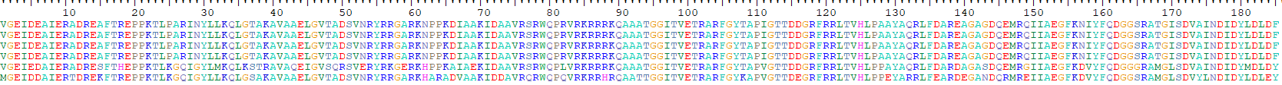
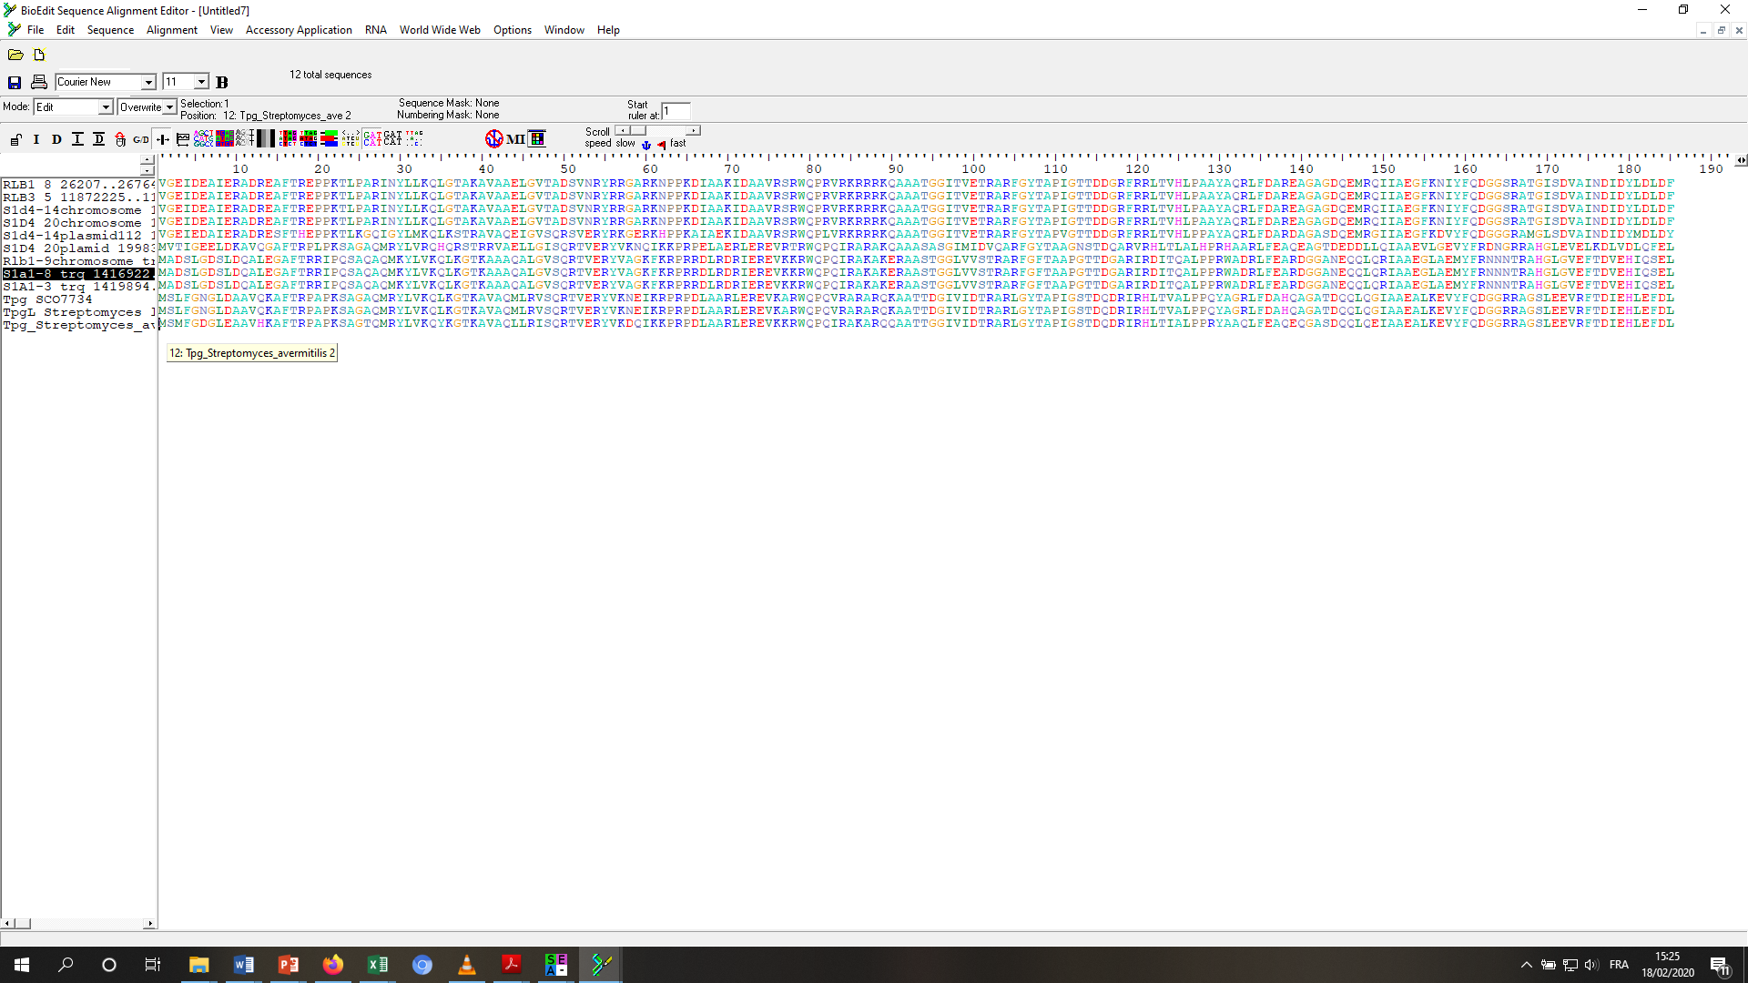
Telomere
sub-clade
Strain
I
RLB1-8
I
RLB3-5
I
S1D4-14
I
S1D4-20
I
pS1D4-14.1
S. dengpaensis
pS1D4-20
II
RLB1-9
II
S1A1-3
II
S1A1-8
S. coelicolor
S. lividans
S. avermitilis
Fig. S1

