Slide 1
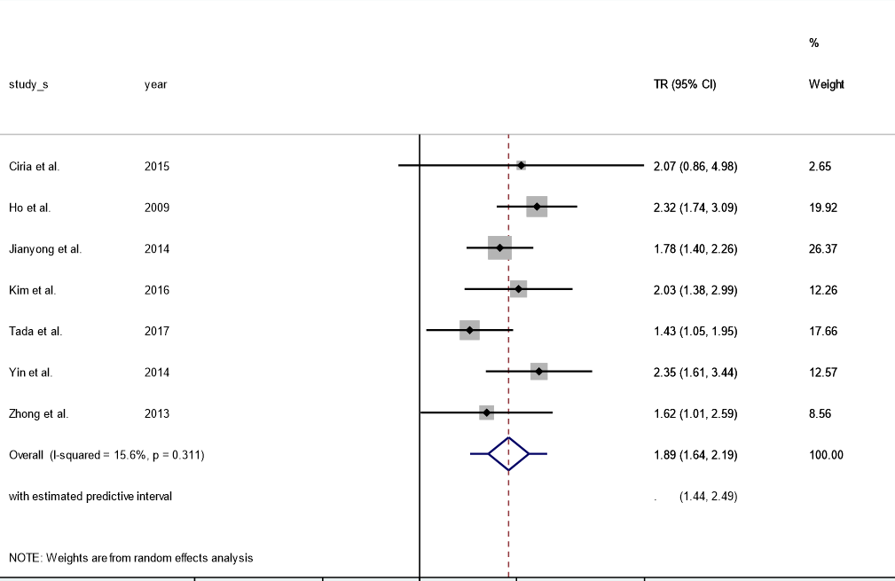
Study
Year
Time ratio (95% CI)
% Weight
.2
.5
1
2
5
Favors TACE
Favors PH

