Slide 1
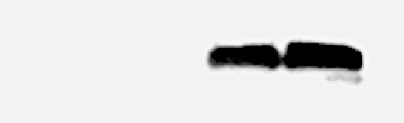
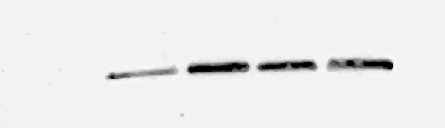
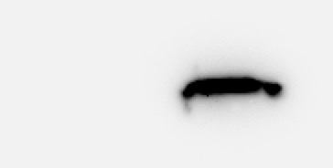
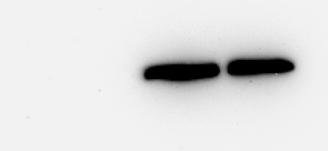
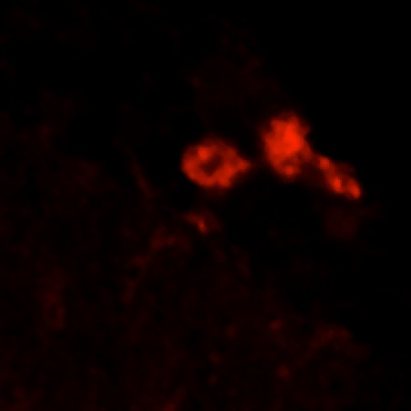
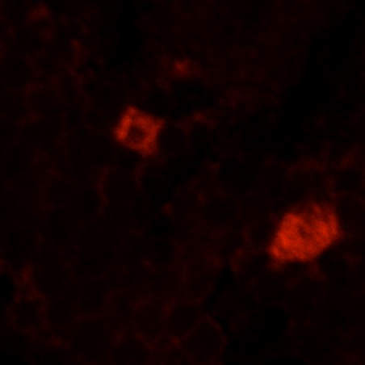
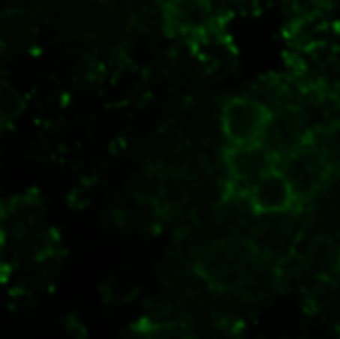
(a)
(b)
Control
Glia
Neuron
Both
Control
Glia
α-syn.
GAPDH
Neurons
Both
α-synuclein
GAPDH
(c)
Control
Glia
Neurons
(d)
Control
Glia
Neurons
0
repo
elav
α-synuclein
α-synuclein
Merge
Merge

Slide 2
(a)
(b)

Slide 5
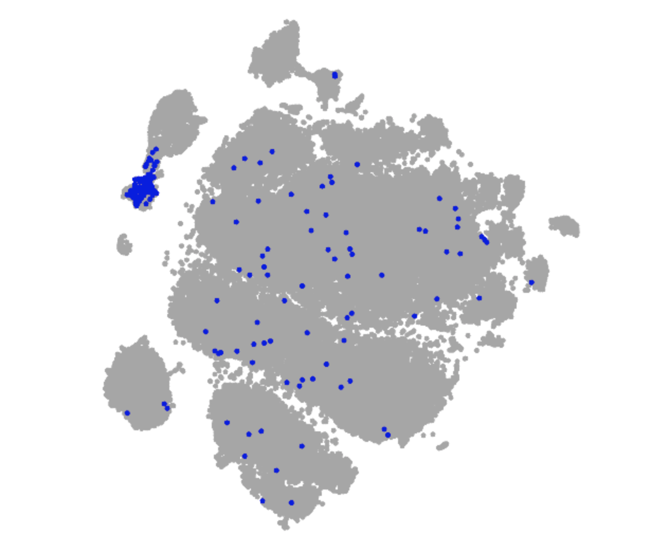
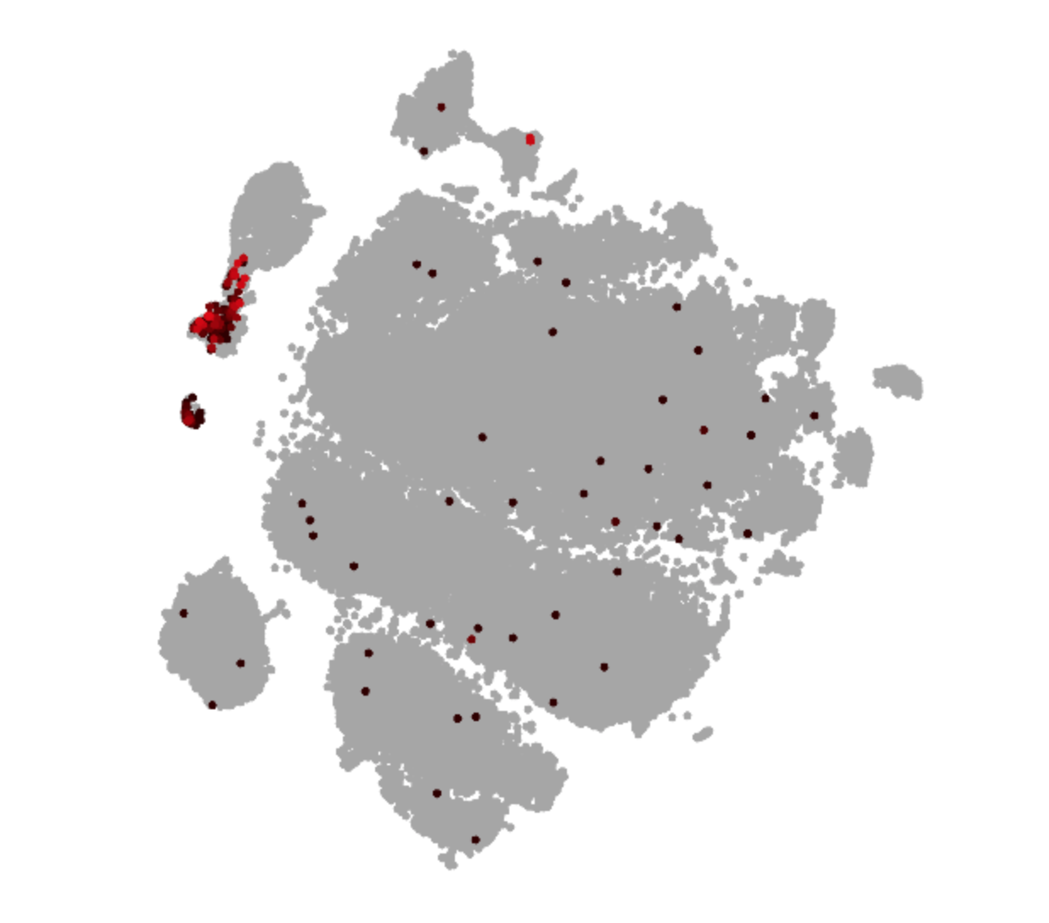
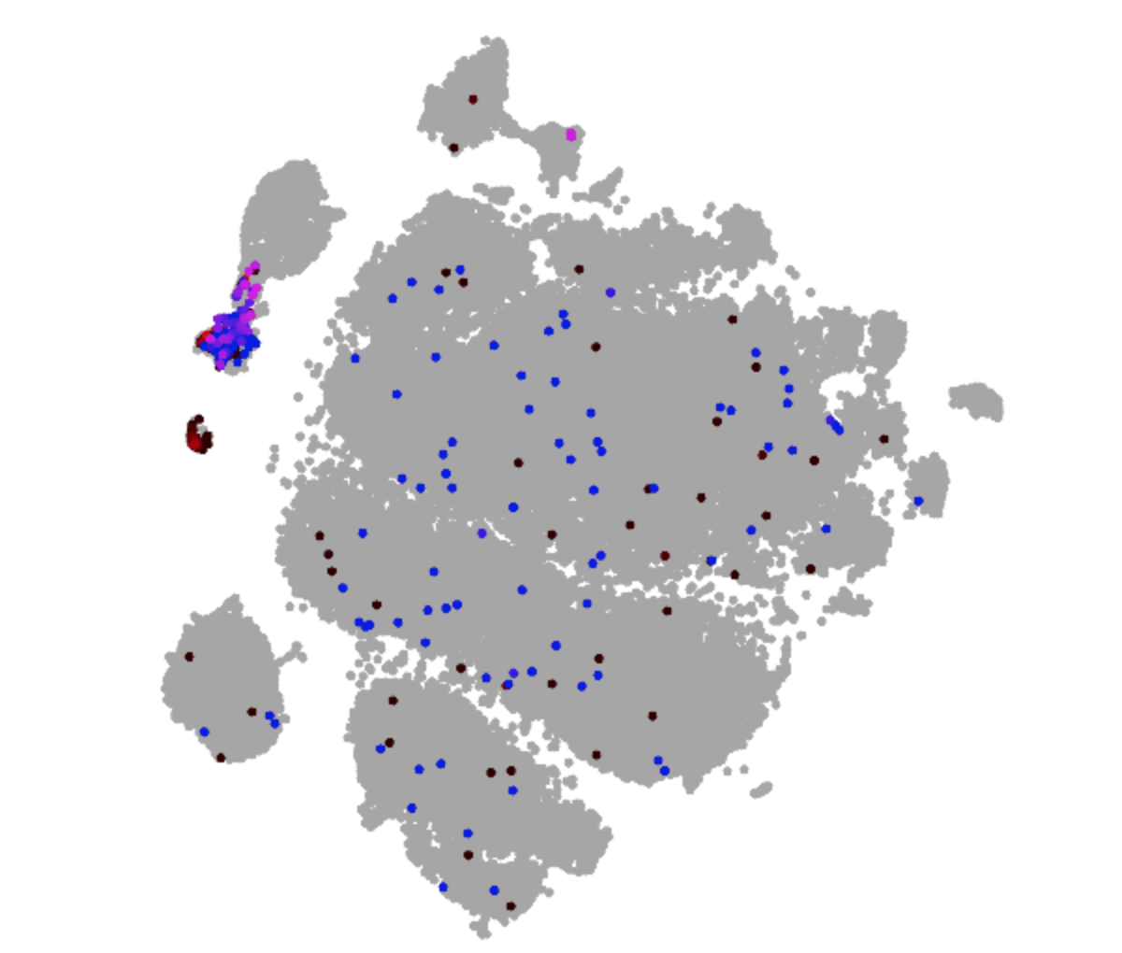
(a)
(b)
Merge of subperineurial
glia and Ance
Subperineurial glia
Ance
(c)
(d)
Control
GFP
UAS-EGFP
Ance-Gal4, UAS-EGFP
1 2 3
1 2 3
GFP

