Slide 1
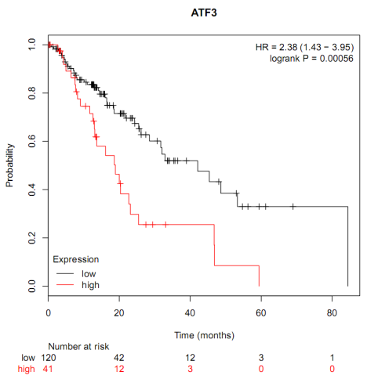
Supplementary Figure S1
A
B
A: ATF3 was substantially elevated in ESCC tissues when compared with the adjacent normal tissues by TCGA RNA-seq database analysis
B: High expression of ATF3 was negatively correlated with the prognostic survival curve in patients with esophageal cancer by TCGA RNA-seq database analysis

