Slide 1
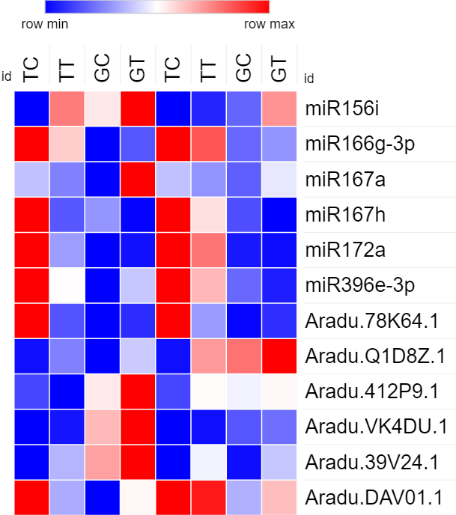
qRT-PCR
Sequencing
TC TT GC GT TC TT GC GT
miR156i
miR166g-3p
miR167a
miR167h
miR172a
miR396e-3p
Aradu.78k64.1
Aradu.Q1D8Z.1
Aradu.412P9.1
Aradu.VK4DU.1
Aradu.39V24.1
Aradu.DAV01.1
Relative expression level
Figure S2. Comparison of sequencing and qRT-PCR results for the miRNAs and genes using heatmap. Heatmap was generated by online software Morpheus (https://software.broadinstitute.org/morpheus) according to the relative expression in comparison with the control sample TC.

