Slide 1
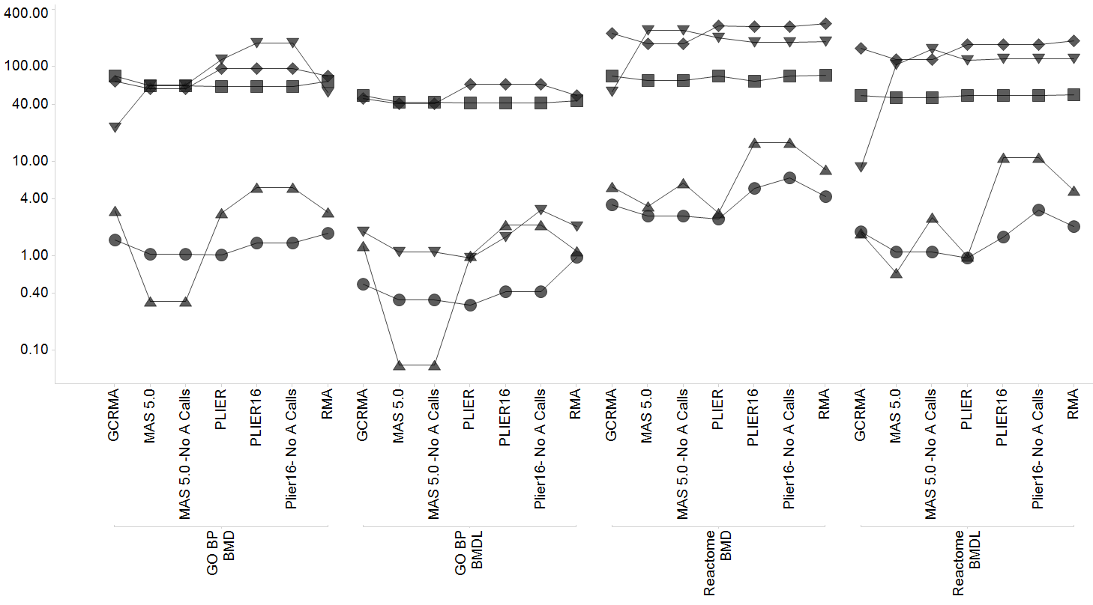
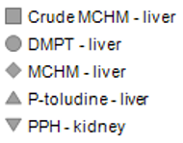
Supplementary Figure 2
Gene Set BEPOD/L (mg/kg/day)
Notes:
Supplementary figure 2. Patterns of effect on BEPOD/L values as a result of different normalizations of the data from the 5 data sets.

