Slide 1
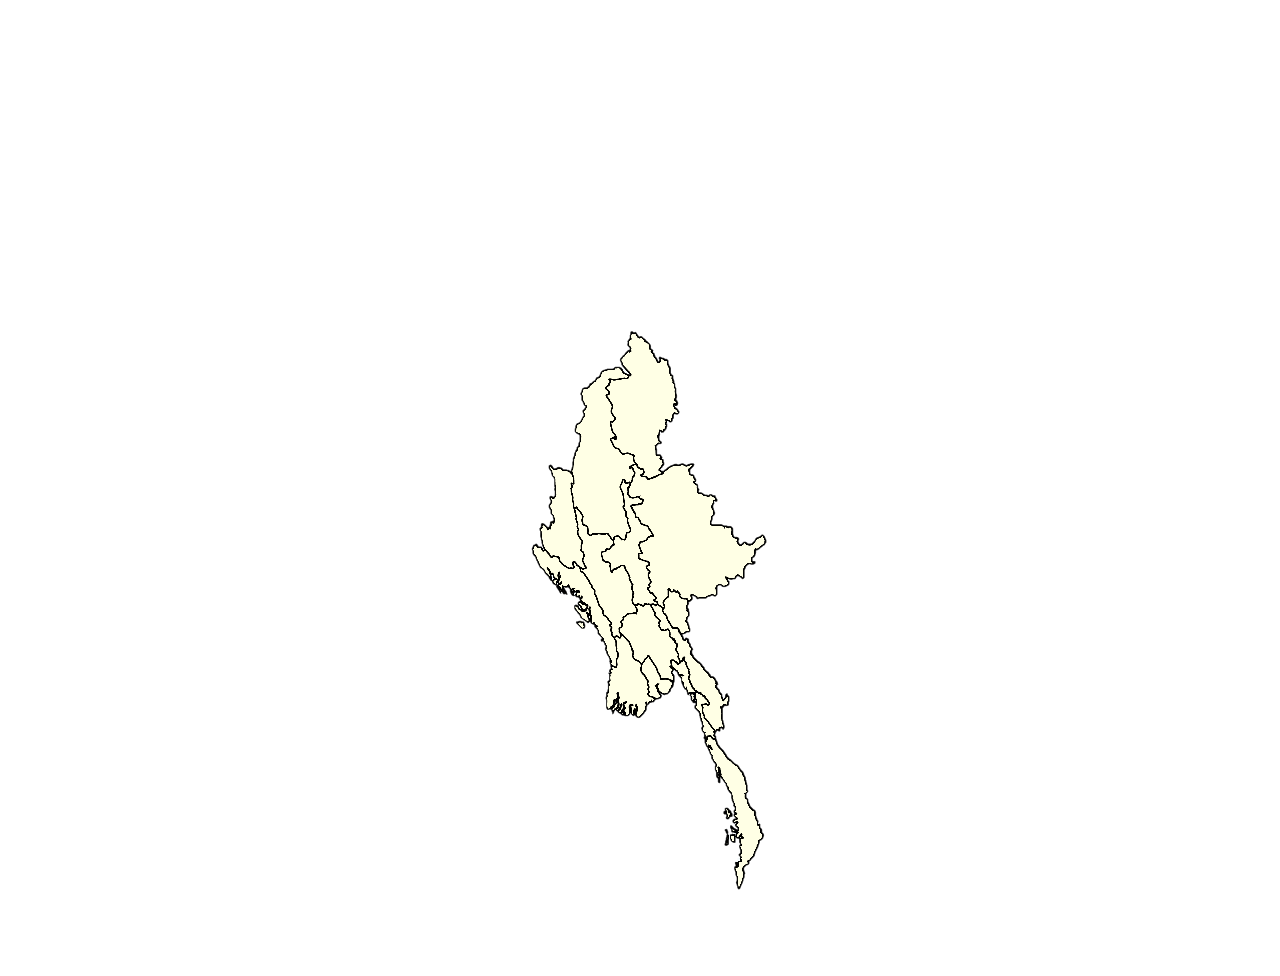
Tha Beik Kyin
Naung Cho
Mandalay
Pyi Oo Lwin
Mandalay Division
Shan State
Figure S1

