Slide 1
CRC78
*
CRC56
CRC44
pol26
pol29
Notes:
Supplemental Figure 1: Pedigree of family F

Slide 2
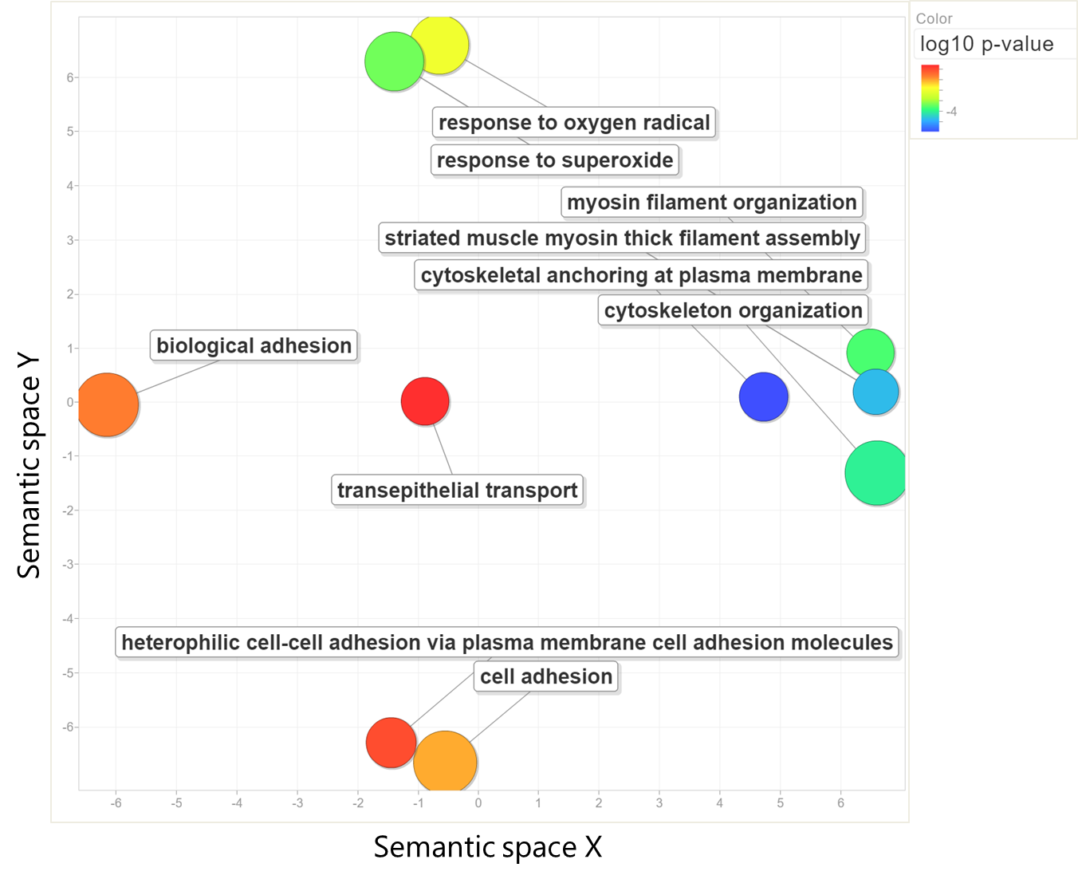
Notes:
Supplemental Figure 2: Enriched terms of familial and sporadic CRC TCGA cohort.

