Slide 1
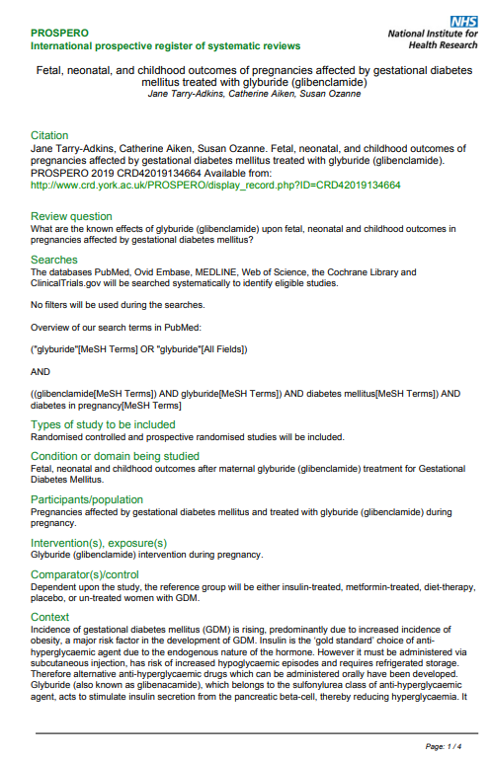
S1 Text: PROSPERO registration

Slide 2
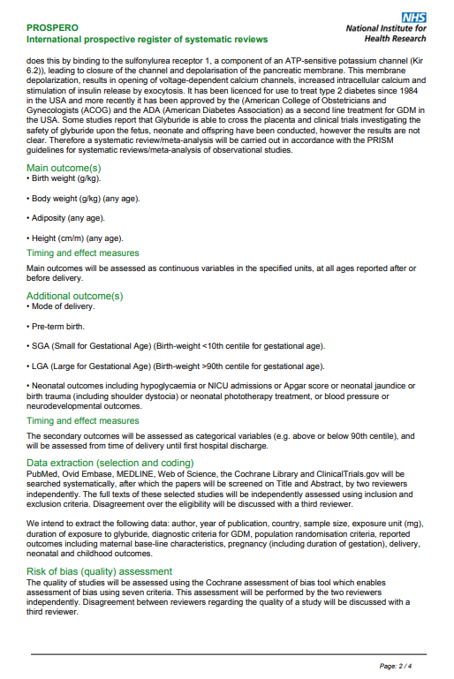

Slide 3


Slide 4
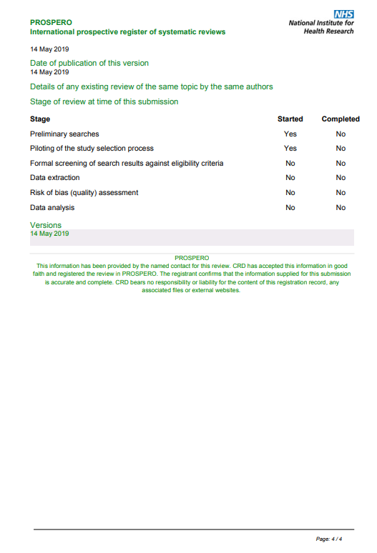
S1 Text PROSPERO Registration protocol

