Slide 1
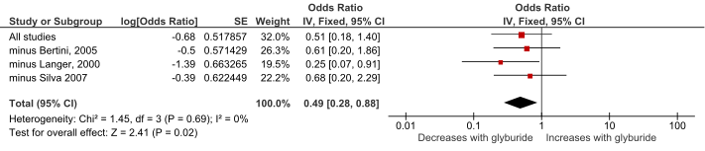
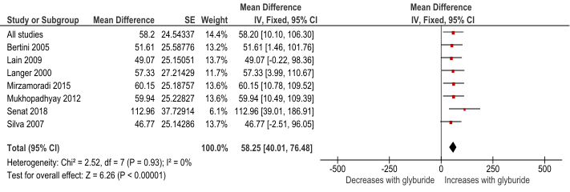
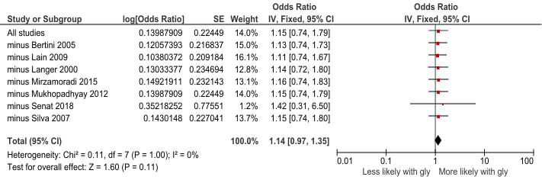
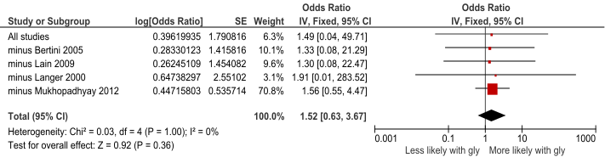
S3 Fig – Leave-one-out sensitivity analysis
Glyburide vs. insulin
(A) Gestational weight gain
(B) Birth weight
(C) Macrosomia
(D) LGA

Slide 2
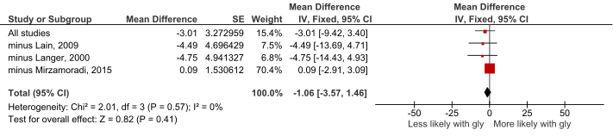
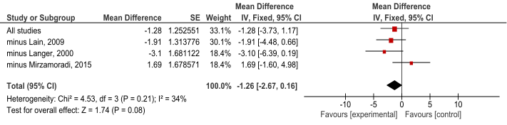
(E) FBS
(F) RBS
(G) HbA1c
Only one study, therefore LOO analysis unable to be conducted.

Slide 3
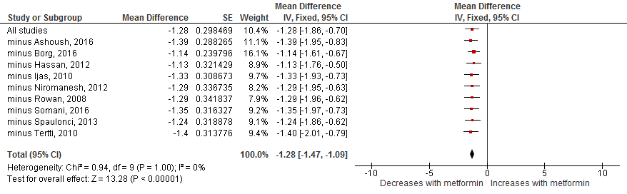
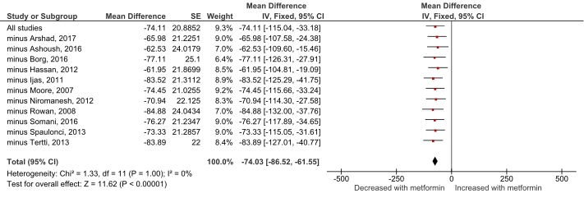
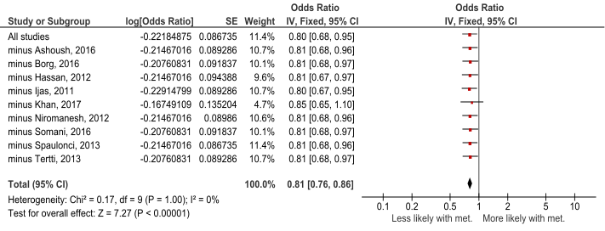
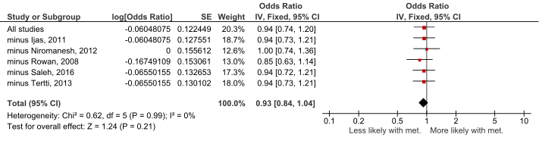
Metformin vs. insulin
(A) Gestational weight gain
(B) Birth weight
(C) Macrosomia
(D) LGA

Slide 4
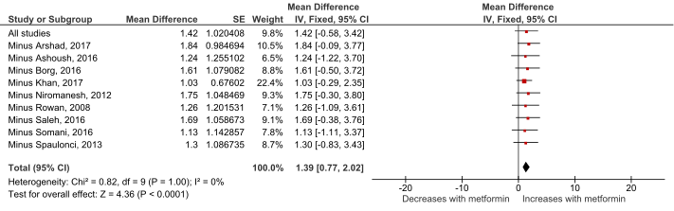
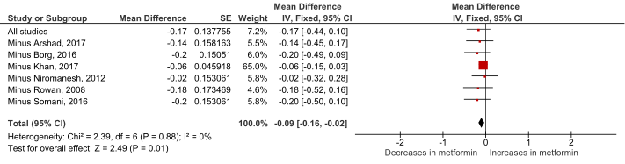
(E) FBS
(F) RBS
(G) HbA1c

Slide 5
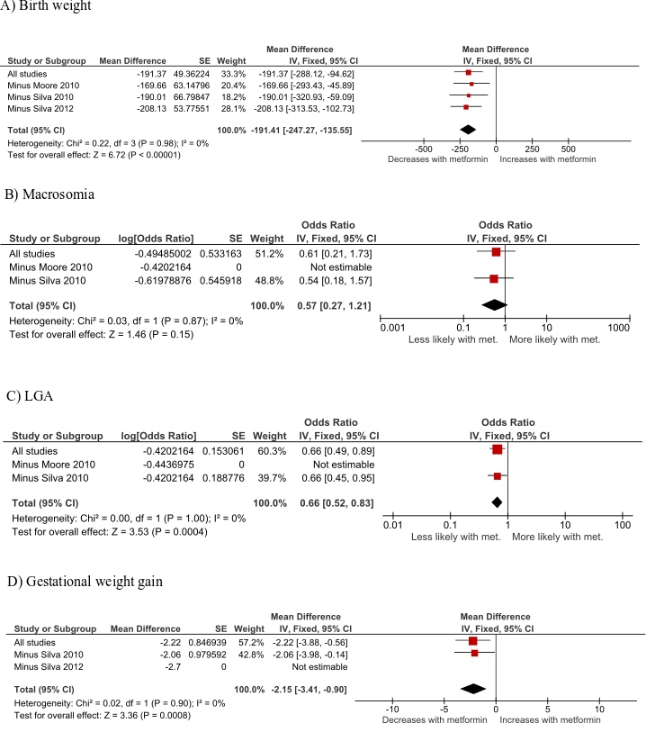
Metformin vs. glyburide

Slide 6
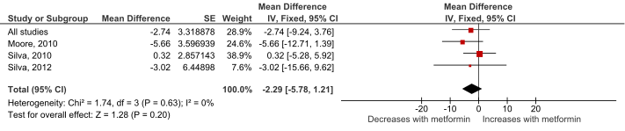
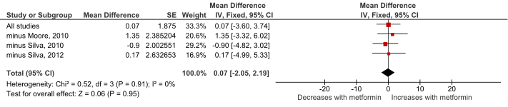
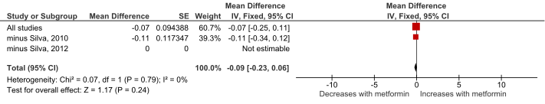
E) FBS
F) RBS
G) HbA1c

