Slide 1
S4 Fig Funnel plots – Maternal glycaemic control
Glyburide vs. insulin
A) FBS
B) RBS
Metformin vs. insulin
C) FBS
D) RBS
E) HbA1c

Slide 2
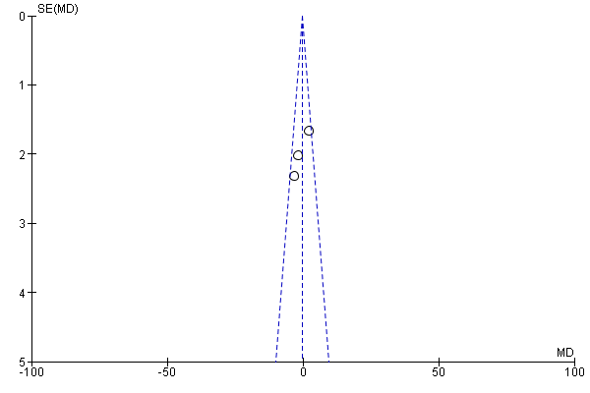
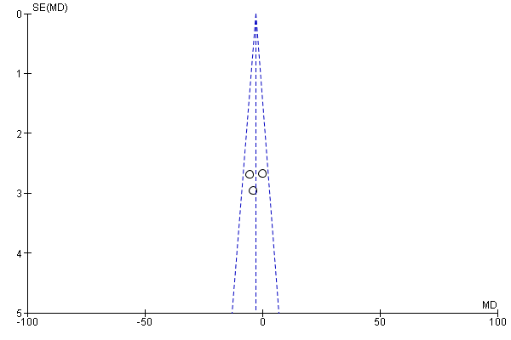
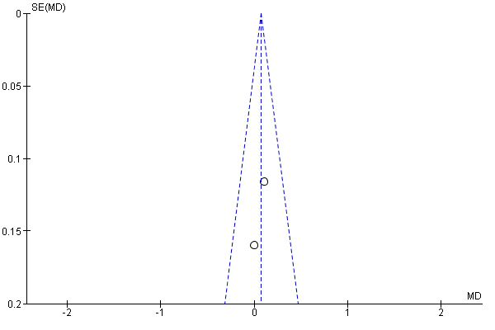
Funnel Plots - Maternal glycaemic control
Glyburide vs. metformin
A) FBS
B) RBS
C) HbA1c

Slide 3
Funnel plots – Total pregnancy weight gain
Glyburide vs. insulin
Metformin vs. insulin
Glyburide vs. metformin
Metformin vs. insulin: Late gestational weight gain

Slide 4
Funnel plots – Birth weight, macrosomia & LGA
Glyburide vs. insulin
A) Birth weight
B) Macrosomia
C) LGA

Slide 5
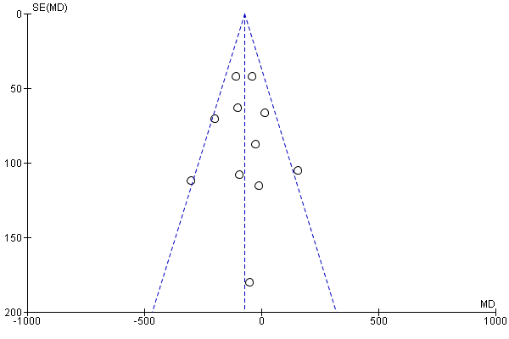
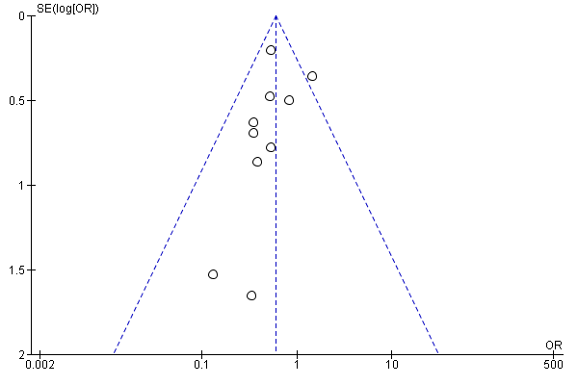
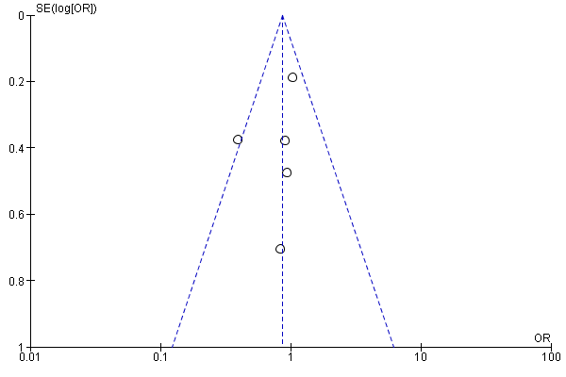
Funnel plots – Birth weight, macrosomia & LGA
Metformin vs. insulin
Birth weight
Macrosomia
F) LGA

Slide 6
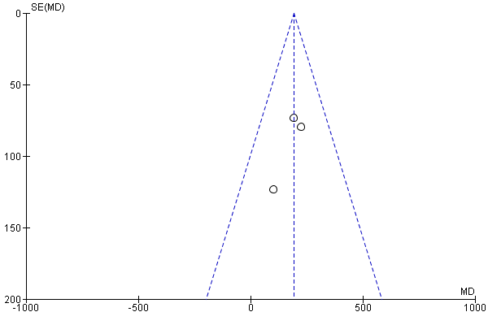
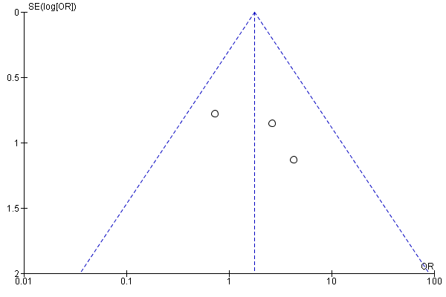
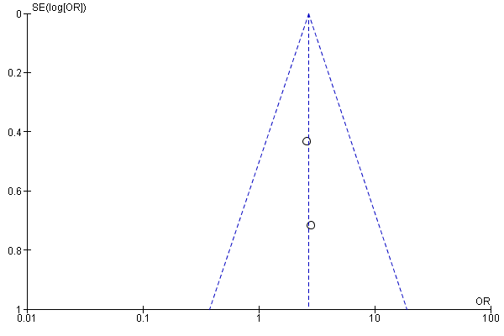
Funnel plots – Birth weight, macrosomia & LGA
Glyburide vs metformin
Birth weight
Macrosomia
LGA

